Slide 1

Huntington Progress Review

Slide 2
Objectives of today
Review how Compass is supporting Huntington’s goals to address the opioid crisis
Review key milestones achieved to date
Share knowledge of measures for success
Provide a high level update on each action, deep diving into 3 workstreams where we could use your help to accelerate impact!
Get your input on our approach to this and future meetings so we effectively use your time to problem solve and drive long term delivery.

Slide 3
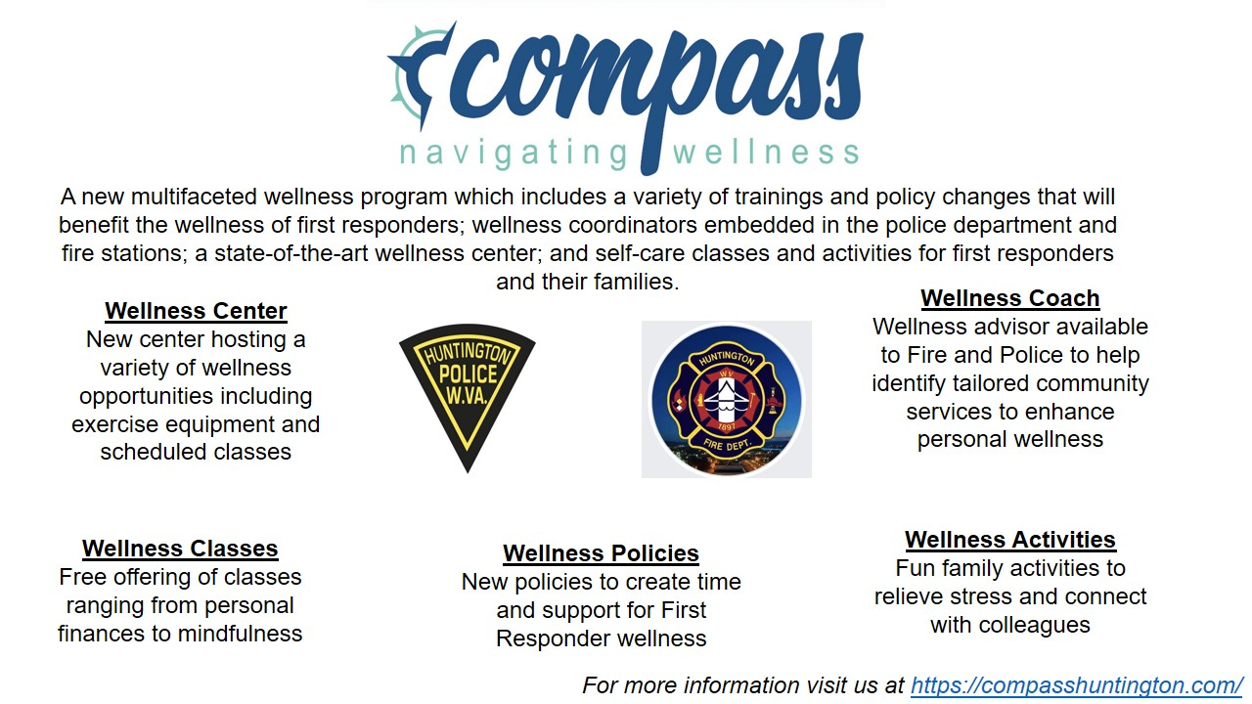
Our project addresses compassion fatigue by promoting physical and mental wellness in first responders
Vision: Address compassion fatigue by engaging first responders to develop self-care, training, and mental health resources for overcoming empathy depletion that impacts personal, professional, and community wellbeing.
Source / Footnote: Axiforma Regular 8pt
Source / Footnote: Axiforma Regular 8pt
© Copyright 2018. All rights reserved
© Copyright 2018. All rights reserved

Slide 4
Good progress has been made since we last met in May

Slide 5
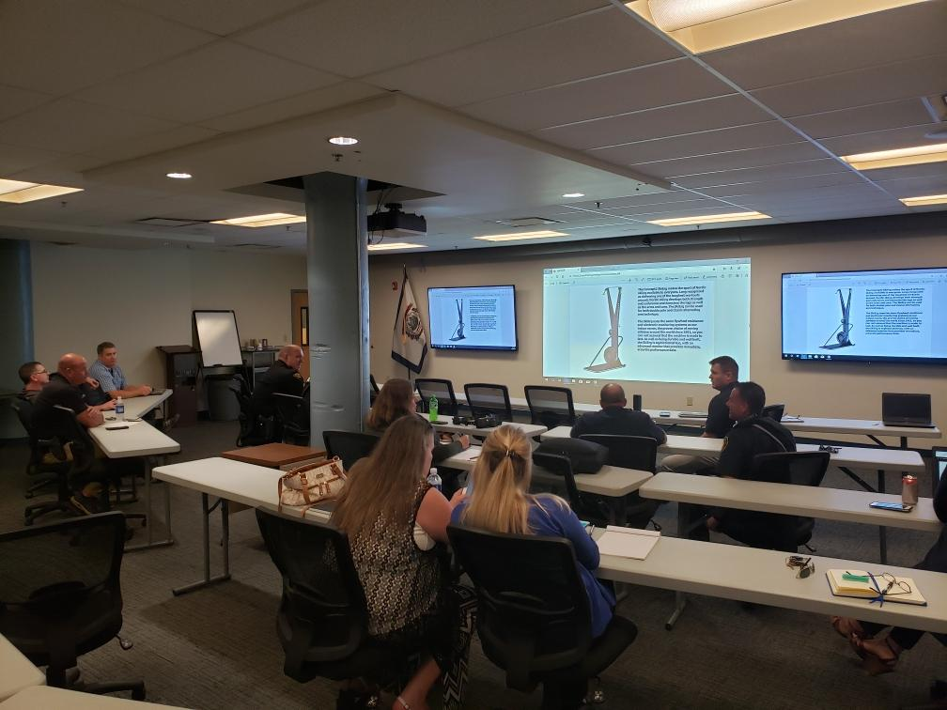
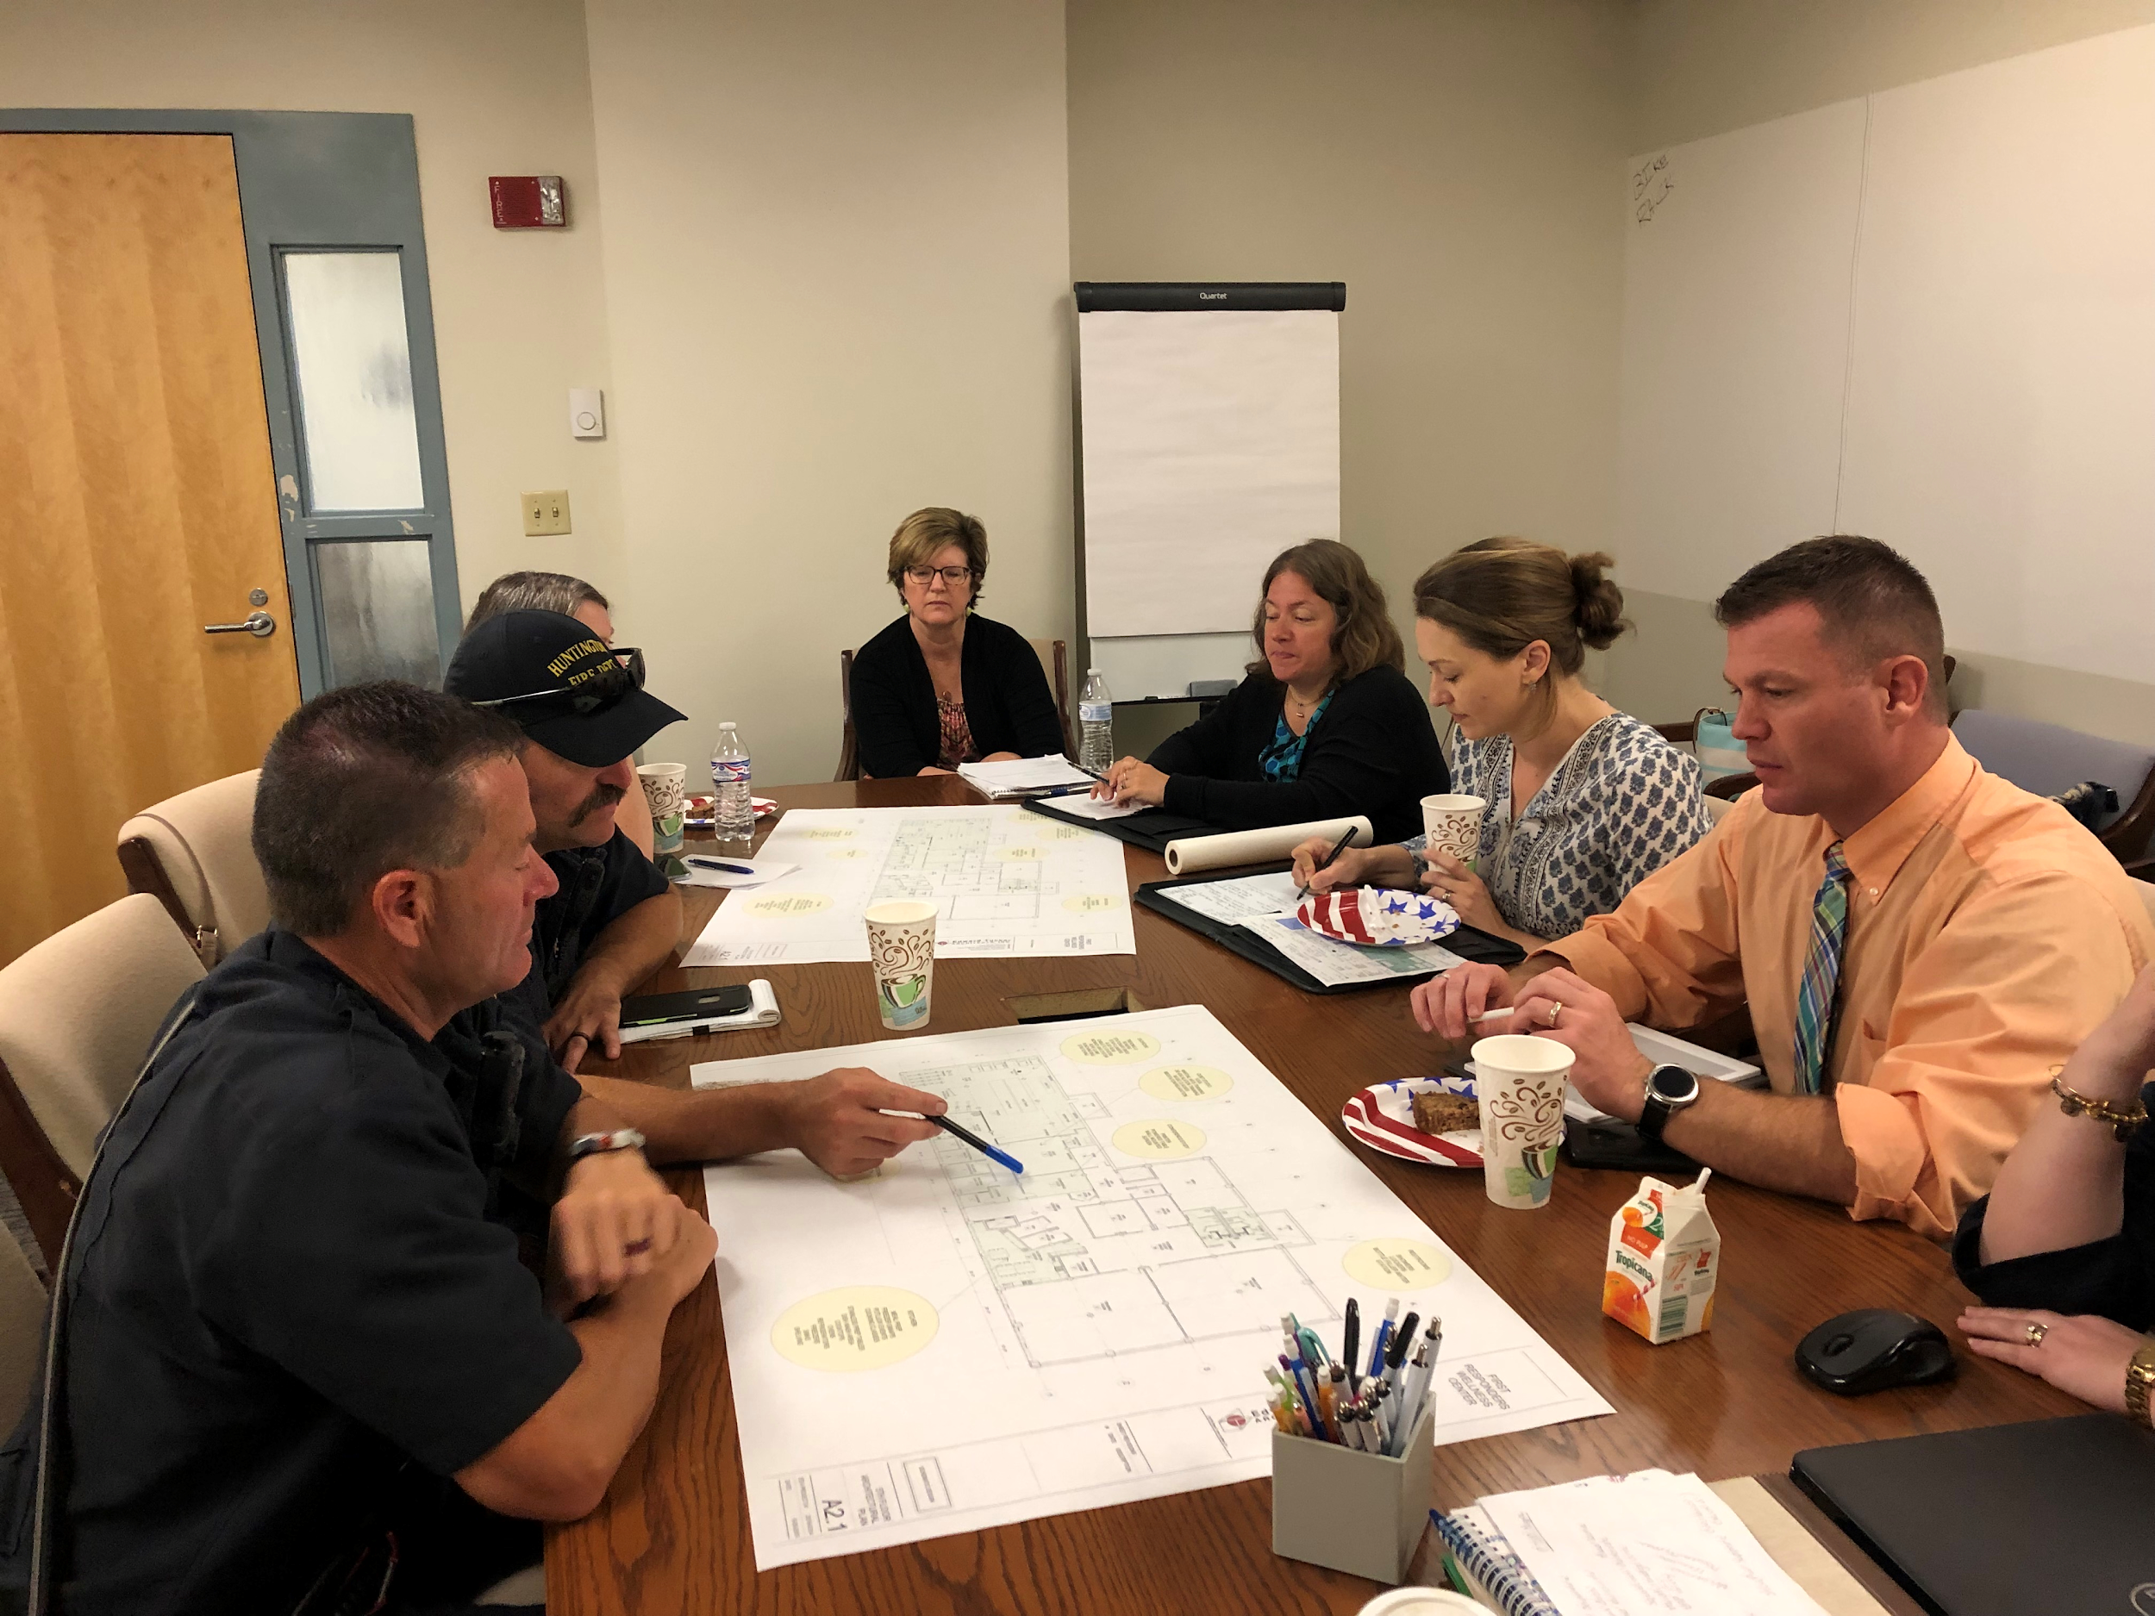
The wellness center has been designed with local architects and first responders
Notes:
Add one more photo

Slide 6
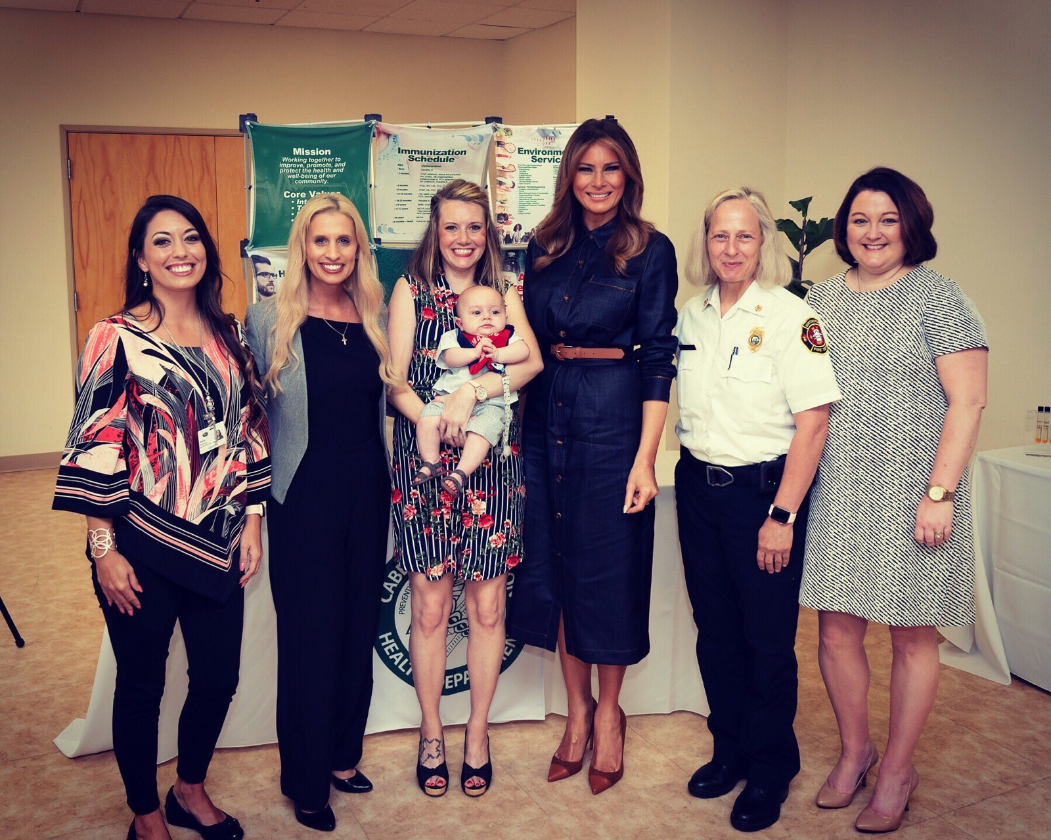
There has been interest in the project by many other cities and leaders
Notes:
First Lady of the United States
NYC Thrive
AT&T
City of Solutions
City of Columbus Police Department
US Department of Health & Human Services, Centers for Medicare and Medicaid Services

Slide 7
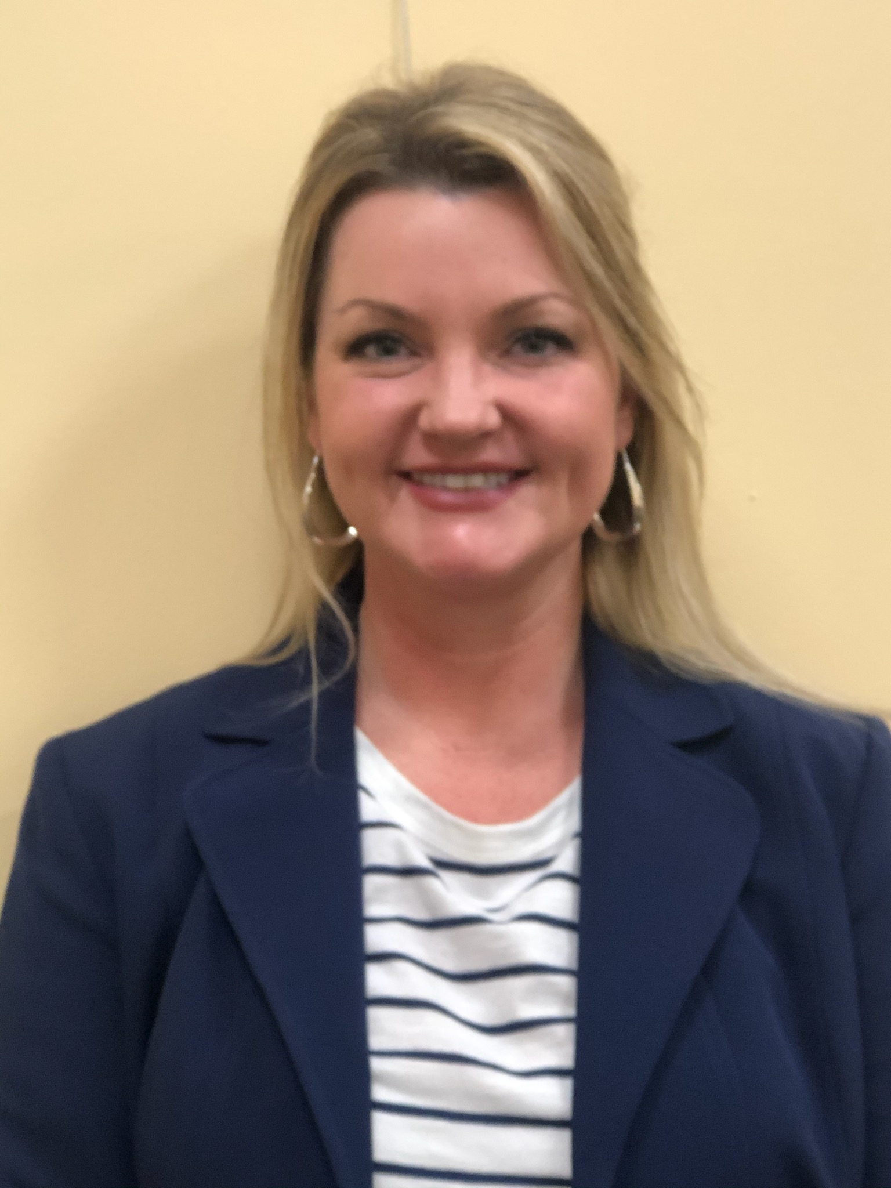
The new wellness coach has been hired and introduced alongside the program in a “wellness launch”
We are administering surveys to obtain baseline data on mental health, coping skills, perception of self as a helper, and overall wellness.
Notes:
Pic of Amy and Gabe’s anchor page

Slide 8
We are now going to take stock of the project as a whole
We would appreciate your support to help us make the maximum impact for first responders and the community

Slide 9
We hope to use our approach of quarterly progress reviews as an opportunity for this type of problem solving
What we promise you
What we hope to get from you
Focus on the top priorities - areas that will make a difference
Honesty and transparency in diagnosing barriers to progress
Use of data to help monitor performance
Quarterly stocktakes w/Compass team, Mayor + City leadership
Willingness to prioritize and problem solve
Your ideas on how we can leverage your leadership support to overcome barriers to progress and achieve goals
Notes:
Mayor how does that sound to you?
Anum/Eloisa

Slide 10



Several targets for December 2021 are still under development
The wellness and quality of the professional life of first responders
  TBD (survey just collected for baseline)
Utilization of wellness resources by first responders
60% of first responders using at least one mental and physical
health resource each month
Sick leave and retention rates at HPD and HFD
Increase retention by decreasing resignations from
5% to 2% of workforce per year (TBD)
Sickleave TBD
Source / Footnote: Axiforma Regular 8pt
Source / Footnote: Axiforma Regular 8pt
© Copyright 2018. All rights reserved
© Copyright 2018. All rights reserved

Slide 11
Workstreams have been developed further and measures of success defined (1 of 2)
Workstreams | Progress | Goal by Dec 2021
Educational Trainings for first responders related to all aspects of wellness | Getting ready to launch the Financial Wellness to HPD & HFD next week. Feedback from focus group was very positive. | 70% voluntary attendance in at least one training
Embed Wellness Coaches | Hired 1 of the 2 Wellness Coaches. Planning on hiring a second Wellness Coach by Dec 2019 | 200 contacts (digital and verbal) with wellness coaches each month
Policy Change related to traumatic and stressful events | Researched and reviewed existing policies | Three new policies implemented

Slide 12
Workstreams have been developed further and measures of success defined (1 of 2)
Workstreams | Progress | Goal by Dec 2021
Media & Publicity Strategy | Promoting the Compass project through multiple press events such as AT&T Press Conference, Cities Thrive, City of Solutions | 80% of first responders have login
First Responder Wellness Center | Construction documents are completed and bid has been released | 60% of first responders have used wellness center in past month
Activity Planning to encourage wellness and stress relieving activities | Continuing to provide at least 2 activities per month to promote various aspects of wellness e.g. Paint & Sip, Carter Caves | 2 activities a month with 70% of places filled
Data Systems to evaluate the success of the workstreams | Administered baseline surveys to first responders and have had over 100 responses so far

Slide 13
We are now going deep dive into three workstreams

Slide 14
Training

Slide 15
Success of training will be measured by voluntary participation
Goal: 70% of first responders have attended at least one voluntary training
Training starts in Oct 2019
Anticipated increase in attendance after wellness center opening (e.g. with nutritional classes in the new kitchen)
Anticipated increase in engagement after wellness center opening

Slide 16
Training workstream milestones
Now
Training Launches with
Life Skills Curriculum
May
Launch Mindfulness Curriculum
.
2019
2021
2020
Launch Healthy Relationships
Curriculum
2019
Launch Community Impact
Curriculum
Phase 2:

Slide 17
Training
Progress to date
Identified 4 curriculum streams and built timeline
Financial wellness tested with focus group and to be provided next week in departments
Key next steps
Identify trainers for all curriculum
Logistics and budget for all trainings
Discuss and establish feedback mechanisms from first responders
Challenges
Buy in and attendance from first responders
Fire dept training officer being deployed in 2020
Budget restrictions – potential need to prioritize other training needs prior to wellness
Varying cultures between police and fire – considerations for joint training
Support
Notify Compass team of new training officer for fire for planning & continuity
Set up wellness training for sustainability (culture, budget etc)
Encourage participation in your departments

Slide 18
Policy changes related to traumatic incidents and job induced stress

Slide 19
Policy workstream milestones
Oct/Nov:
Draft first 2 policies
and finalize with committee
and leadership
October:
Implement bi-annual
health checks policy
.
2019
2021
2020
Now
Jan:
Implement triggers
for counselling and hours
for wellness policies
Gather feedback and iterate policies
2019

Slide 20
Policy
Progress to date
Brainstormed and prioritized policies to implement
Researched and compiled policies from other cities
Feedback from first responders on ‘trigger for counselling’ policy
Key next steps
First draft of trigger and hours for wellness
Impact analysis for policies
Feedback from policy committees
Approval through governance and senior leadership
Challenges
Project resource across multiple workstreams
Practicalities and logistics of implementing hour for wellness (e.g. cover)
Support
If you receive feedback allow Compass team to review and provide input and justification for policy
Assist in communicating and supporting policy changes

Slide 21
Wellness center

Slide 22
Wellness center workstream milestones
June/July
Wellness center opens!
Now
.
2019
2021
2020
Design finalized
Classes continue in center
2019

Slide 23
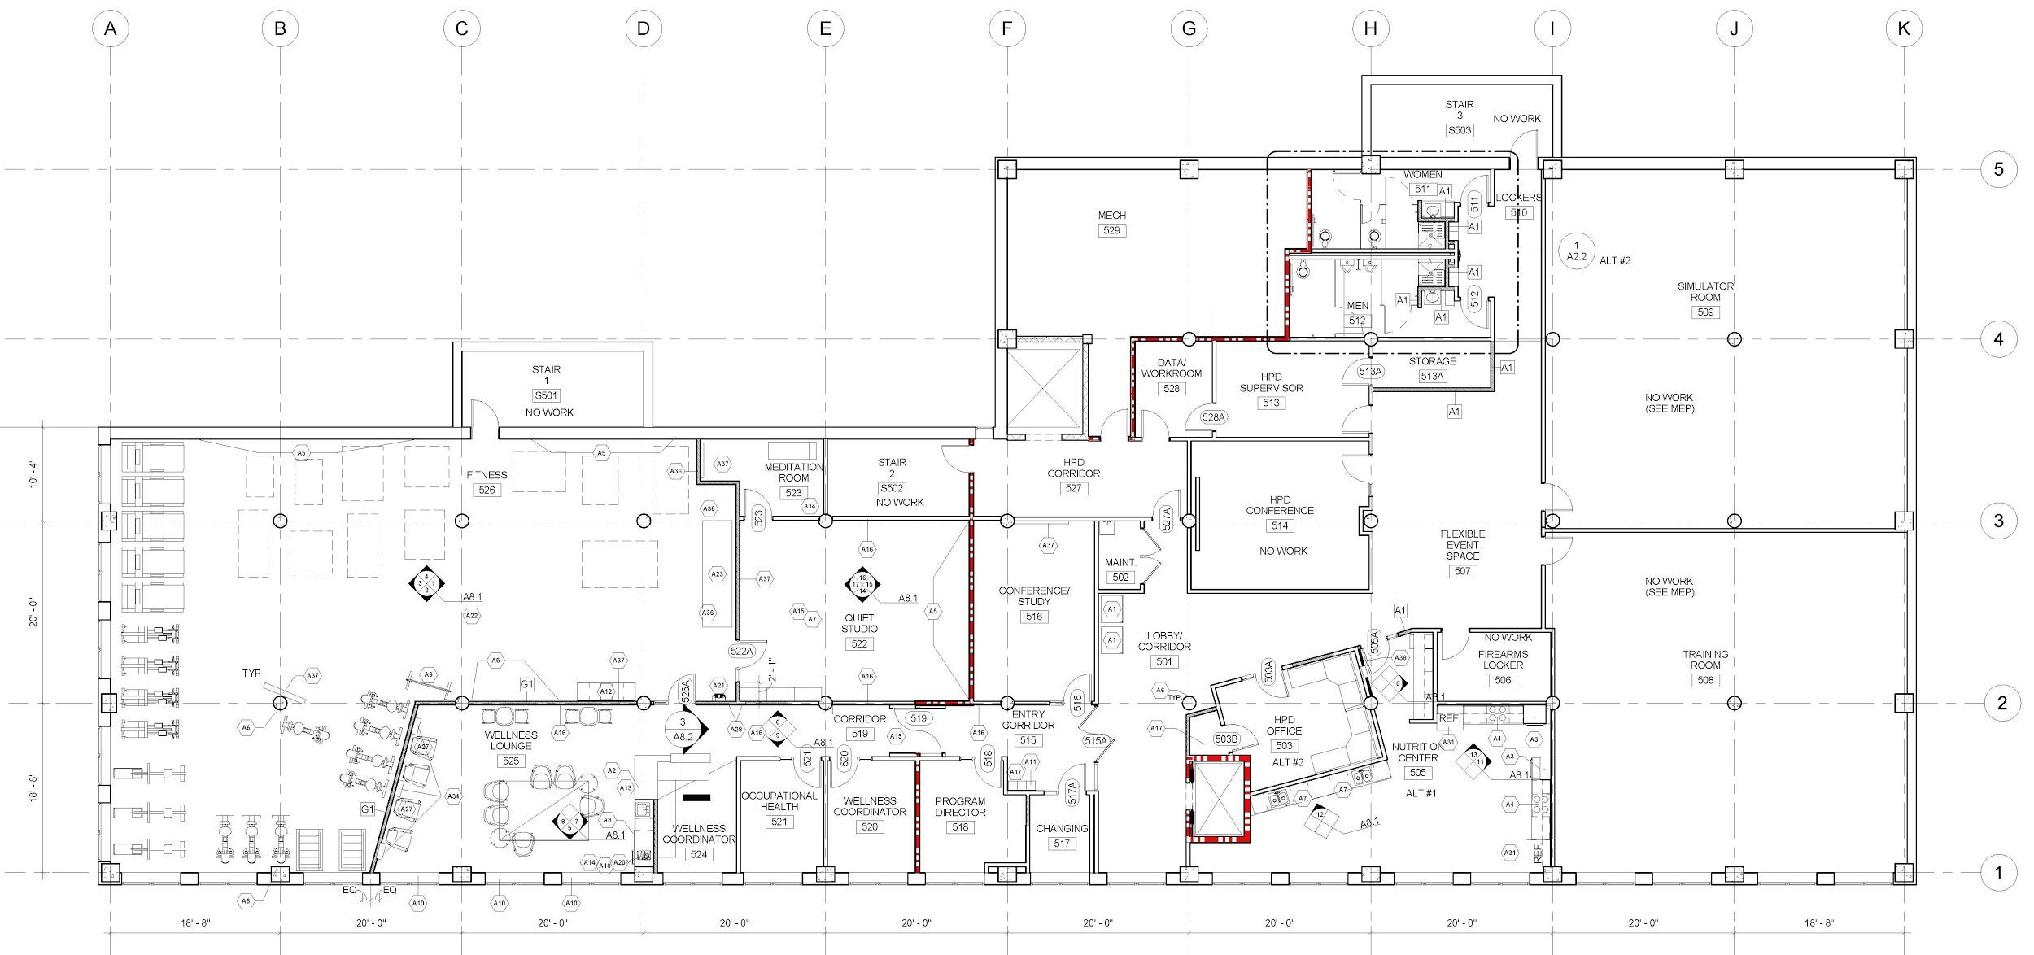
Wellness center blueprint and key components
Nutrition
Center
Wellness
Lounge
Quiet
Studio
Occupational
Health Space
Compass
Staff Office
Space
Gym with “First
Responder
Functional”
equipment

Slide 24
Success of the wellness center will be measured by use in the last month
Goal: 60% of first responders to have used the center in the last month
Wellness center anticipated to open in June 2020
Anticipated enthusiasm and good attendance on opening, then a drop off the following quarter. Then steady increase to Dec 2021
Anticipated increase in engagement after wellness center opening

Slide 25
Wellness Center
Progress to date
Held multiple focus groups with first responders to determine equipment needs and spatial use
Finalized design with architects
Key next steps
Fundraising
Solicit for bids (pending funding)
Challenges
The center requires $331k additional funding for build out by Dec 19 to open on time
Keycard access installed at HPD for first responders to access wellness center without entering through HPD services
Support
Fundraising assistance: support letter, joint meetings, reaching out to potential donors

Slide 26
We need to raise $330k for the wellness center

Slide 27
We would value your support
Fundraising
  Fundraising support letter from the Mayor for when we talk to potential donors
  Joint meetings with Police and Fire Chiefs for fundraising
  Help communicate the monetary and emotional value of the project to potential donors (ex. Highmark)
Chiefs support of wellness policy changes
  Assist in communicating and supporting policy changes
  As you receive feedback, please forward to the Compass team so they can continue the policy development process
  Any future proposed changes should continue to include the Compass process
Notes:
We hope you value the organic process we are using to help recommend policy changes and training moving forward. This is based on data, best practices, and input from employees.
This is grassroots bottom up process instead of a top down approach.
Gathering data but soon we are going to be able to demonstrate that this program is not a passing fad but is a true value to permeate throughout the department

Slide 28
We would value your support
Continue to champion the culture shift towards holistic wellness in your departments by setting an example and incorporating and encouraging wellness daily
When faced with a dilemma or crisis how can Compass be a resource?
Continue to share news about the Compass project at speaking & press engagements
To continue our focus on future sustainability by identifying funds in the budget to dedicate to wellness and Compass

Slide 29
Questions?

Slide 30
Thank you for your time!

