Slide 1

http://www.khoa.go.kr/oceangrid/khoa/intro.do

Slide 2
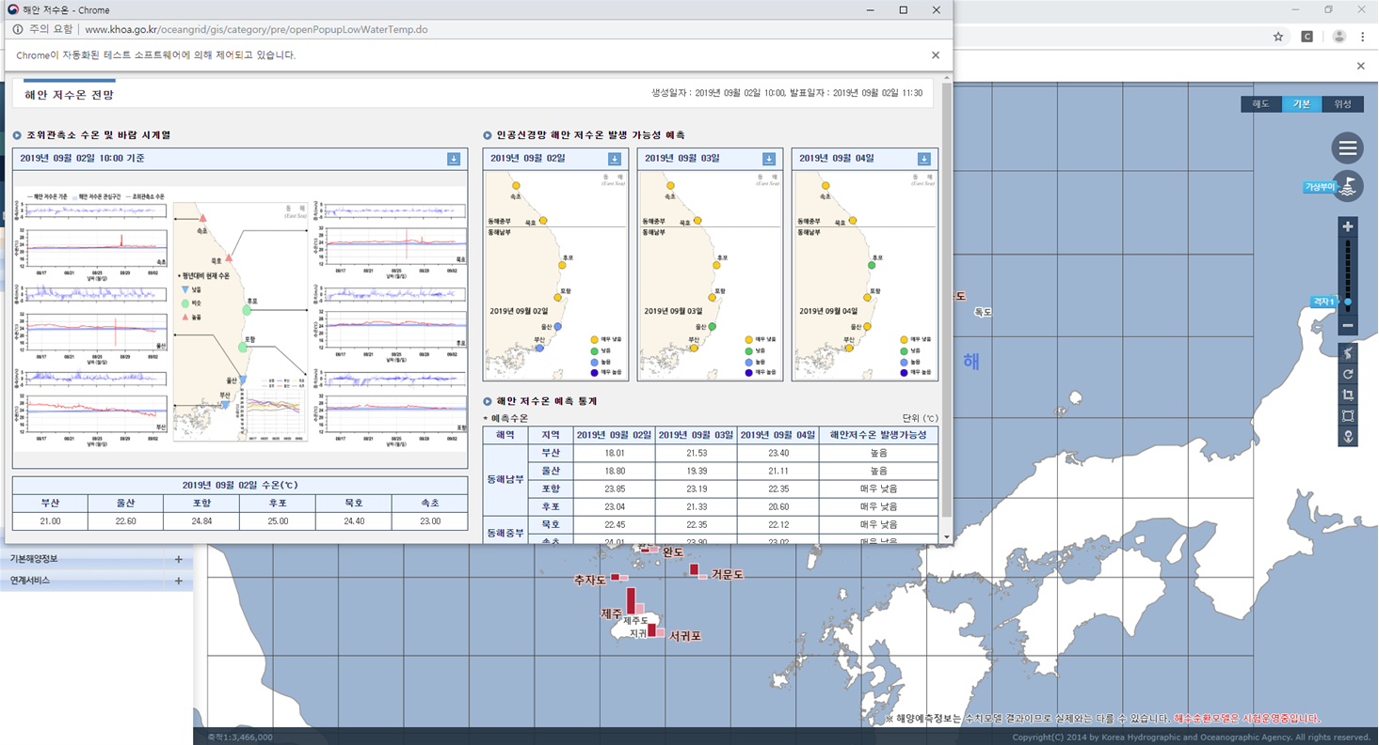
Prediction of abnormal low temperature @ Ocean Data in Grid Framework

Slide 3
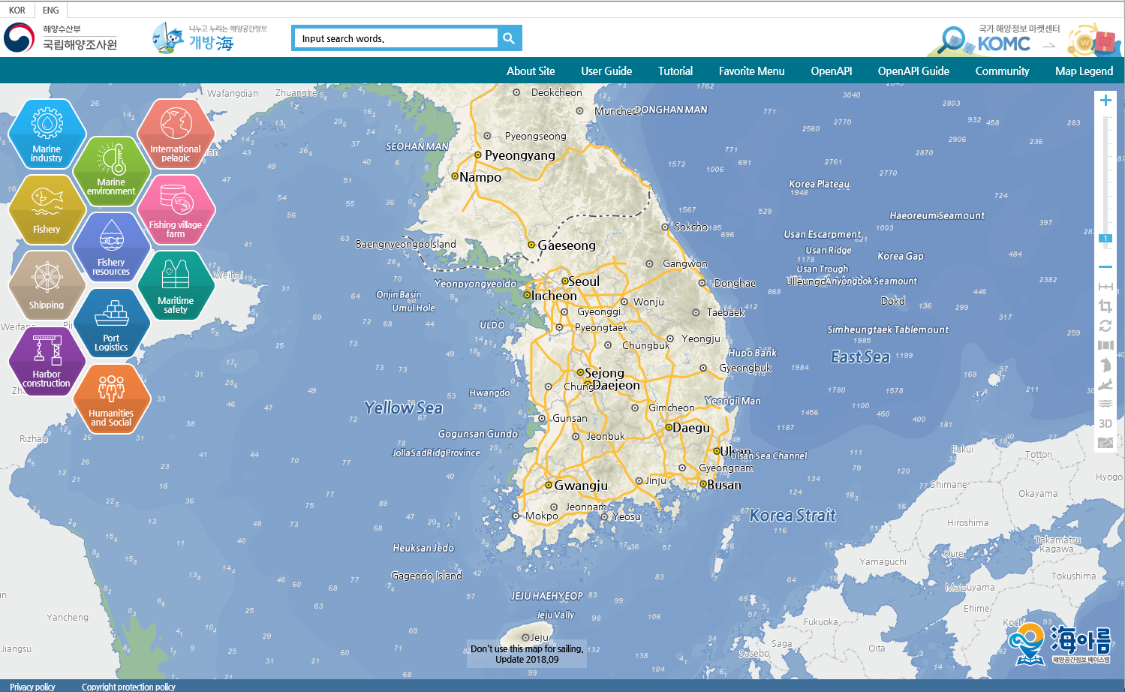
http://www.khoa.go.kr/oceanmap/main.do

Slide 4
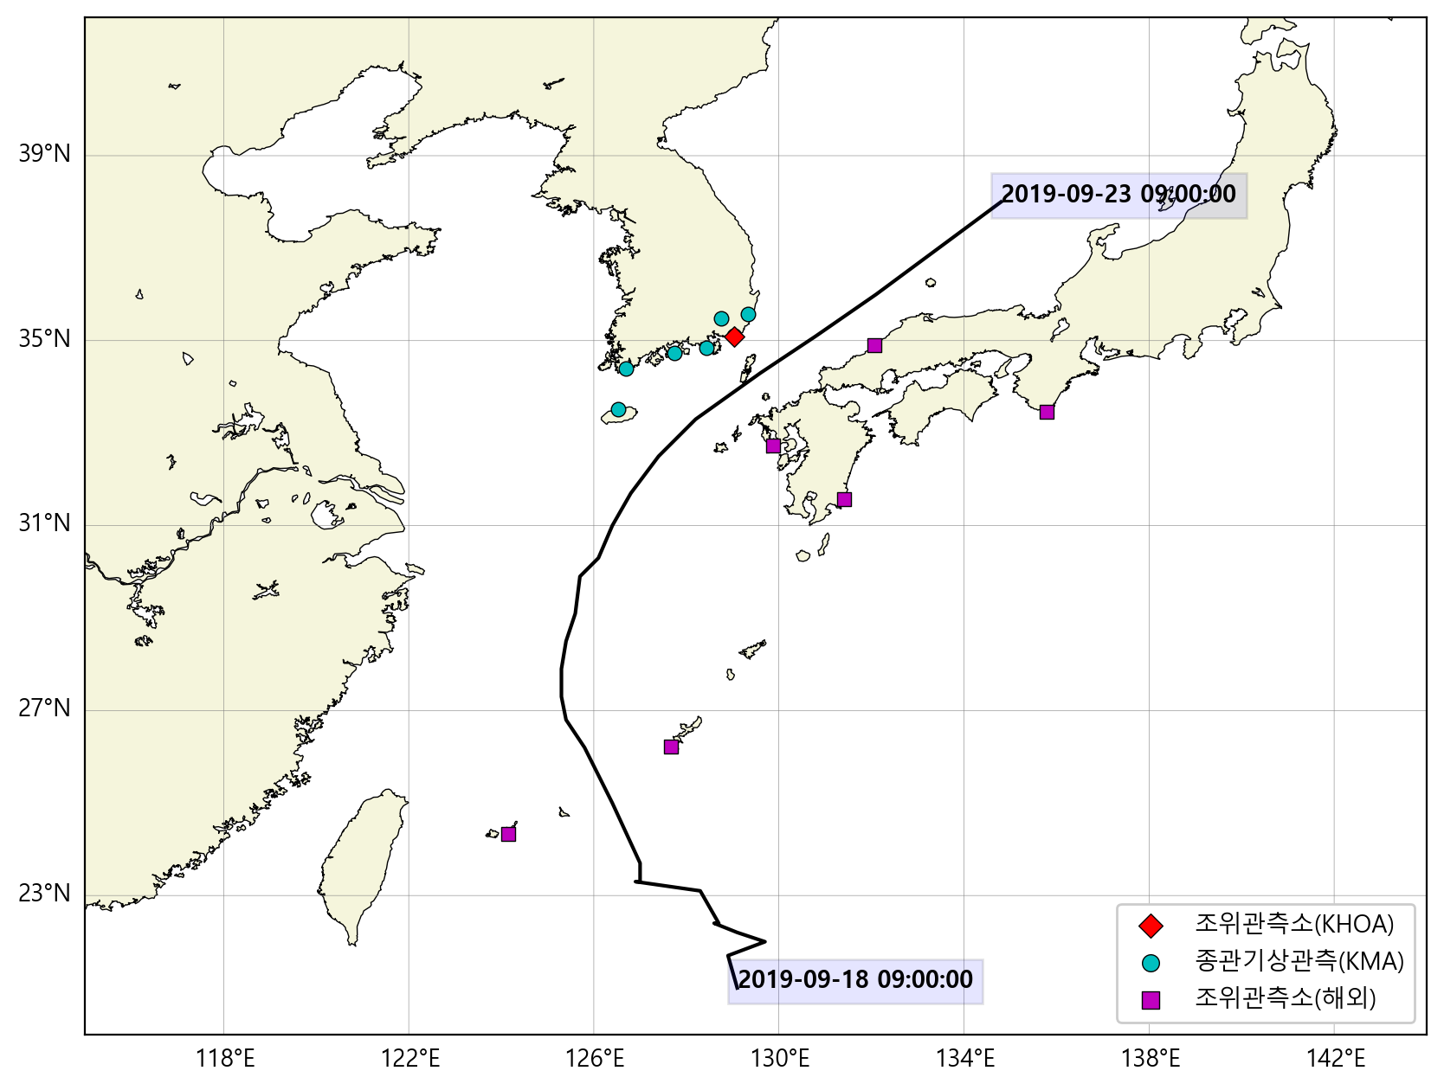
prediction of typhoon-driven sea level at Busan

Slide 5
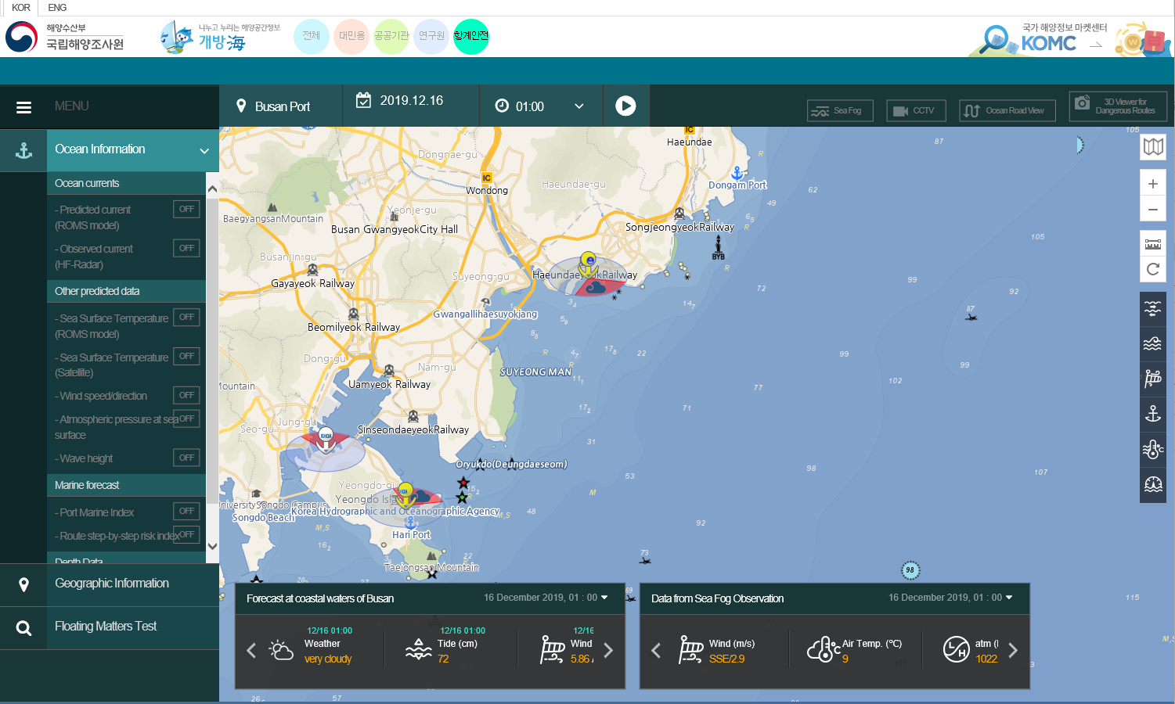
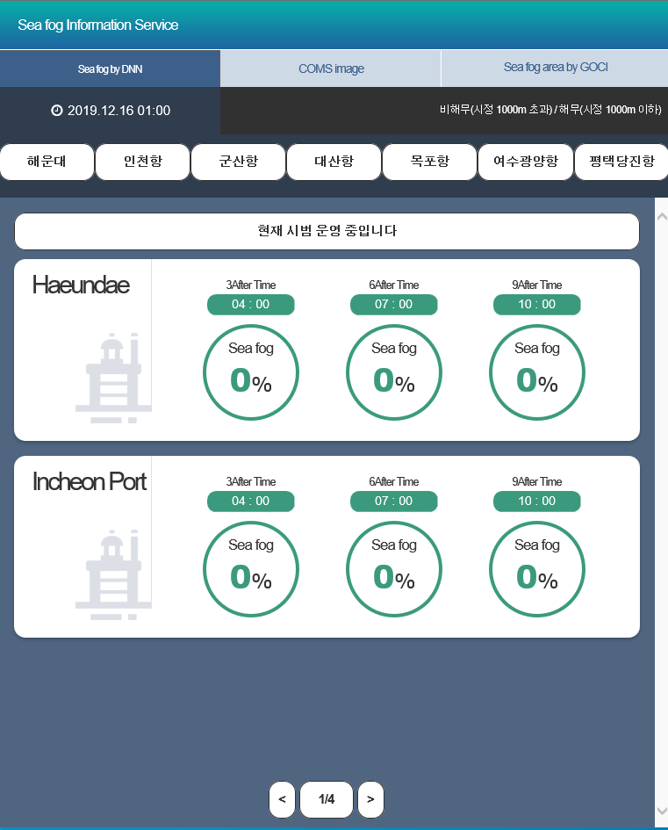
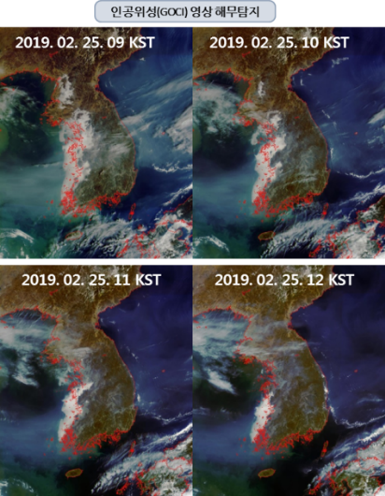
Sea for Information
Prediction sea fog occurrence @ Oceanmap (http://www.khoa.go.kr/oceanmap/main.do)

Slide 6
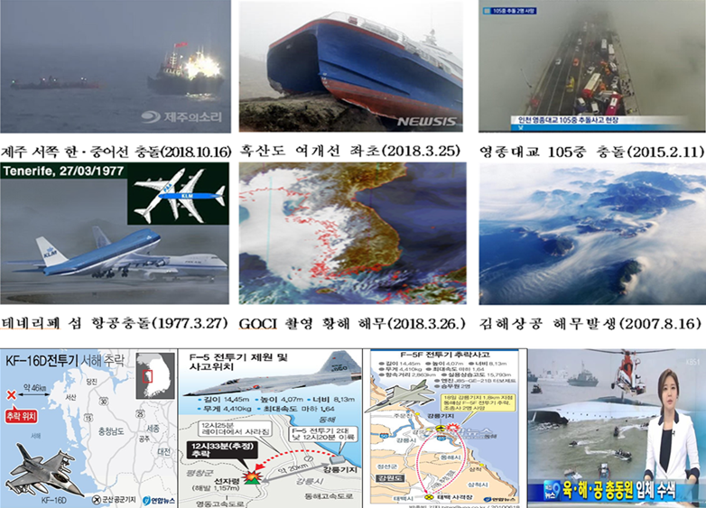
Motivations of Sea fog prediction

Slide 7
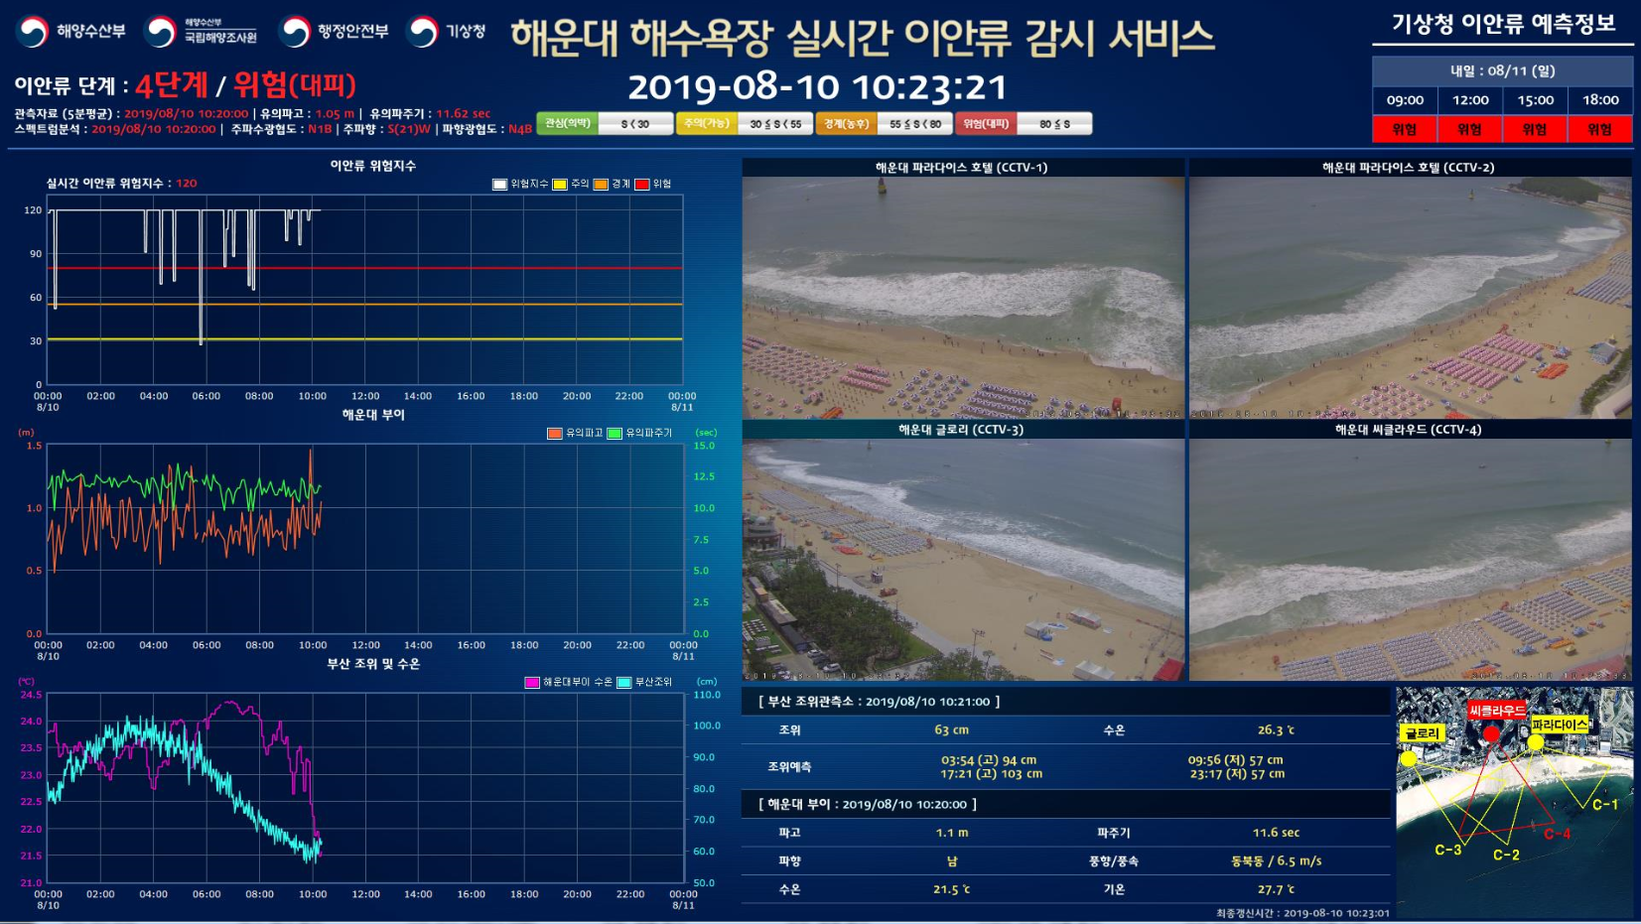
Numerical model based-rip current prediction at Haeundae beach

