Slide 1

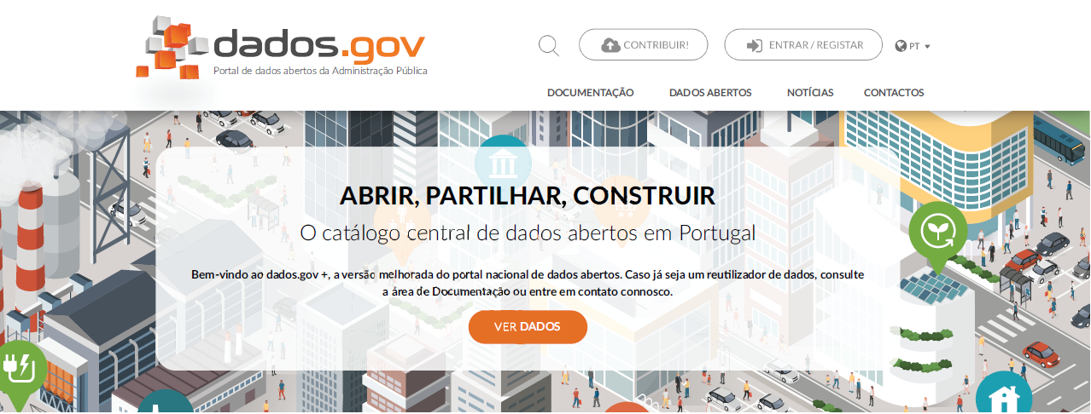

PORTUGAL TODAY VIDEO

Slide 2

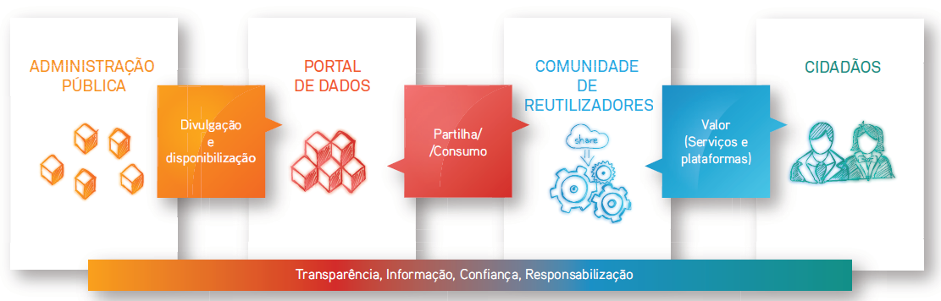
1. dados.gov: Creating Value

Slide 3




1. dados.gov: Creating Value
Public Administration
Data Portal
Reusers Community
Citizens
Dissemination and
Availabilty
Sharing / Consumption
Value
(Services and Platforms)
Transparency, Information, Confidence, Accountability

Slide 4
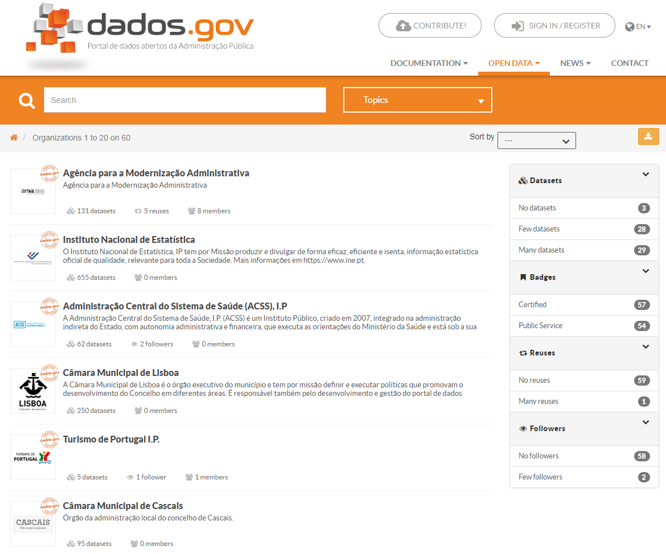
2. dados.gov : Partners
84 Suppliers
Notes:
154 Milhões = acumulado

Slide 5
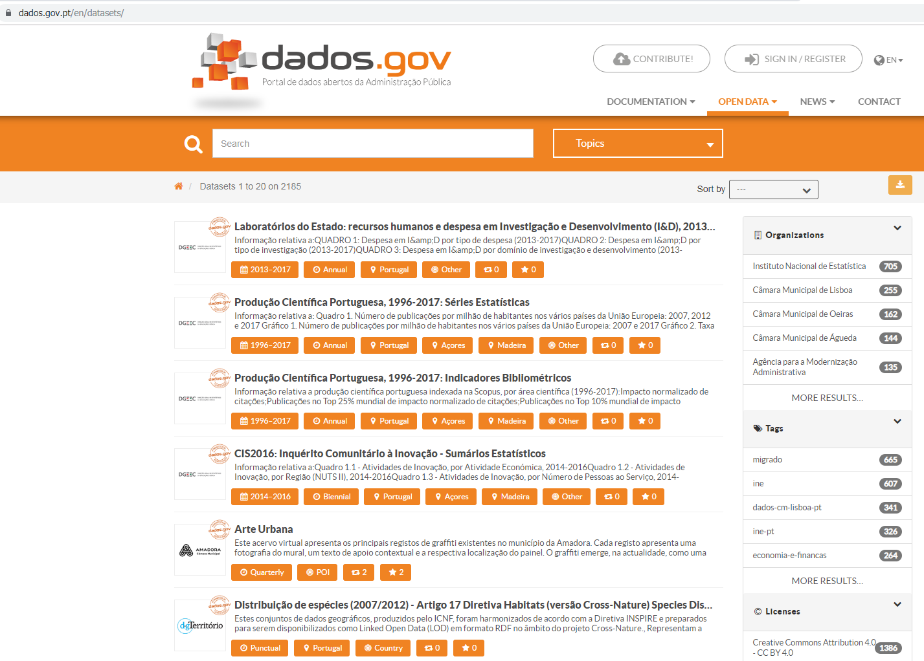
3. dados.gov: Datasets
2.210 datasets and growing
Notes:
154 Milhões = acumulado

Slide 6
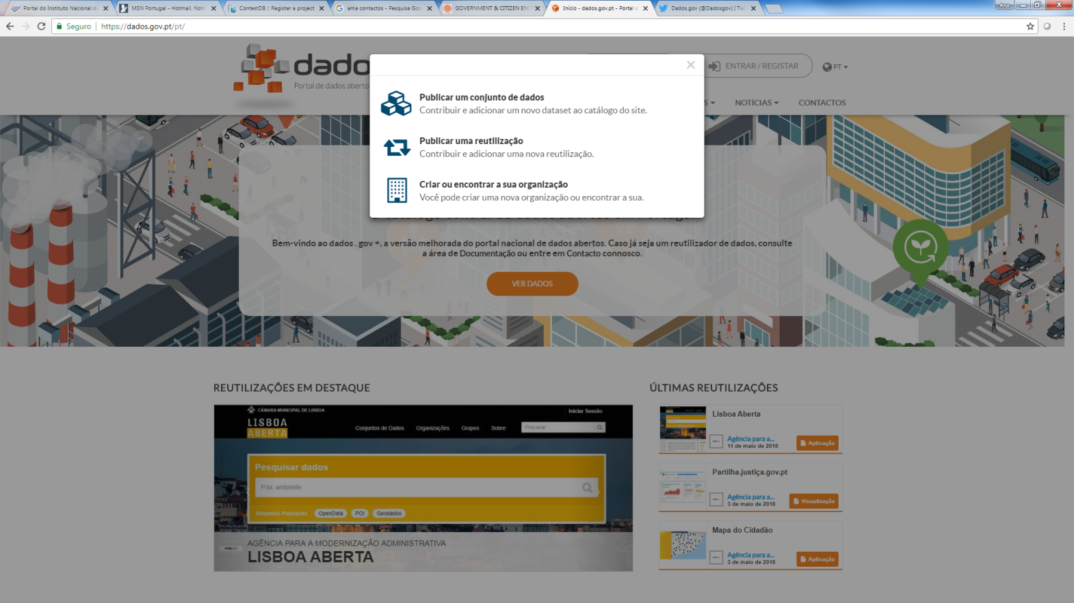
4. dados.gov : Data Reuse
A portal where any stakeholder can reuse and publish data
Notes:
154 Milhões = acumulado

Slide 7
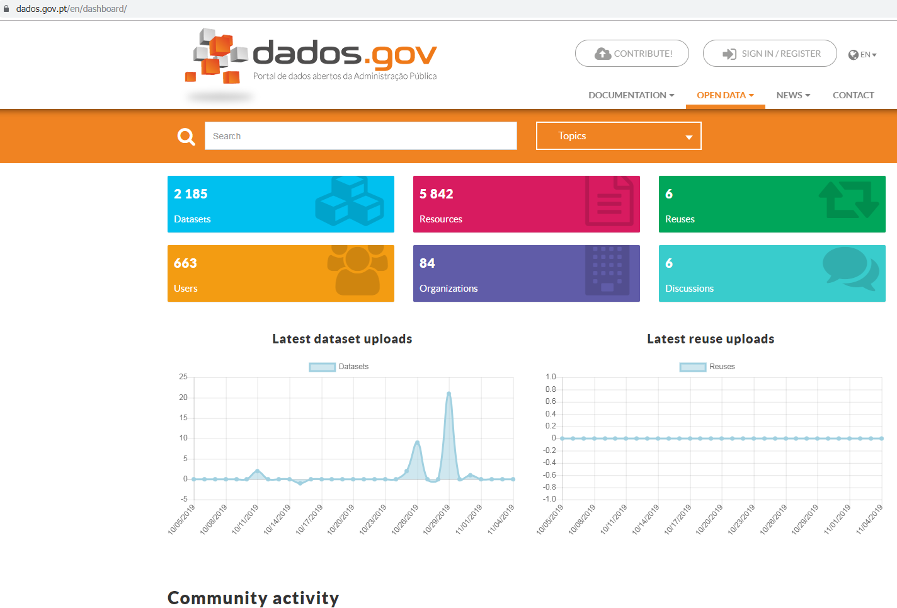
5. dados.gov : Updated Portal
Several available dashboards
Notes:
154 Milhões = acumulado

Slide 8
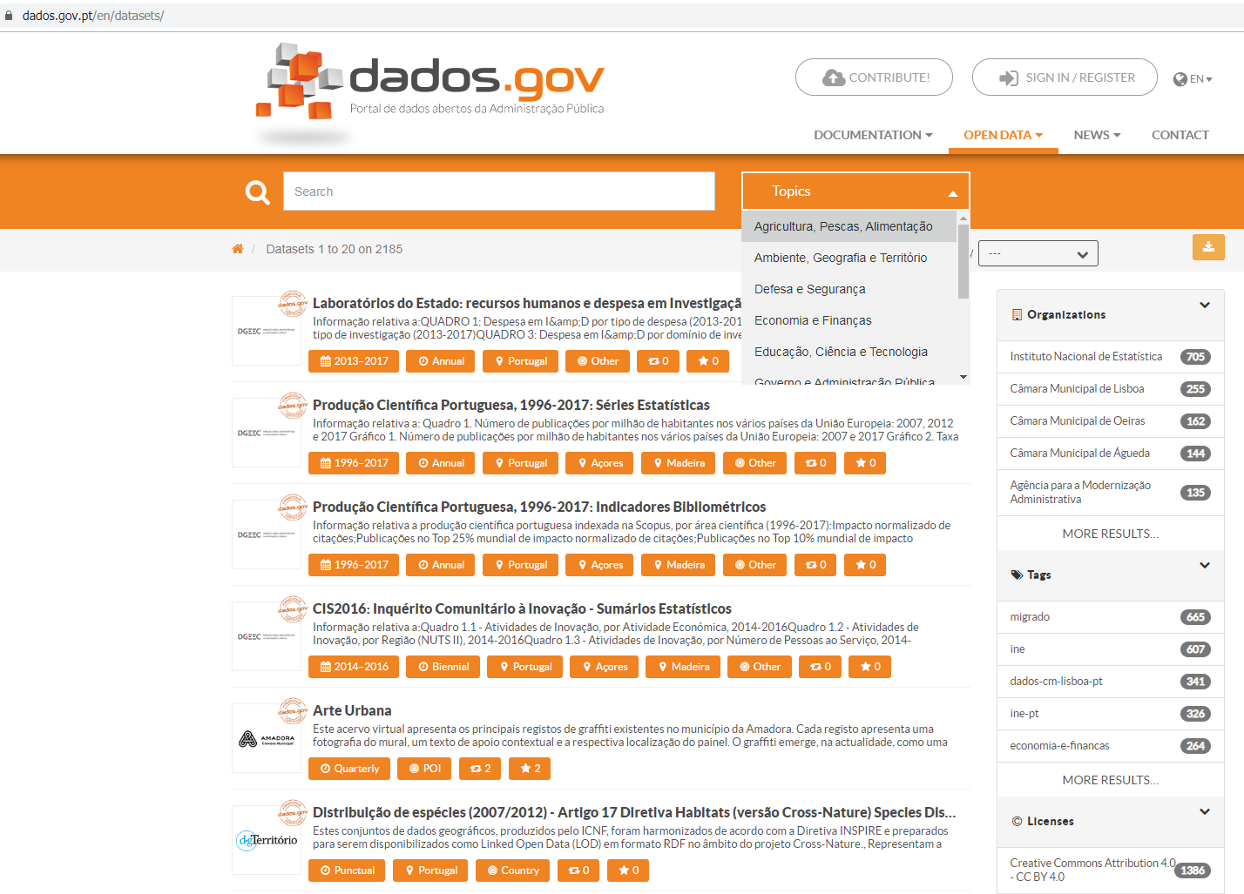
6. dados.gov : Dataset diversity
Several thematic areas covered
Notes:
154 Milhões = acumulado

Slide 9

7. dados.gov: Quality Stamp
Quality Assurance:
Certified Supplier Stamp
Notes:
154 Milhões = acumulado

Slide 10
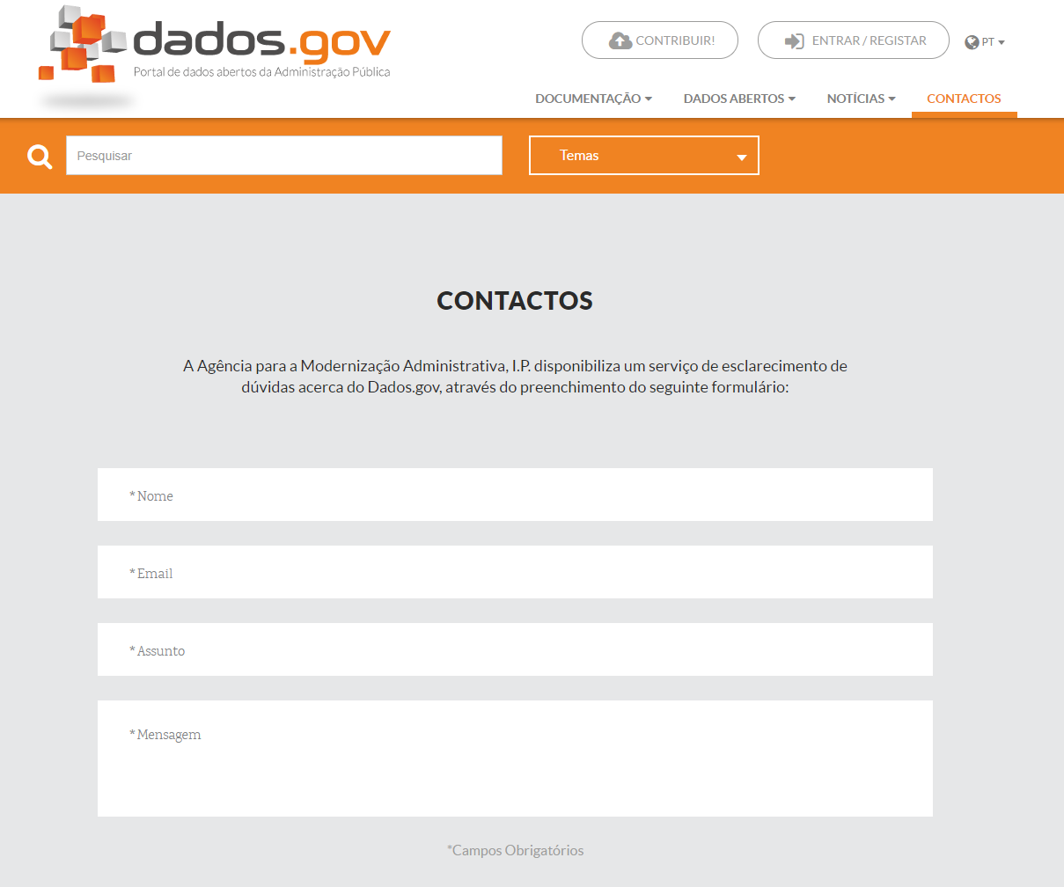
8. dados.gov: A User Driven Approach
A interactive Portal
Notes:
154 Milhões = acumulado

Slide 11
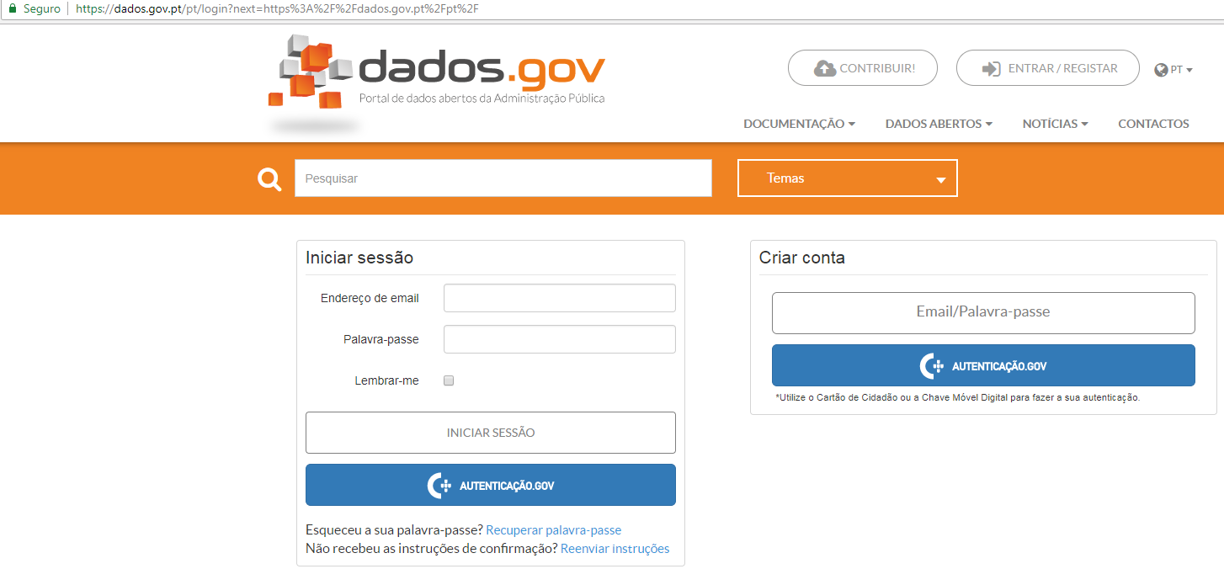
9. dados.gov: Secure Authentication System
The users can provide their email address and associate a password to it, or they can authenticate through autenticação.gov, using the Citizen’s Card or the Digital Mobile Key (DMK).
Notes:
154 Milhões = acumuladoIn order to authenticate themselves, the stakeholders can provide their email address and associate a password to it, or they can authenticate through autenticação.gov, using the Citizen’s Card or the Digital Mobile Key (DMK). The DMK is the National ID mobile solution that allows citizens to electronically identify themselves in most all the public websites, but also from some private companies, through their smartphones, tablets or laptops.

Slide 12
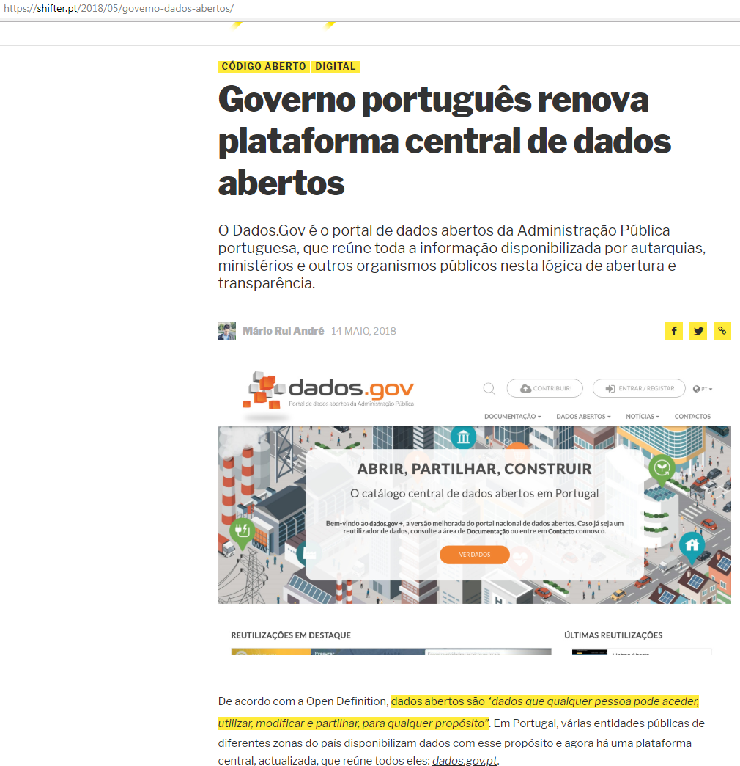
10. dados.gov Media Coverage
“Portuguese Government renews its open data central plataform”
14th May 2018
Source: Shifter.pt
Notes:
154 Milhões = acumulado

Slide 13
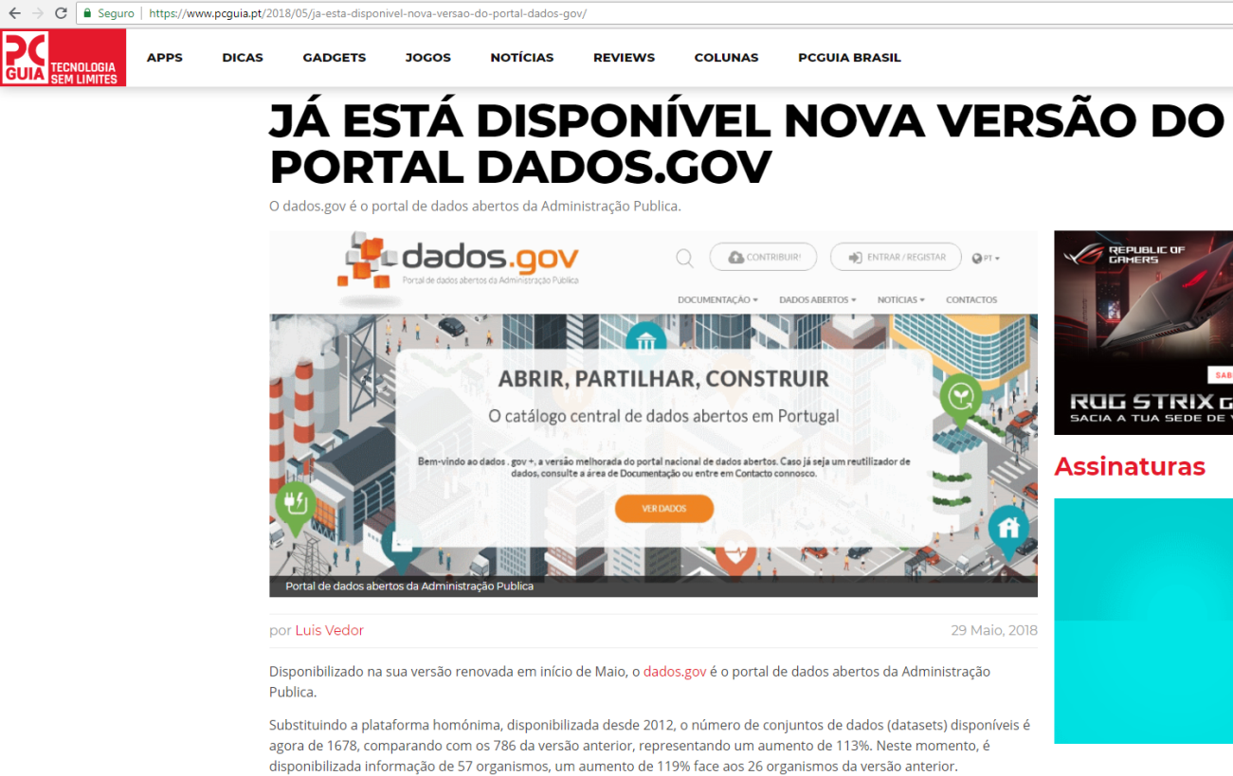
10. dados.gov Media Coverage
“New version of the dados.gov portal already available”
29th May 2018
Source: PC Guia
Notes:
154 Milhões = acumulado

Slide 14
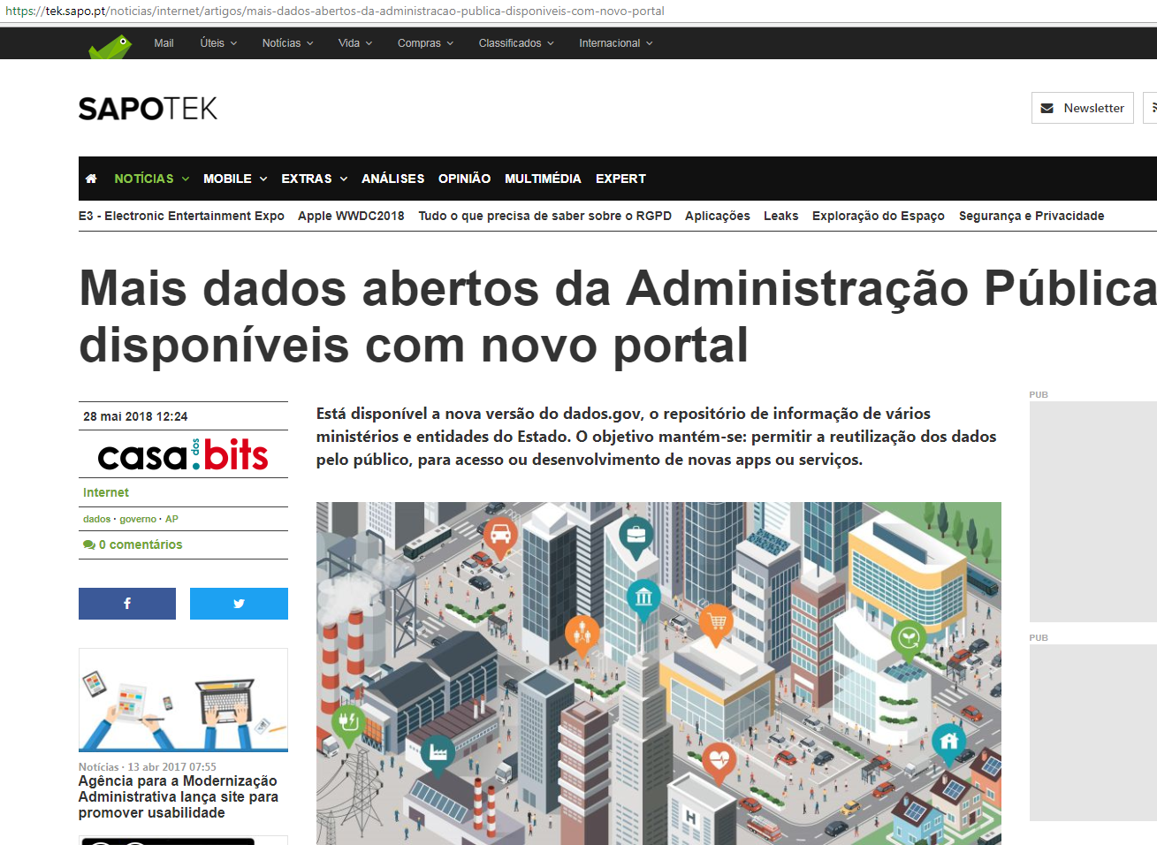
10. dados.gov Media Coverage
“More public administration open data available in the new Portal”
28th May 2018
Source: SapoTEK
Notes:
154 Milhões = acumulado

Slide 15



