Slide 1

Careview
A web-app to tackle social isolation in our cities

Slide 2

AGENDA
Time | Item | Leads
1230 | Introduce participants - must include end users (All) Approval of Draft Agenda (All) Explain purpose of meeting (ESA) | Giulia Rancati Antje Vogel Jon Hindley
1250 | Summary of activities carried out since last milestone | Abhay Adhikari
1310 | Review of Action Item List in SharePoint | Giulia Rancati Antje Vogel
1330 | Update of the Business Plan (BP) | Giulia Rancati Abhay Adhikari
1350 | Presentation and review of the CDR documents: Requirement Documents ^GR, ^NN, QD Project Bar Chart ^GR System and Service Architecture (SSA) ^QD System Verification Document (SVD) ^QD | Giulia Rancati Quinn Daley Natalie Nelissen
1450 | PilUP and Use Cases Leeds PilUP ^NN, ^JH All use cases ^AA | Natalie Nelissen Jonathan Hindley Abhay Adhikari
10 minute break
1530 | Planning for activities to be carried out before next milestone meeting and set date for next milestone meeting | Giulia Rancati Abhay Adhikari Antje Vogel
1550 | Any other business | Giulia Rancati Abhay Adhikari Antje Vogel
1600 | Agree on Action Item List Conclusions Review Minutes of the Meeting and Signature | Giulia Rancati Abhay Adhikari Antje Vogel
1630 | Meeting Concludes

Slide 3
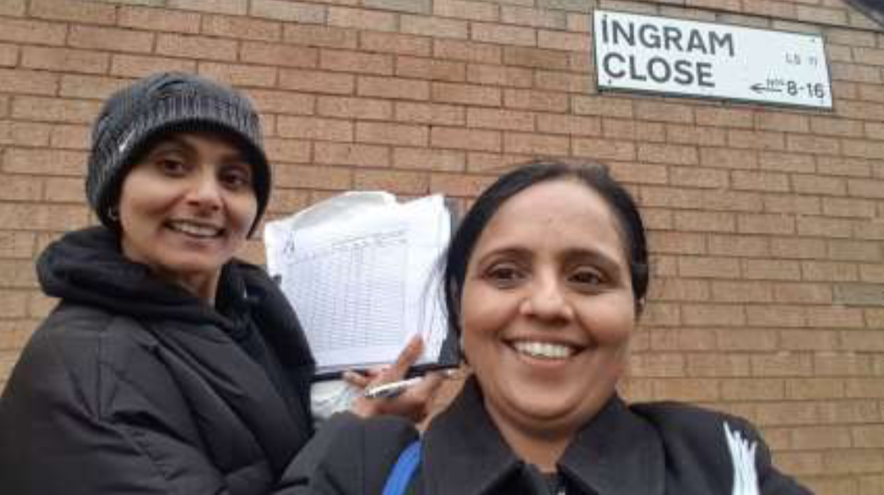
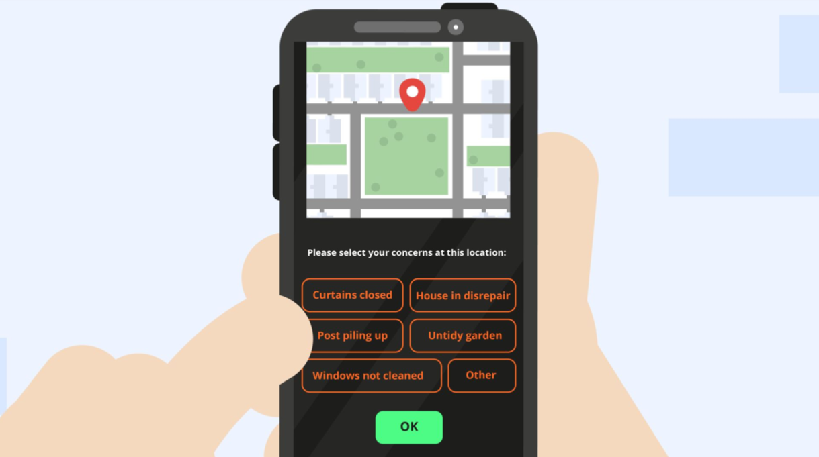
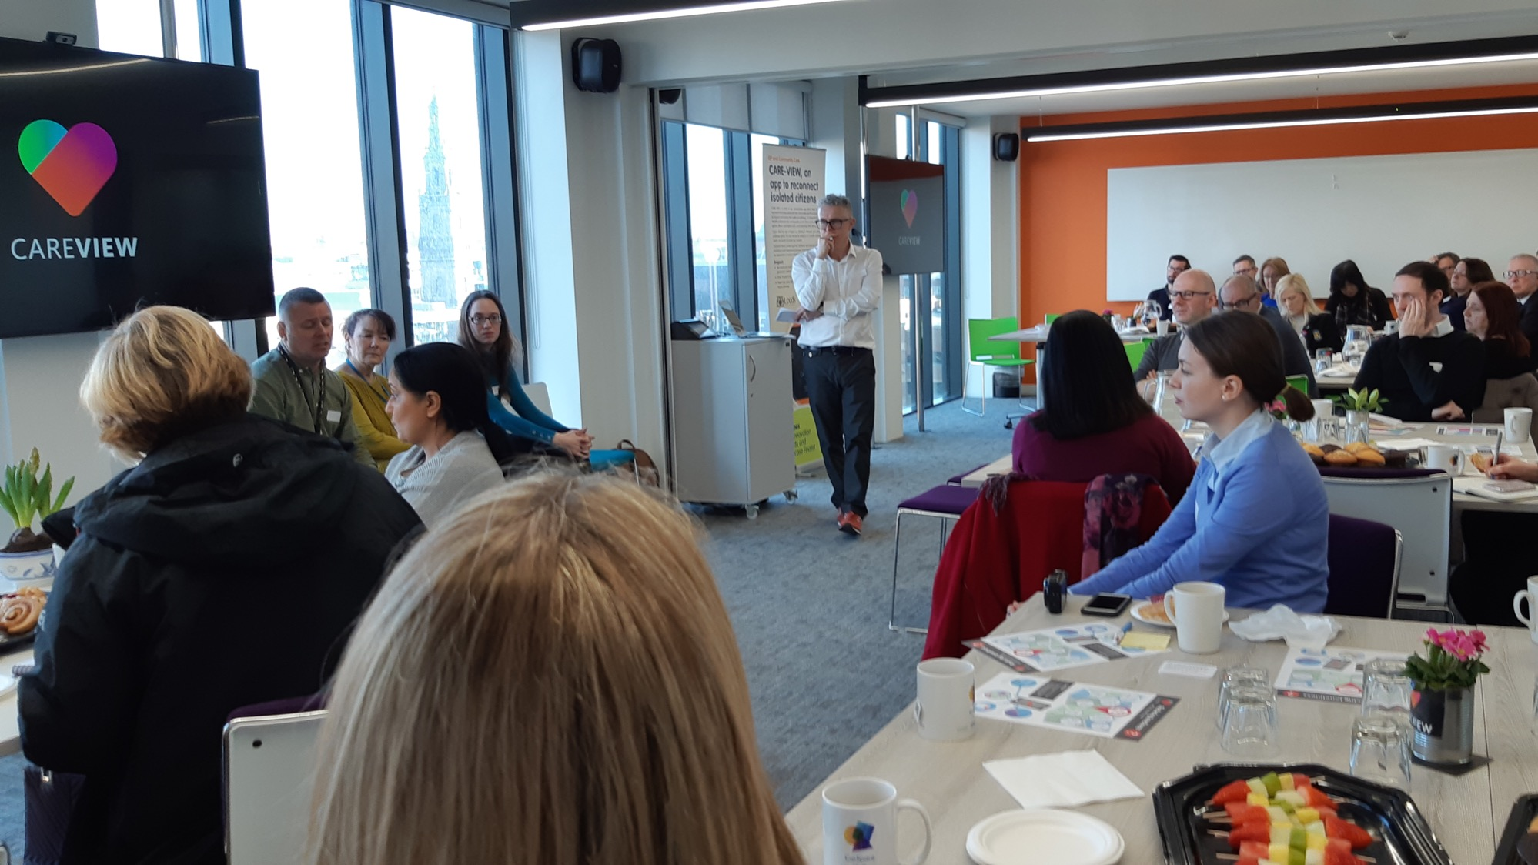
SUMMARY OF ACTIVITIES CARRIED OUT SINCE LAST MILESTONE
Front Line Staff using Careview in their daily job
Tap-the-Heart : a simple one-step application to crowdsource map of socially isolated residents
Urban Sustainable Development Lab is a division of Dhyaan Design Limited
Notes:
Abhay to lead the conversation
This slide should be used in conjunction with Careview October and November Monthly Progress Reports.

Slide 4
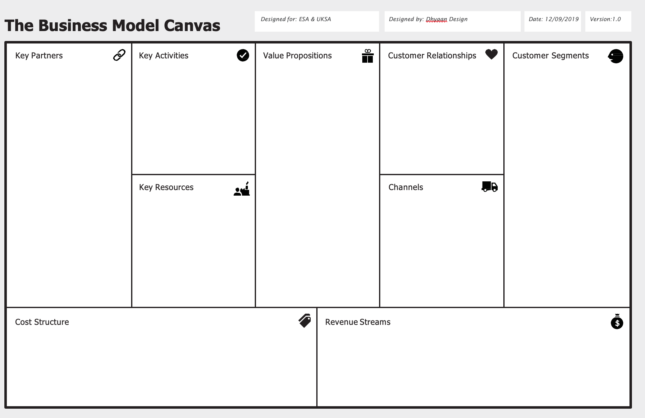
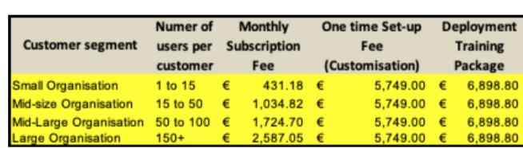
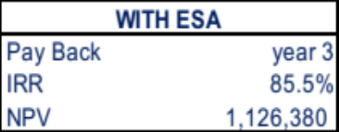
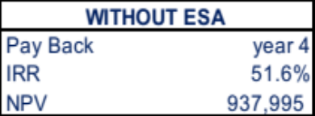
Date 28/11/2019
Leeds City Council – our core pilot city – is putting €125,000 funding in-kind towards the project and they promoted Careview across multiple public sectors forums and events.
Service and technical enhancement with two new features.
Commercialise through strategic partnerships and land new customers.
Grow a Sales & Marketing Team to scale.
Develop promotional channels for national and European expansion .
Careview is a web-app that uses GNSS positioning to improve the accuracy of outreach and door-knocking to identify socially isolated residents helping city councils save money. This satellite technology is vital to improve the statistical chance of finding socially isolated residents. Careview was the only non-clinical solution to win an NHS Innovation Award in 2017
Local Authorities (UK and EU Cities). Departments include Public Health, Adult Social Care & IT. These departments, responsible to engage with socially isolated and vulnerable residents across the city, are looking for digital tools that create efficiency savings by streamlining operations and providing up to date insight.
Leeds City Council & Bury City Council as pilot cities, with Bury becoming a test case for Greater Manchester Authority.
Bury City Council, part of Great Manchester Authority, will prove the Careview business model and will be a pilot for other cities in the authority.
Age UK (Wakefield district) as pilot charity, with a significant potential to scale nationally if we prove the business
model
Age UK Wakefield – First national charity. They will validate Careview in the charity operational model
Mid-large Charities with a regional or national remit. These organisations are contracted by local authorities or act independently to deliver a provision of care to vulnerable residents
Citizens Advice: in conversation for joint national initiatives.
MHA: National charity working with up to 18,000 older people.
CEO : Abhay Adhikari - strategy, sales, marketing and & contract manager
Innovation Showcases hosted by our pilot cities & UK and EU networks.
Digital: social media promotional toolkit, website, newsletter.
Expos and Conference: showcase Careview to target customers in the UK and EU.
Media coverage: We’ve received regional, national & international coverage.
COO: Giulia Rancati - finance , operations and project manager
Careview is a location based service with a single-step operation – tap the heart icon– to crowdsource location intelligence from users. This make it easy to use and low cost/low maintenance, hence the attractiveness both for front line users and procurement departments
Research departments in private and public sector organisations that focus on urban development. We’ve been approached to develop variations of Careview that can be used to create thematic heatmaps in the built environment. Budget holders are Programme Leads and Heads of Digital.
EUROCITIES and URBACT
networks for European expansion
CTO : Quinn Daley - Software Architect
Business Development: Eddy Adams – strategic partnerships for UK / EU Expansion.
Usability expert & researcher – Natalie Nelissen
Software-as-a-Service (SaaS) subscription model
As in any SaaS Model Costs of Sales (CoS) will be in single digit.
Opex are growing proportionally to the increase in customers
Ability to leverage Dhyaan Design existing resources to manage costs
From to 2 to 38 active customers over the forecast period.
15% addressable market captured.
Over €1M revenue over 5y
Notes:
Giulia to lead the conversation. This slide is based on Careview Business Plan v1.0, November 2019

Slide 5
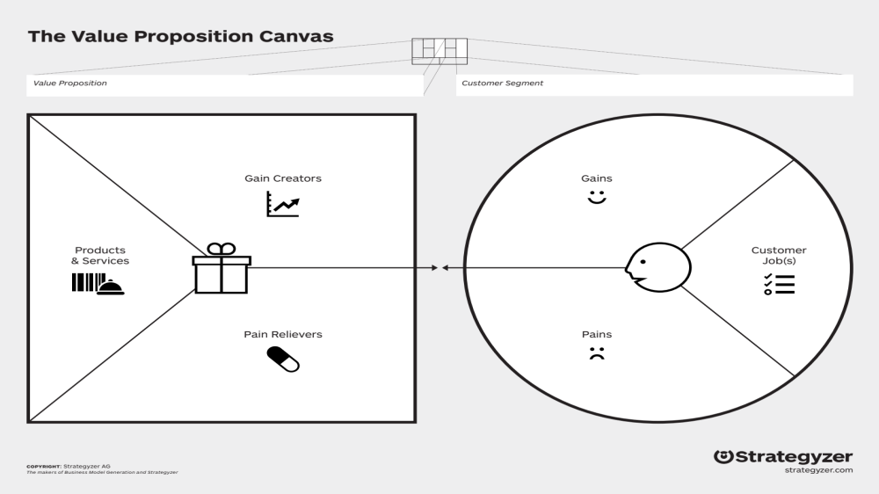
Addressing social isolation in an simple, efficient and effective manner
City Councils
Charities focused
on aging population
Success stories/Increase impact
Significant £ saving: £65K early efficiency savings when deployed in Leeds 10% most deprived areas*
Find more isolated residents & re-integrated them in the community
Actionable solutions
for outreach team
Use new technologies to keep
costs down
Platform and web-app
to identify socially isolated
residents
Cross-agencies co-operation to optimise resources
Head of Adult Social Care
Department of Communities & wellbeing
Head of IT & Digital
Head of Procurement & Programs
Subscription service
Facilitate cross-agencies collaboration & optimise resource
Protect personal data
Low cost, low maintenance
High costs associated with each socially isolated resident (£12K per person per year)
Use GNSS to improve accuracy of
door-knocking and outreach
services
Council front-line staff
Agencies front-line staff
Charities front -line staff
Lack of of effective tools for
Outreach activities
No need of extra staff
Easy and fast to use application: no extra-burden on front line staff
Shortage of staff and budget
* Using social isolation calculator
Notes:
Giulia to lead the conversation. This slide is based on Careview Business Plan v1.0, November 2019

Slide 6
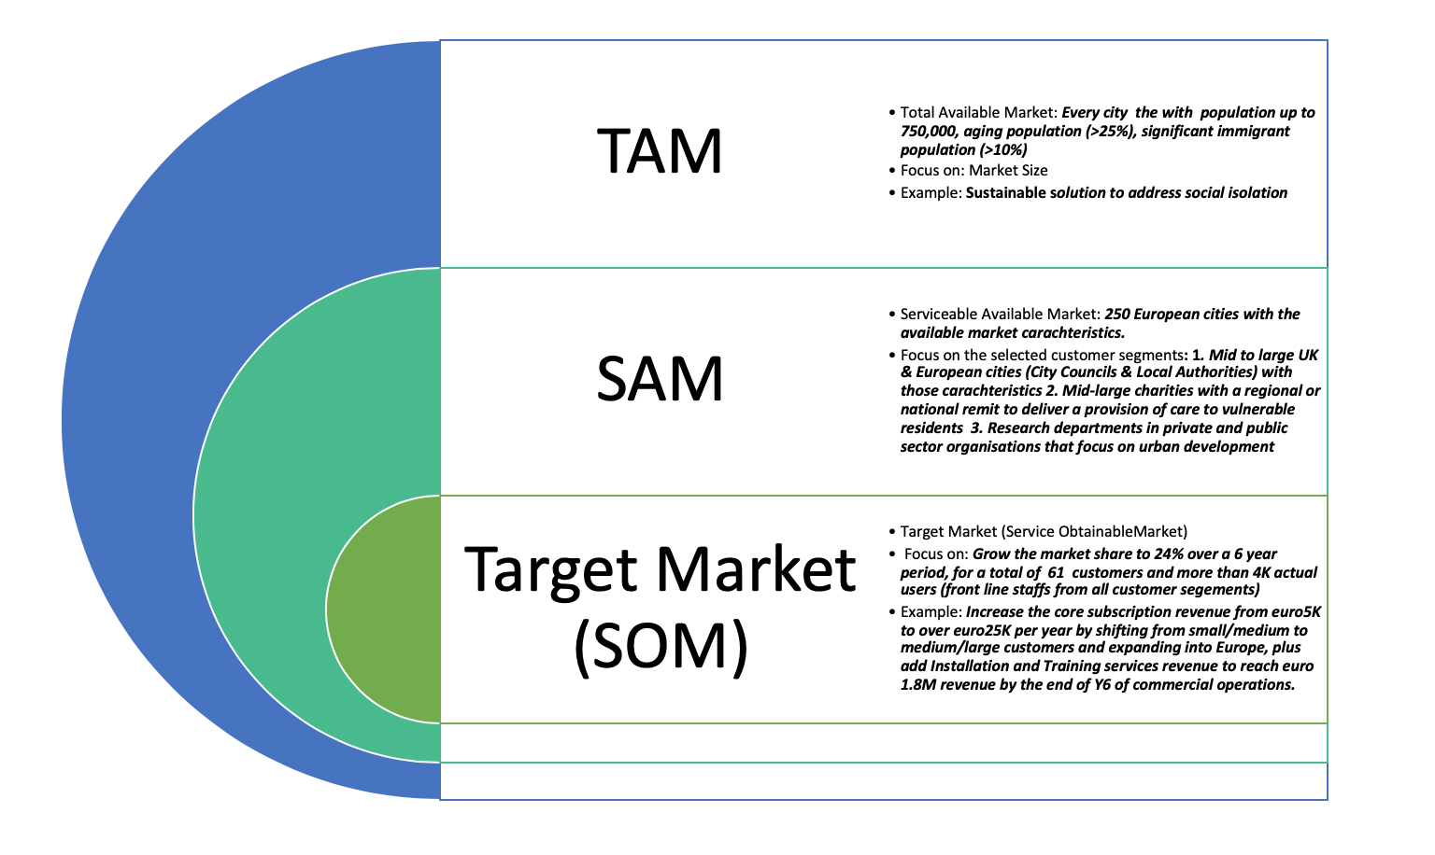
THE MARKET OPPORTUNITY
Notes:
Giulia to lead the conversation. This slide is based on Careview Business Plan v1.0, November 2019

Slide 7
THE FINANCIAL MODEL
In line with business plan forecasts
Annual revenue by year6:
Euro1.8m
NPV:
Euro1.1m, with ESA Contribution
Market share
Pricing scheme
Addressable market
(
)
220 cities
x
24%
x
220 EU cities with population up to 750k
61 customer at the end of years6
Tiered SaaS offering
Notes:
Giulia to lead the conversation. This slide is based on Careview Business Plan v1.0, November 2019

Slide 8
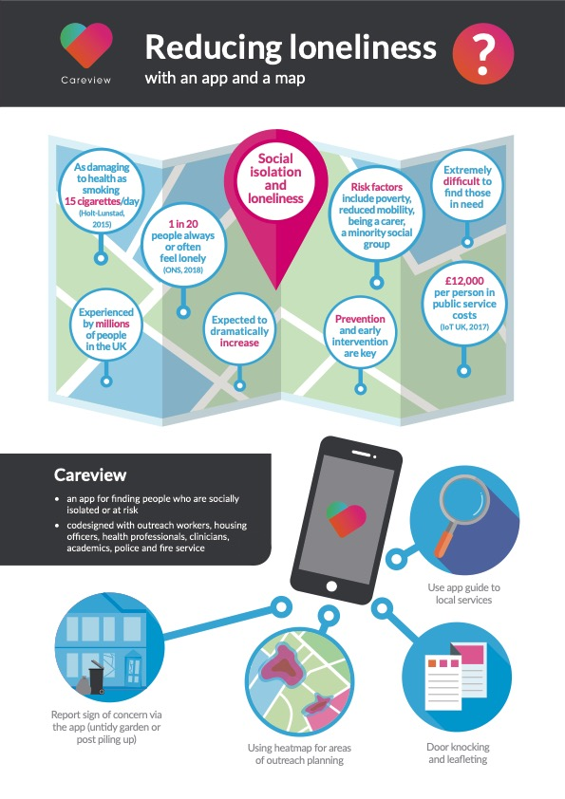
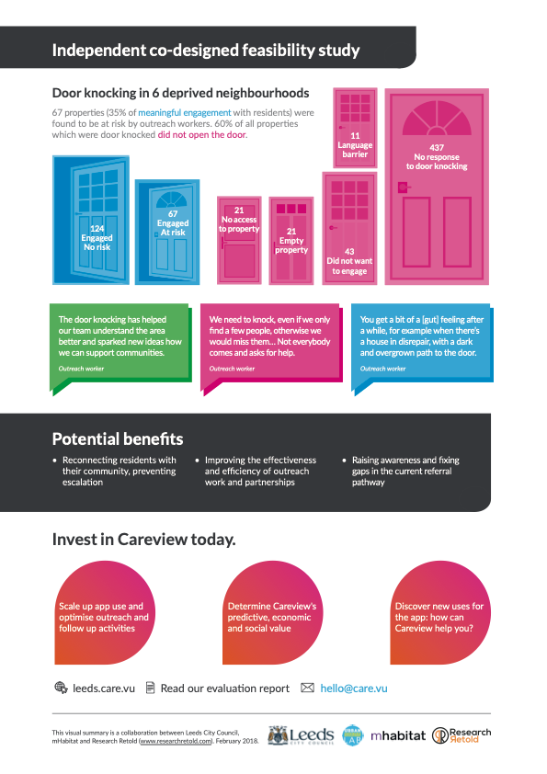
Notes:
Giulia to use this slide to hand over to Natalie and Quinn

Slide 9








KEY REQUIREMENTS…
ROLES
ADMIN USERS
Careview Team and assigned mid-manager in the customer’s organization
PROFESSIONAL USERS
EXPERT USERS
Members of other institutions (e.g. fire services or police) whose organizations have agreed to deploy Careview and have the ability to “tap the Heart”
Front-end staff delivering the provision of care
CAREVIEW TECHNICAL DEVELOPMENT TEAM
CAREVIEW OPERATIONS
Achieving operational excellence and imagining new ways of working
Turn user requirements in future proof features
Notes:
Natalie to lead the conversation

Slide 10
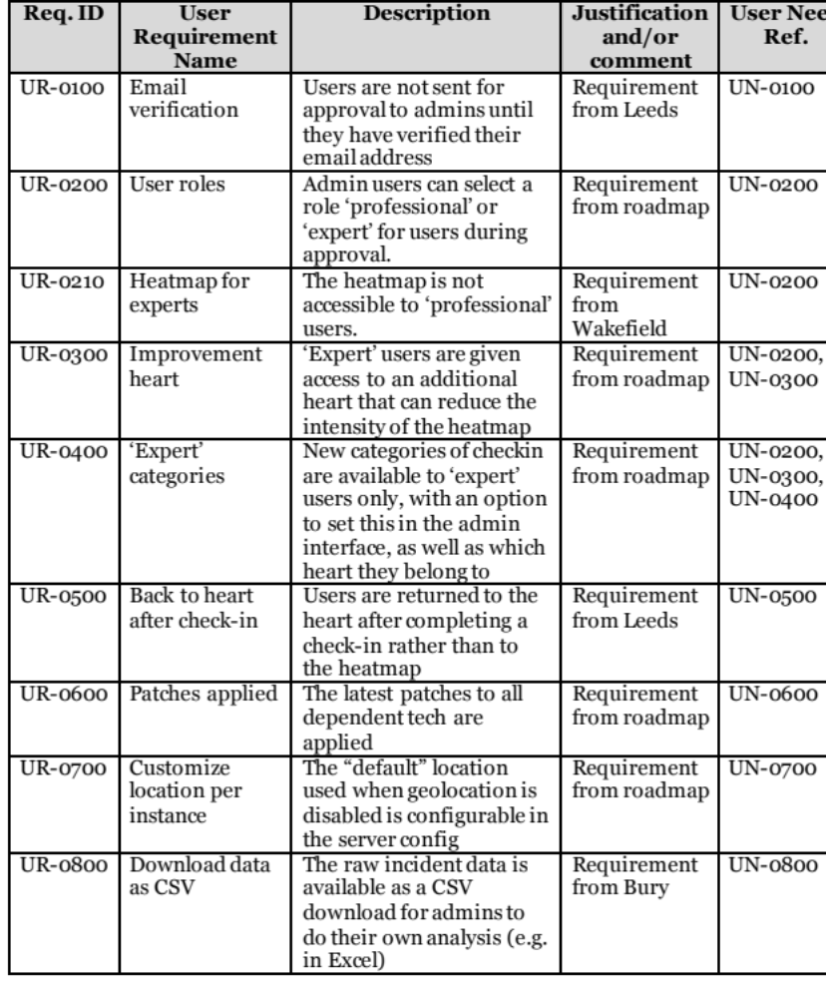
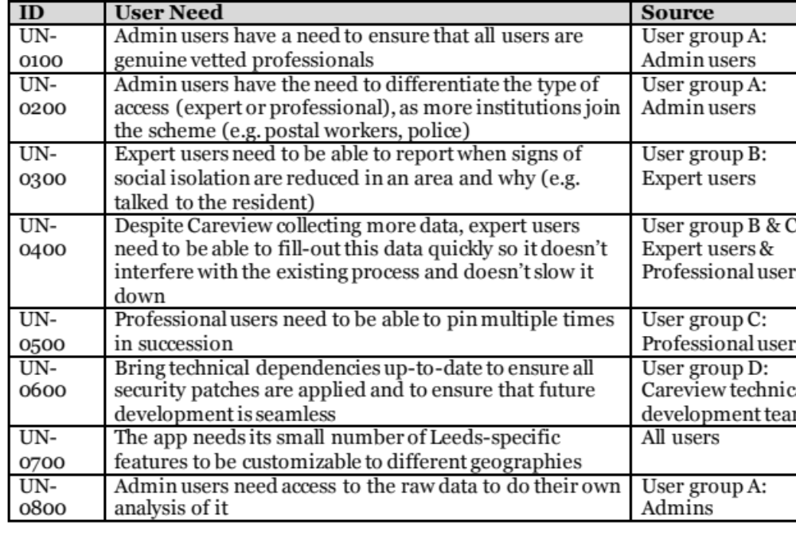
…KEY REQUIREMENTS
USER NEEDS AND REQUIREMENTS
Notes:
Natalie & Quinn to lead the conversation

Slide 11
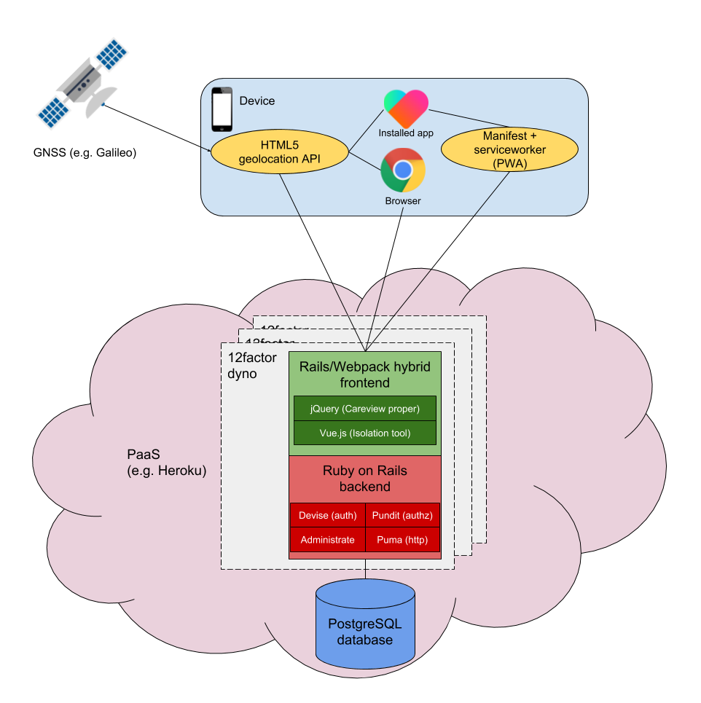
SERVICE & SYSTEM ARCHITECTURE (SSA)
Notes:
Quinn will design the architectures to the next level of details during the meeting.

Slide 12


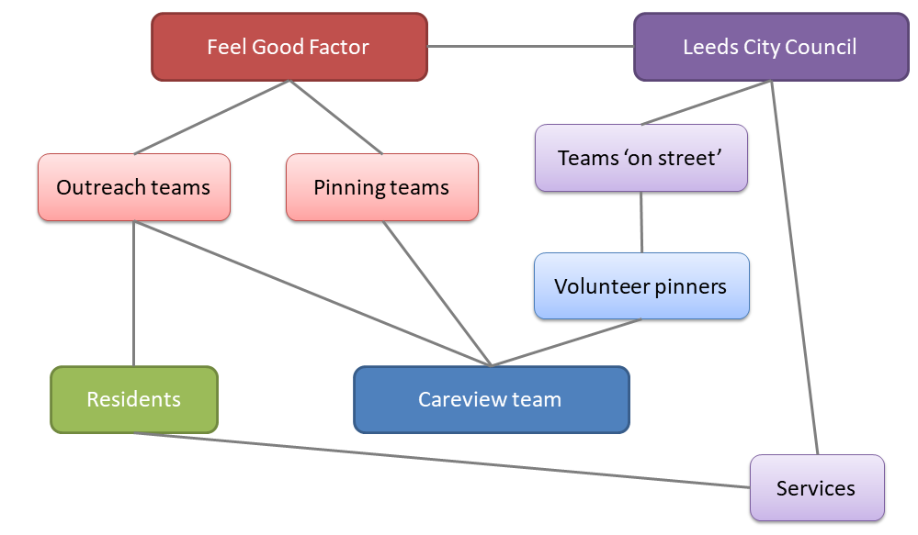
LEEDS PILOT
Notes:
Natalie and Abhay will leverage this slide to illustrate the Leeds pilot and build from here.

Slide 13
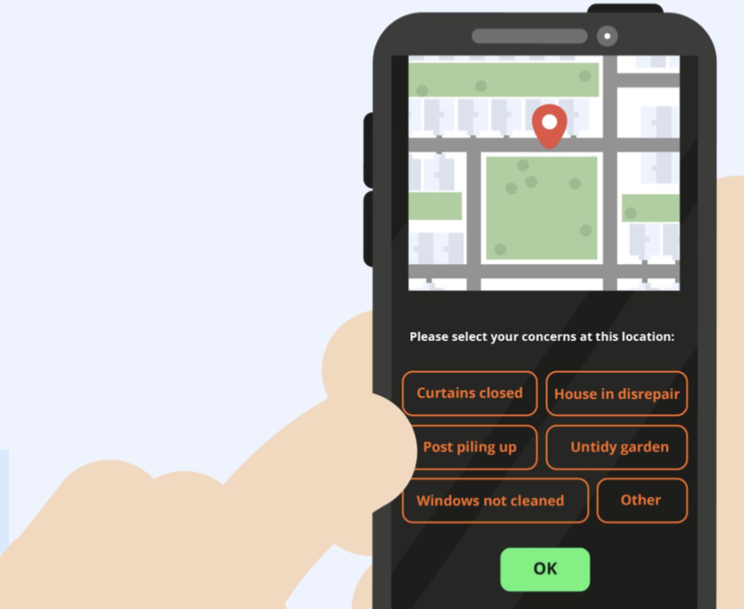
YOUR QUESTIONS
ESA BDR/CDR Meeting, Leeds, 9th November 2019

