Slide 1


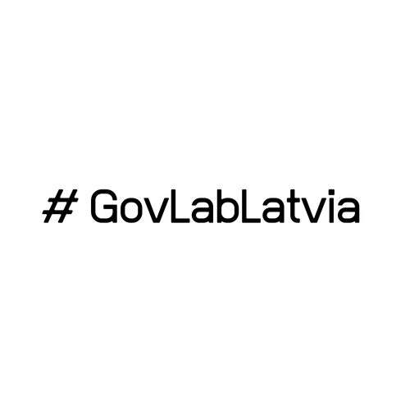


Creation of 3 innovation labs in Latvia
Factsheet
September 2019
Supported
by

Slide 2
Creation of 3 innovation labs in Latvia
Supported
by
Why?
What?
How?
Need for public sector transformation
Increasing societal service quality demands, budgetary constraints and changing political and economic circumstances represent significant challenges for Latvian public administration and impact its performance. These challenges outline the necessity to raise the overall quality of public administration in the country by promoting creativity, innovation and applying new ways of addressing problems and developing solutions.
Setting up innovation labs
The State Chancellery seeked for support from the European Commission Structural Reform Support Service in the creation of three innovation labs in Latvia.
Administrative simplification lab aims at creating new approach for measurement and simplification of administrative burden in Latvia.
HR lab aims at creating HR framework with HR processes, based on stakeholder and best practice inputs.
Branding and reputation lab aims at shaping the working culture in the public sector based on values rather than processes and rules.
Overall ambition of the project was to introduce innovation labs as a new approach to tackle different topics in public administration. Such approach allows flexibility and improves cross-sector, cross-institution and cross-department collaboration as well as introduces the currently lacking experimentation in the process. The project aimed at identifying the most suitable approach for sustaining and operating innovation labs in Latvian context through learning by doing.
Division of responsibilities
Rigid division of responsibilities of the involved parties was applied.
Ensuring innovation process
The State Chancellery was responsible for providing strategic direction, defining lab agenda and taking care of organisational work.
Consultants from PwC were advising on preferred direction in line with lab’s maturity, policies, best practices.
Creating content
Lab participants (10-15 participants per lab) with interest and relevant skill-set dedicated to actively participate in lab work.
Facilitating process
Consultants from PwC were fully responsible for facilitation, provision of methodology, tools and know-how in the beginning of the project.
The State Chancellery gradually overtook facilitation by the end of the project.
National policy context
Policy planning documents focus on the overall development of the public administration by strengthening innovation capacity.
Sustainable development strategy Latvia 2030 highlights the need for innovation through sectoral and institutional collaboration and public participation.
Public Administration Reform Plan 2020 is envisaged to raise the overall efficiency and effectiveness of public administration.
State Chancellery has launched the "ExCeL!" programme to address key drivers of public administration efficiency.
Approach
The user-centric approach and design thinking methodology were applied to funnel innovation.

Slide 3
Overview of the prototypes developed
Supported
by
Administrative simplification lab
HR lab
Branding and reputation lab
Official shadows entrepreneur
Official meeting with an entrepreneur to learn about the issues that the business is facing and to foster development of user-centric policies.
Responsible: Ministry of
Economics
Website: https://ierednieno.org/
Digitalisation of occupational health (fit for work) examination system
Digital solution as part of e-health system available to citizens, entrepreneurs and healthcare professionals.
Responsible: Ministry of Welfare and National Health Service
Leadership development matrix
Learning and development needs and pathways.
Responsible: the State Chancellery
HR framework in public administration
Framework that will support the implementation of the OECD Leadership and Capabilities Framework in the public administration.
Responsible: the State Chancellery
Values
workshop
Workshop with practical tasks (value game and visual stories exercise) designed to raise awareness for public administration employees on public administration values.
Responsible: the State Chancellery
On-boarding platform for managers
Digital solution accessible to managers from pre-onboarding up to 1 year in employment.
Responsible: the State Chancellery
"Experts
bank"
Exchange with competencies, hire
of employees in cross-institution and cross-sector level.
Responsible: the State Chancellery
Value implementation programme for top managers
Training program for top level managers to raise their knowledge and skills on implementation of values and provide practical tools.
Responsible: the State Chancellery
Proactive e-services
in different life situations
Citizens proactively receive tailored information on public services according to their life situation.
Responsible: Ministry of Environmental Protection and Regional Development
Attractive public administration job add
Unified digital platform on vacancies in public administration.
Responsible: State Employment agency
Excellence
award
Annual awards on outstanding performance on the theme of the year.
Responsible: the State Chancellery
Process improvements in harmonising draft legislation
Change in process by introducing a necessity for institutions to provide a specific solution if objections are raised.
Responsible: the State Chancellery
Digitalisation of waybills in Latvia
Electronic system on goods transportation available to suppliers, recipients, carriers, controlling authorities.
Responsible: Ministry of Finance
Excursion organisation process in the President castle for pupils from 5th to 12th grade
Process improvements for organising excursions ensure that President castle is more open to pupils.
Responsible: Chancery of the
President
Reduction of bureaucracy in staff administration
Optimisation of various personnel administration processes.
Responsible: the State Chancellery
Training talents
program
Adjusting training curriculum for talents.
Responsible: the State Chancellery

Slide 4
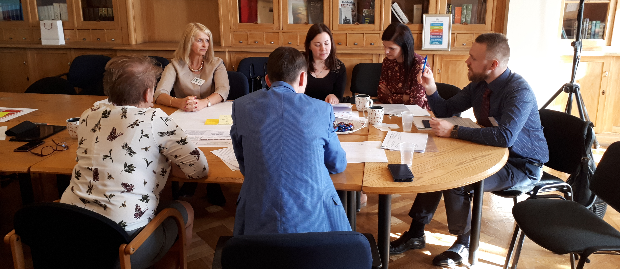
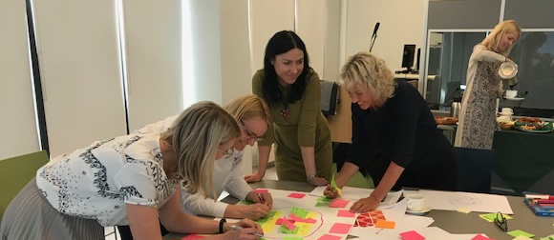
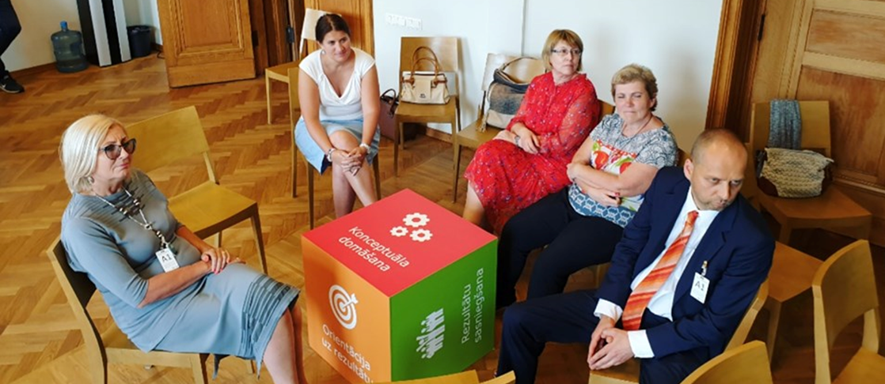
Project highlights
Supported
by
During the project all involved parties have drawn important lessons for future considerations. Project highlights and key challenges have been identified to share experience and propose areas for potential improvement in case if a similar project is executed.
#GovLabLatvia team – drivers and champions of public administration innovation
Team from the State Chancellery that is involved in managing #GovLabLatvia and leading the labs has become a driver and champions of public administration transformation and introduction of innovation. Their enthusiasm, high confidence in the innovative approach and willingness is the basis for spreading a positive message to a wider public.
Example on change of collaboration culture
#GovLabLatvia serves as a solid example on change of collaboration culture in Latvian public administration by promoting cross-sector, cross-institution and cross-department collaboration in developing solutions. To further advance collaboration, it is essential to expand the contact network and ensure that most relevant representatives are involved in the work of lab.
Introduction of the user-centric approach
User-centric approach has become a natural part of #GovLabLatvia. Visible changes in the mind-set of lab teams are observed after they engage with users and discover their perspective. It leads to increased willingness to develop a solution that addresses user pain points and are aligned with their needs.
Ownership of the issue and setting up teams accordingly
The project led to understanding that the most productive approach for achieving successful and sustainable result in lab work is selecting issues with a clear owner that is willing to dedicate resources for solving the issue and implementing the solution. The team of lab participants should accordingly be set up on basis of the specific issue selected to ensure that it is addressed by the most relevant participants. #GovLabLatvia used an approach to completely change the team composition prior to each new sprint according to the issue selected.
Communication of #GovLabLatvia
The State Chancellery has taken steps to promote #GovLabLatvia to the wider audience. #GovLabLatvia page in the website of the State Chancellery has been set up with a purpose of updating on most topical activities. In addition occasional social media activates have also taken place both from the profiles of state institutions (e.g. Cabinet of Ministers, Ministry of Economics) as well as from private profiles of #GovLabLatvia team and involved participants. Outreach activities have also taken place regardless of the project, e.g. participation in conversation festival LAMPA and creativity festival iNOVUSS.

Slide 5
Project challenges
Supported
by
During the project all involved parties have drawn important lessons for future considerations. Project highlights and key challenges have been identified to share experience and propose areas for potential improvement in case if a similar project is executed.
Lab operation alignment with the political agenda
By establishing innovation labs, the State Chancellery has taken steps towards fulfilling the Public Administration Reform Plan 2020. In the future perspective for sustainability of #GovLabLatvia, it is crucial to ensure a solid political support by aligning lab operations with political agenda. The lab should serve as framework for addressing issues of national importance in an user-centric manner.
First steps towards establishment of foundation for innovation lab in Latvia
The key focus of the project has been on establishment of user-centric methods and training the teams. Significant work should be carried out the develop country wide innovation strategy, define priority innovation fields, ensure successful development and implementation of results deriving from the labs and establish sustainable organisational foundations.
Homogeneity of lab teams
Lab teams have been relatively homogenous in terms of knowledge, skill-set and interests. It resulted in a limited ability and capacity to propose different solution options and produce solutions whose development requires specific skills. To enhance performance, it is recommended to form diverse teams and focus on possible added value of each team member. For a purpose of gaining insights on best practices it is essential to promote private sector involvement.
Participation limitations in work of the lab
Lab participants had limited capacities to dedicate substantial amount of time to work in labs due to other responsibilities. Thus, labs had to largely rely on input to be generated in workshops and on several enthusiasts that were willing and capable of carrying out additional tasks outside of lab workshops. To encourage participation, it is essential to develop motivation mechanism.
Limitations of technologies and environment
#GovLabLatvia had no dedicated physical space that could be used exclusively for purposes of lab work. Therefore, there were considerable limitations with regard to creation of innovation micro-environment by displaying topical information, ideas and solutions as well as storing information, materials, sketches, etc. Significant improvement possibilities relate to the provision of materials and technologies to improve the level of quality.
Use of analytical capacity
Resource constraints prevented full use of analytical capacity that is essential for discovery of the issue and generating ideas. With a purpose of enhancing capacity cooperation with academic and research institutions should be fostered.
Implementation of solutions deriving from innovation labs
Implementation of the solutions developed is expected to be the largest challenge for institutions as it will be necessary to balance expectations of lab with regard to solution concept and realistic implementation possibilities. Most of the prototypes are still in the stage of development within institutions and has not yet turned to the pilot. At a large extent it responds to the challenge of resource scarcity that hinders future activities and limited involvement of the lab to critically assess the proposed solution with regard to various facets (value proposition, risks, impact, implementation possibilities, etc.). Implementation opportunities are linked with the critical lesson learned about the ownership, meaning that the owner should set a rough frame for potential solution to ensure its implementation is realistic.

Slide 6
www.pwc.com
PricewaterhouseCoopers SIA, Kr. Valdemara iela 21-21, Riga, LV-1010, Latvia, LV40003142793
T: +371 6709 4400, F: +371 6783 0055, www.pwc.lv
PwC firms help organisations and individuals create the value they’re looking for. We’re a network of firms in 158 countries with more than 250 000 people who are committed to delivering quality in assurance, tax and advisory services. Tell us what matters to you and find out more by visiting us at www.pwc.lv
©2019 PwC. PwC refers to the PwC network and/or one or more of its member firms, each of which is a separate legal entity. Please see www.pwc.com/structure for further details.

