Slide 1
Neighbourhood watch
Communities that care: A community based approach to fraud prevention
August 2019
Notes:
Opening page: Keep the text hierarchy here. Title 120pt / Subtitle 72pt / Speaker 36pt

Slide 2
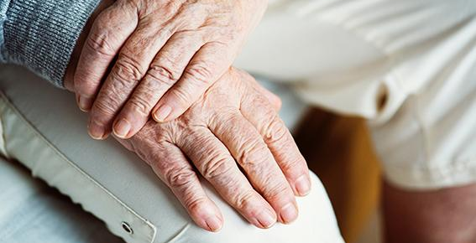
53% of over 65s have been victims of fraud
Older people are 54 times more likely to be a victim of fraud or computer misuse than they are robbery
Notes:
Pixelated image - not suitable

Slide 3
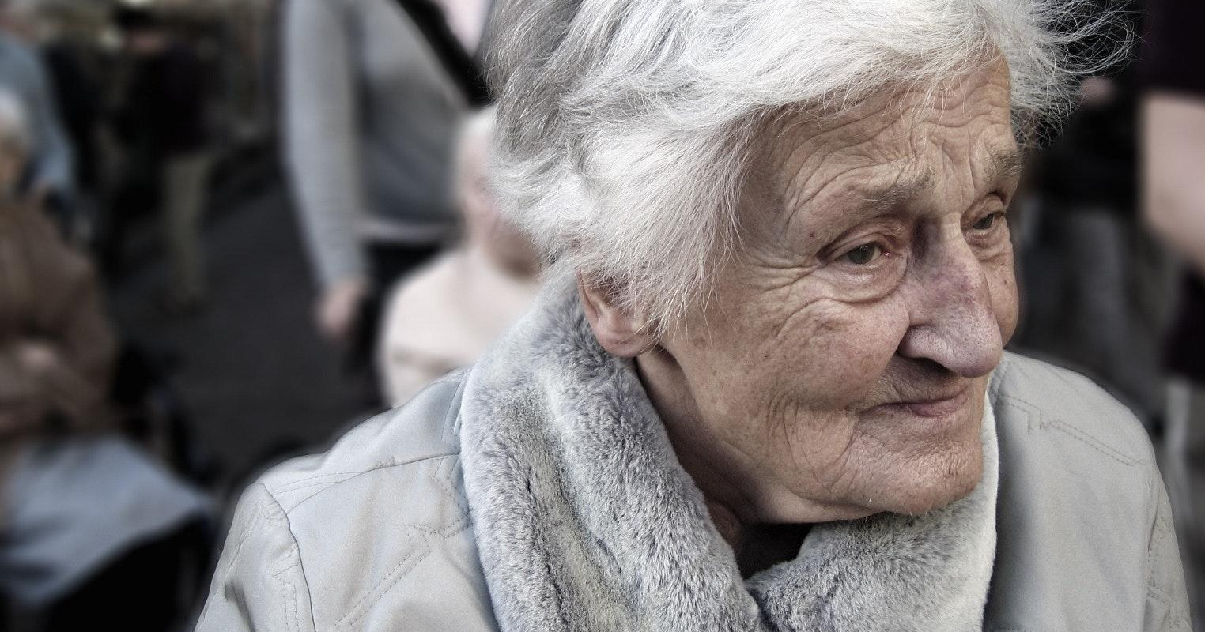
Long term impacts, especially for older people include
anxiety (82%), isolation (39%), lose confidence (79%)
Notes:
We spend time researching in homes, work places and on the street to understand what they need and how they like to access it.
Staff are service users too. We spend time researching internal systems to understand if how the service being delivered can be improved and made more efficient.

Slide 4
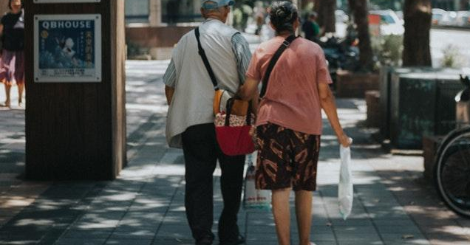
18% wouldn’t tell a friend of family member if they had been scammed
36% are unwilling to talk about their personal finances with loved ones. 79% would rather discuss death than money matters
57% of people worry about an older friend or family member falling victim to a scam or fraud
Notes:
We spend time researching in homes, work places and on the street to understand what they need and how they like to access it.
Staff are service users too. We spend time researching internal systems to understand if how the service being delivered can be improved and made more efficient.

Slide 5
How might we train NHW volunteers from existing schemes to advise and encourage older people (aged 65+) to better protect themselves from fraudsters and give practical and emotional support to older people who are victims of fraud and their support circle?

Slide 6
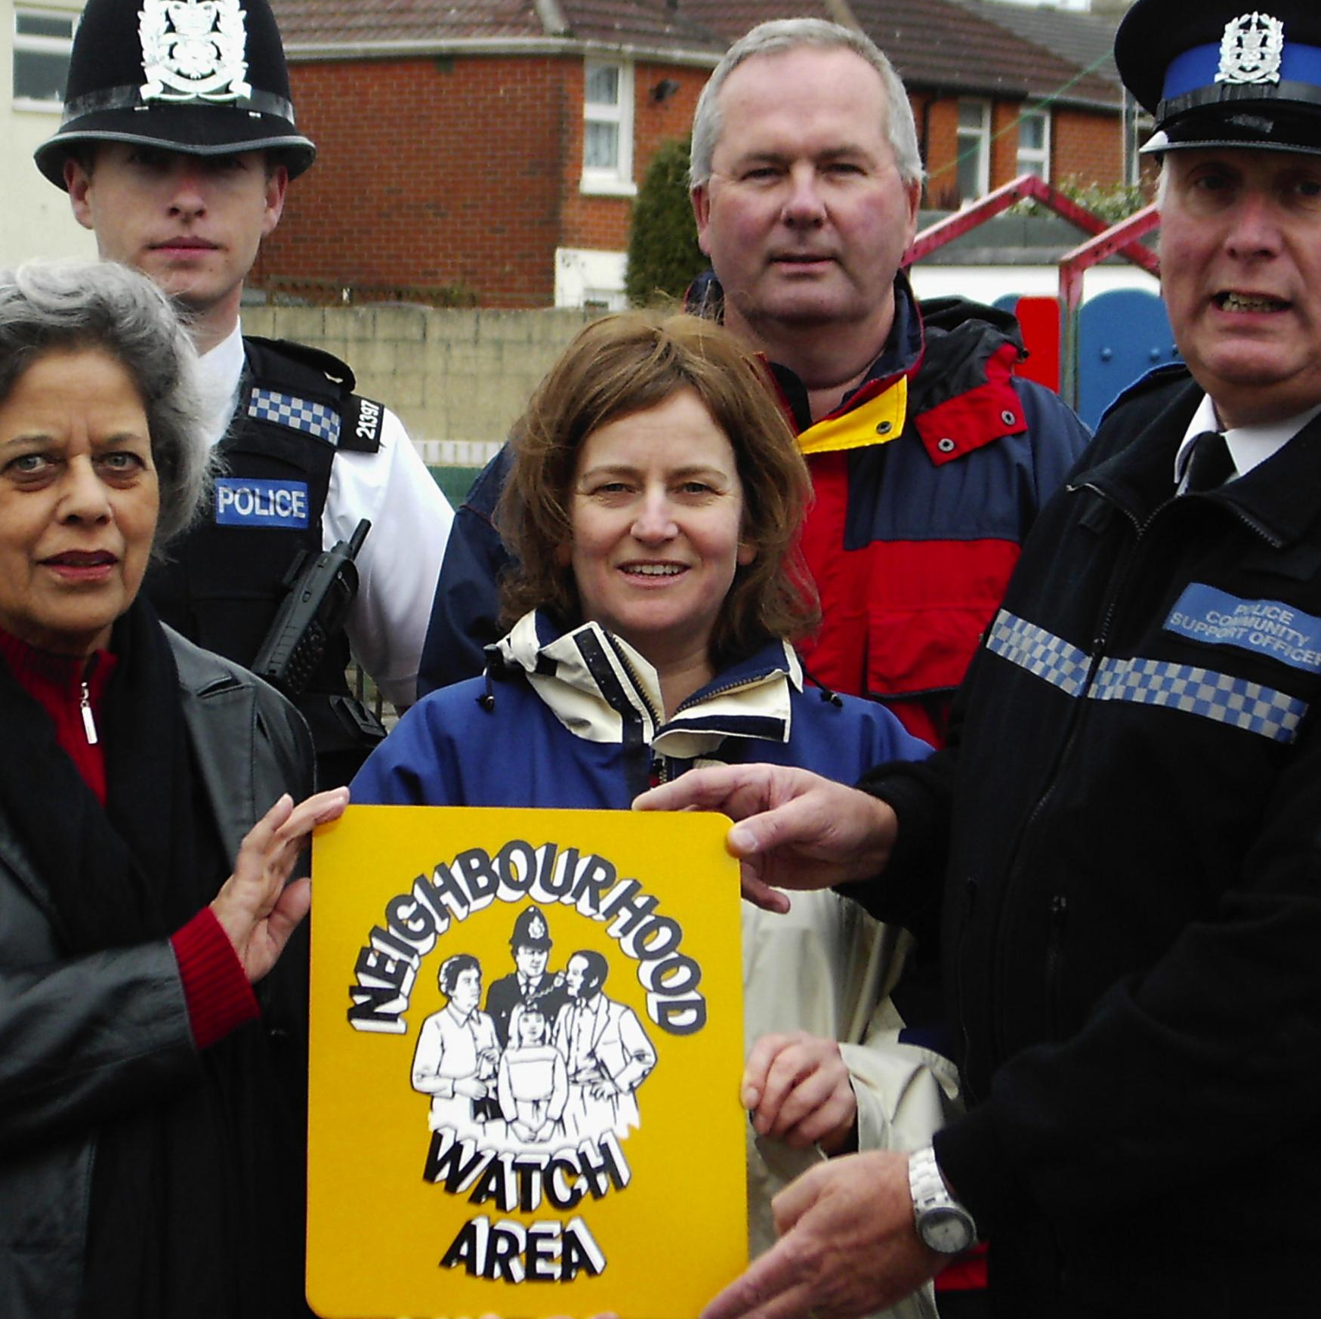
Research with schemes
In line with the 2018-2021 strategy, we will focus on supporting and developing existing ‘strong’ Neighbourhood Watch schemes (eg. Cheddington village) as a priority before extending the reach to new areas of high crime or deprivation.

Slide 7
Unaware
Aware
Areas of opportunity
We will focus on prevention and aftercare as the main points where the elderly require the most support.
Targeted
Crime
Report
Aftermath
Know

Slide 8
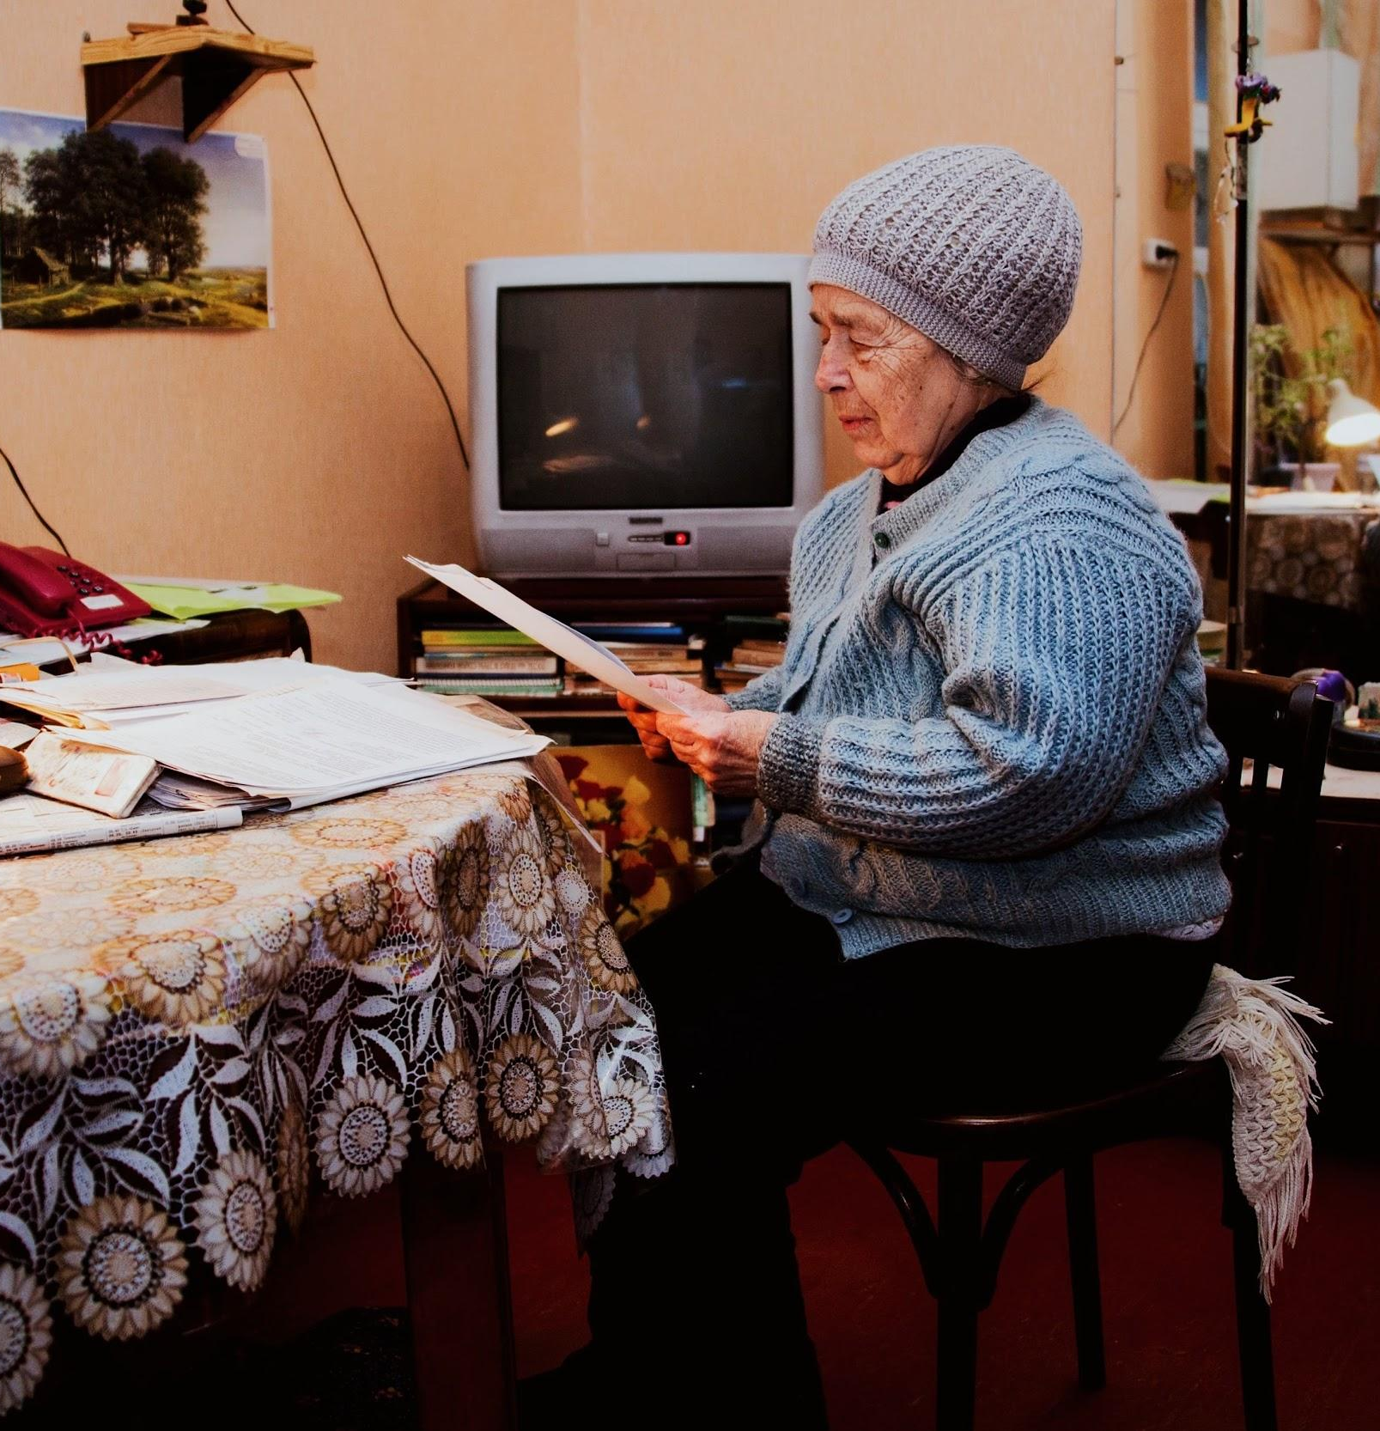
Higher risk groups
People aged 75/80+
This group often miss out on village email alerts and online information, advice and guidance, preferring face-to-face communication.
*Through raising awareness with this group, we believe other groups will be successfully signposted to existing support

Slide 9





Police / SNT
Mapping the
support network
If family aren’t nearby, or the elderly person doesn’t feel comfortable talking to them it is often a neighbour/passer by/visitor that picks up on something unusual and lets the family (or/and local NHW Watch coordinator) know.
Bank
Action Fraud
Friend/neighbour
Barry, 91
Daughter / Family member
Visitor (cleaner/ Gardner)
NHW volunteer
for elderly
NHW
Coordinator

Slide 10
User research

Slide 11
We spoke to
5
Older people with experience of fraud
2
Supporters
8
Neighbourhood watch volunteers
2
Police / SNTS
Notes:
Over the past 7 years we have honed our experience into not only providing service design expertise but ensuring our processes take organisations on the journey. Together we want to build design capacity across the organisation.

Slide 12
Overview of the research
In 1:1 interviews:
We asked elderly participants about their knowledge of Neighbourhood Watch, experiences around fraud and any practical and emotional support they had received or needed.
We asked volunteers about their roles, needs and expectations.
Notes:
Over the past 7 years we have honed our experience into not only providing service design expertise but ensuring our processes take organisations on the journey. Together we want to build design capacity across the organisation.

Slide 13
Older person
Holistic support
How can I feel comfortable to ask for help without fear of being seen as foolish or unable to cope
Learning about fraud
How can I find out more in a simple, concise and easy to understand way
Appropriate communication
How can I become and remain informed without email and access to the internet
Notes:
Page 2: In bold and at 90pt (paragraph style called ‘Large Statements/Opening Question’ within text formatting), try opening presentation by asking your audience a simple, short question.

Slide 14
Supporter
Offering support
How can I offer support to family/friends/neighbours who may not know they are at risk
Fraud confidence
How can I feel confident with the information I am passing on
Sensitive conversations
How can I initiate difficult conversations without frightening or seeming patronising
Notes:
Page 2: In bold and at 90pt (paragraph style called ‘Large Statements/Opening Question’ within text formatting), try opening presentation by asking your audience a simple, short question.

Slide 15
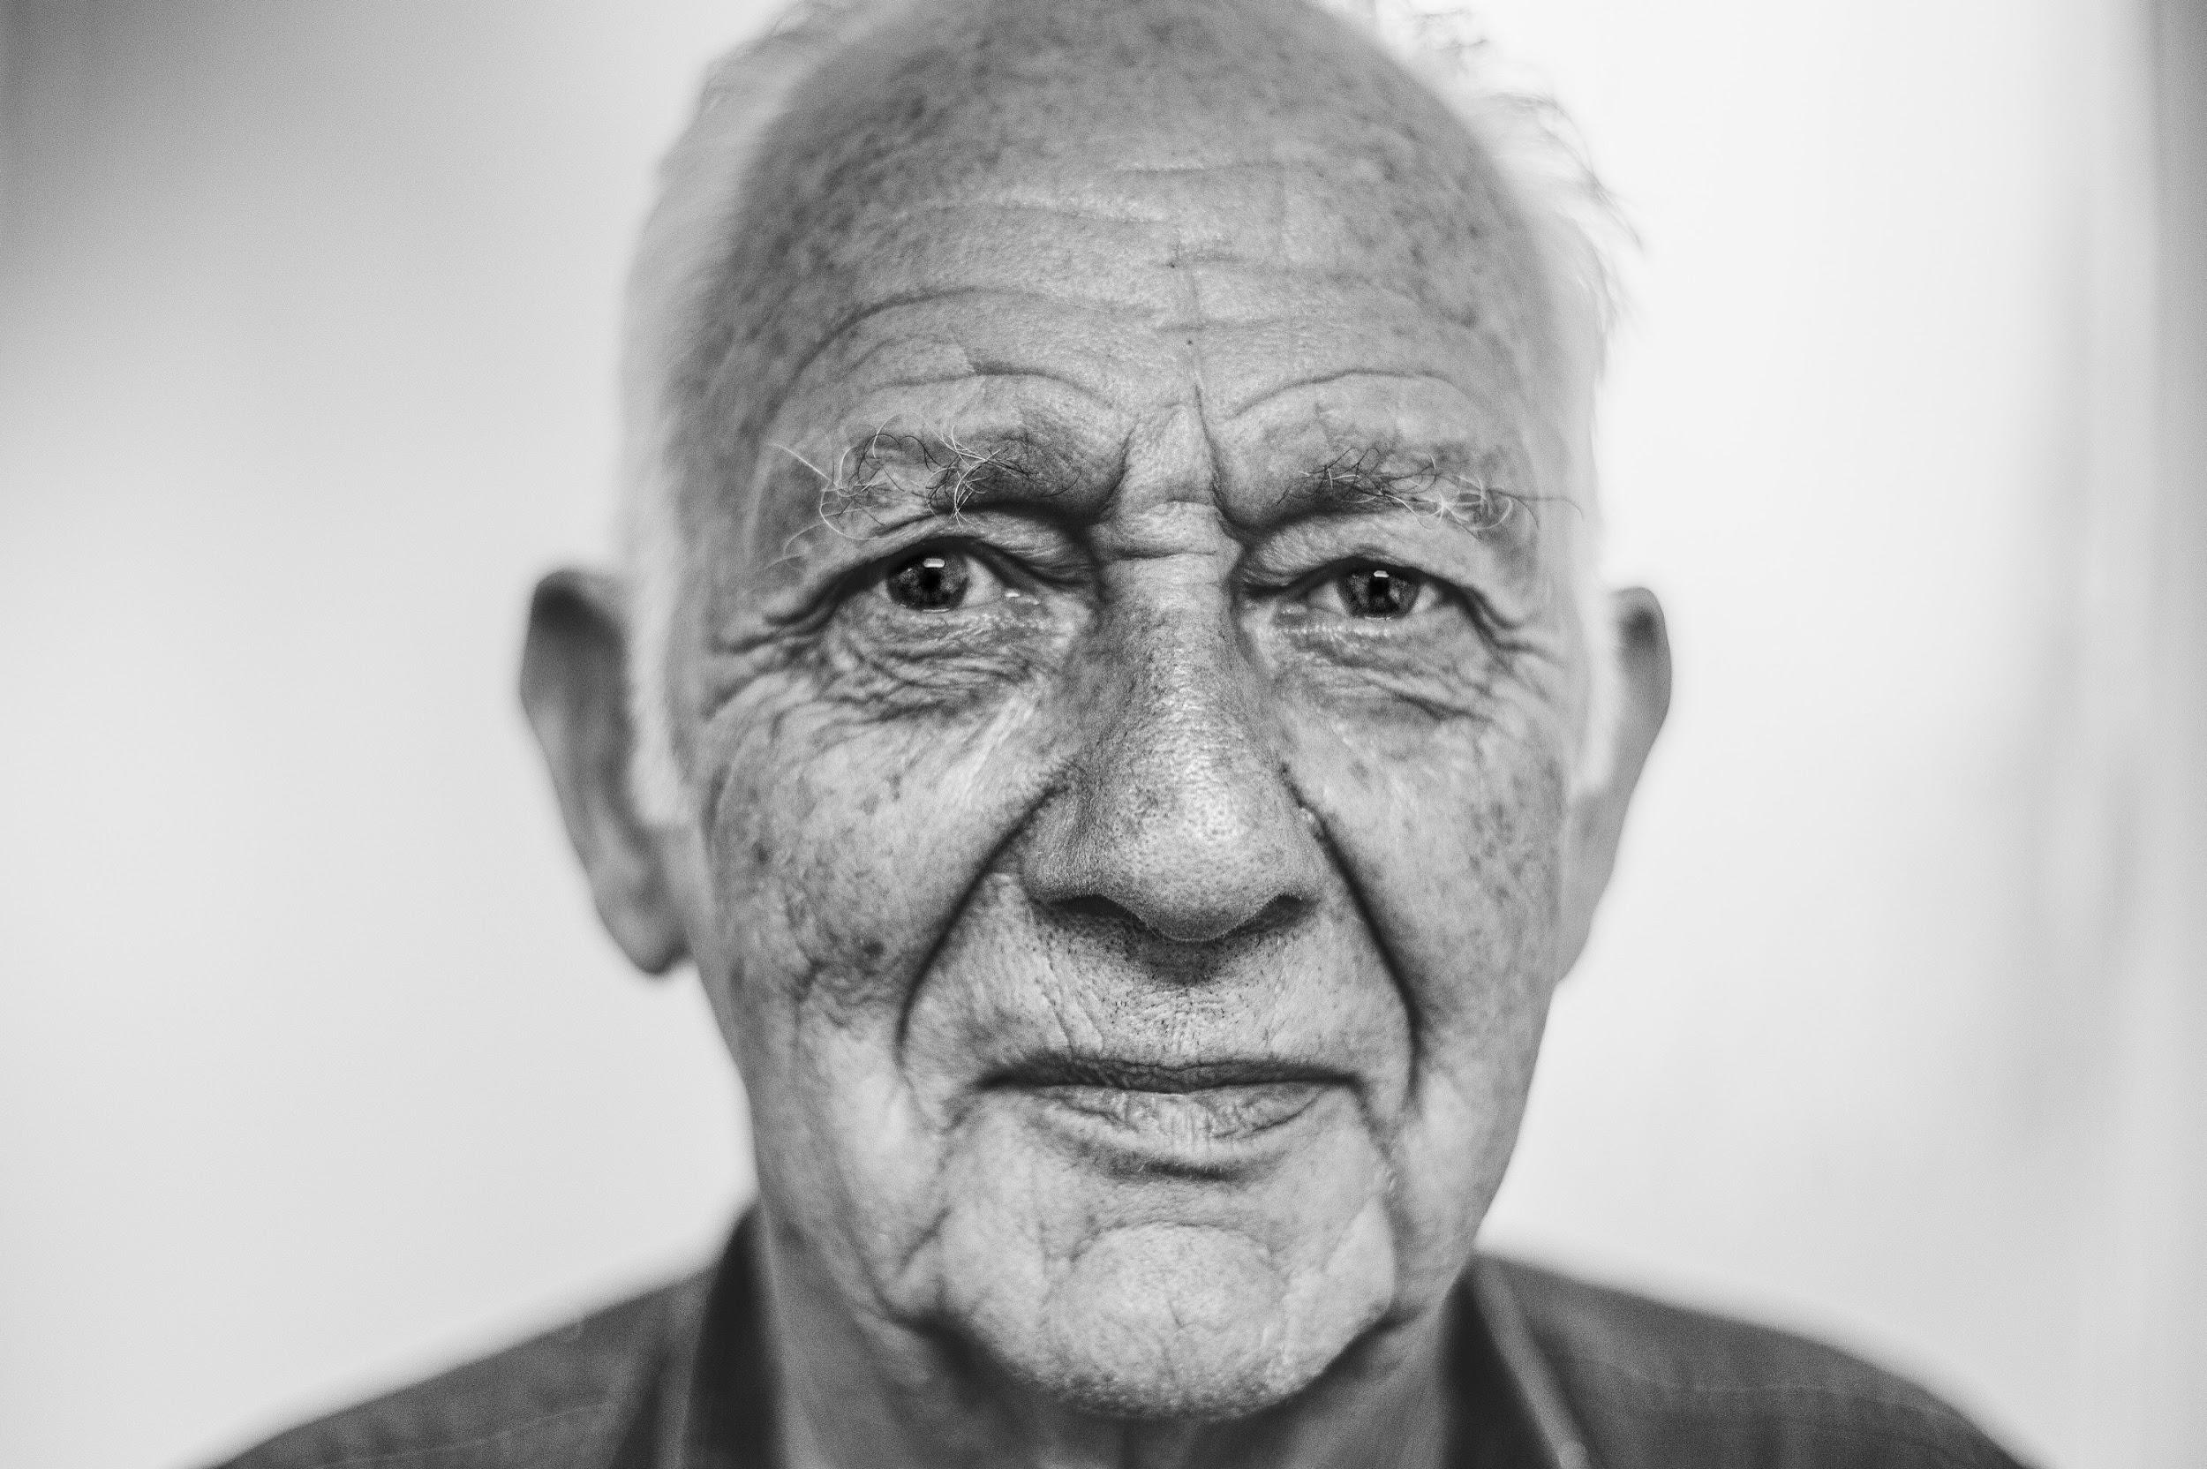
Personas
Needs:
To understand how to be more vigilant
To view speaking out as a way of preventing fraud and not a sign of weakness
To have a trusted support to hand/a phone call away
Wants:
To remain independent and dignified
Old fashioned, personalised communication, help from somebody he trusts
To know only what he needs to so he is not overwhelmed
Not be patronised or made to feel stupid or foolish
Pain
points:
Doubt in himself and loss of confidence
Avoiding phone calls of “unpleasant people selling things that don’t exist”. This adds to feelings of isolation
Worry relatives won’t be able to get through if he doesn’t pick up his phone
Worried about being without cash for 5 days after his bank cancelled his card
Name:
Age:
92
Bert
Clevedon, Bristol
Lives:
Victim
Recently widowed and lives alone. Keen gardener, energetic and independant. Uses his iPad to FaceTime his grandchildren.
They would say:
“
About:
I’m sorry you’ve had to help me with this… it was foolish of me. I’ll be fine!
”
Story:
A cold caller sold Bert a non-existent call blocking service for £600. Having fallen victim to one scam, he was now being targeted by others. Whilst his son was visiting the phone rang and he realised his father had been avoiding phone calls.
Scale of tech knowledge?
Circle where they are on the scale
No interest or knowledge in technology / Other people do it for me
Okay and vaguely confident
Very active and confident with technology
Notes:
He discovered that a cold caller had sold her a non-existent call blocking service for £600. Having fallen victim to one scam she was now being targeted by others. She felt too embarrassed to tell anyone and simply stopped answering the phone.

Slide 16
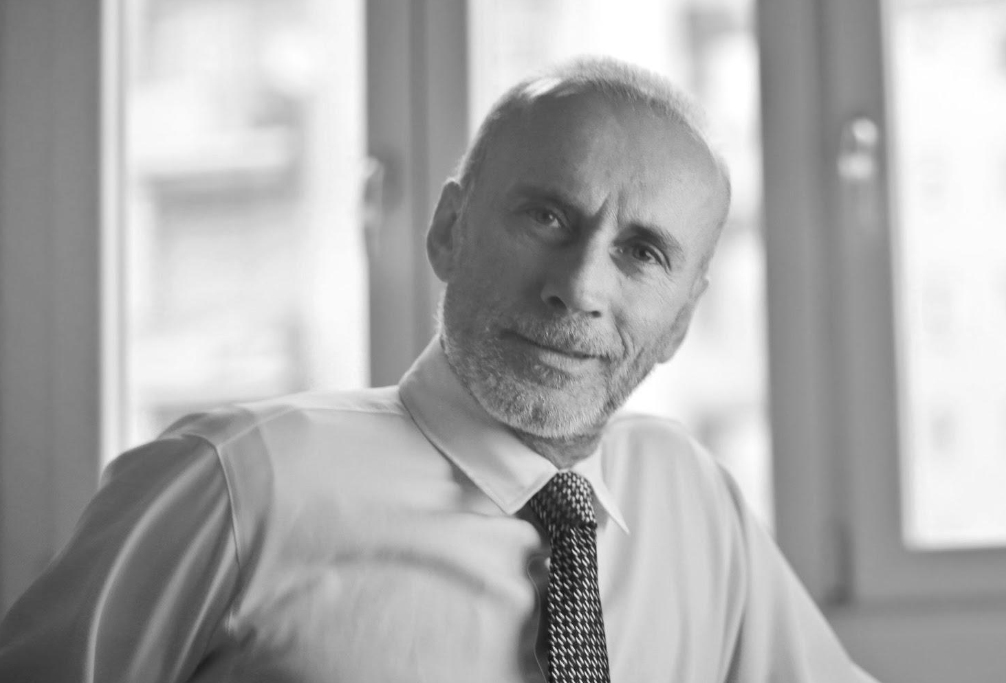
Personas
Needs:
To be aware of fraud, the likelihood of his elderly father being targeted and how he can help
To know what to do if he suspects his father is being targeted by fraudsters
To know how to support him and report it if he is a victim
Wants:
To know he there is a friendly face in his father’s community that can be there when he is not
To know how to facilitate a conversation with him without being patronising and what information to pass on
Pain
points:
Lives far away from his dad and is aware he cannot always be on hand to help with the little things each day
Getting his father to open up emotionally to him or his wife about what is worrying him
Offering him help or advice without coming across patronising
Name:
Age:
56
Andy
London
Lives:
Supporter
They would say:
“
About:
Family man with grown up kids, working in London, tech confident. Lives an hour away from his elderly father, worries about him and he and his wife try to visit often.
Don’t worry dad, it’s very common. We’ll sort it out so you stop receiving so many calls
”
Story:
Whilst visiting his Father he noticed that he was receiving a lot of calls and not answering them or hanging up quickly saying: “unpleasant people are trying to sell me things that don’t exist”.
Scale of tech knowledge?
Circle where they are on the scale
No interest or knowledge in technology / Other people do it for me
Okay and vaguely confident
Very active and confident with technology
Notes:
He discovered that a cold caller had sold her a non-existent call blocking service for £600. Having fallen victim to one scam she was now being targeted by others. She felt too embarrassed to tell anyone and simply stopped answering the phone.

Slide 17
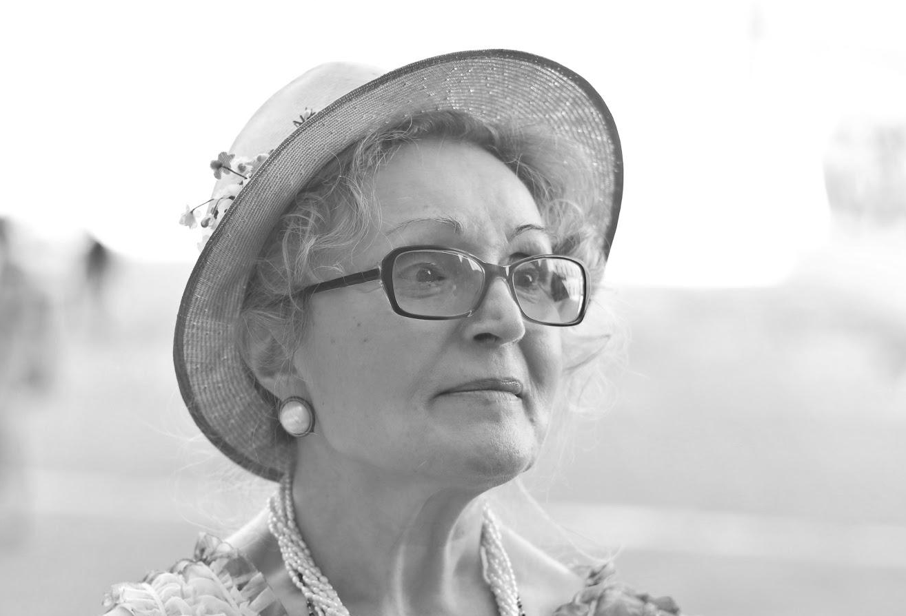
Personas
Needs:
The time, resources and tools to facilitate appropriate face-to-face conversations with vulnerable elderly residents
A strong NHW chair, network and support
Respect from and a strong relationship with the police
Wants:
To foster a welcoming and friendly environment
Build trust with isolated elderly neighbours and offer the face-to-face emotional support that they need
The confidence to teach others about fraud
Pain
points:
Reaching older victims who don’t speak out
Lack of knowledge around the latest, up-to-date and local cases of fraud
Knowing what information to pass on. Filtering wordy and overwhelming 40 page support guides
Name:
Age:
60
Jo
Coordinator
Lives:
Manton, Rutland
Recently retired teacher, active member of the community and has lived in the village 27 years. Her children have left home and elderly mother lives nearby.
They would say:
“
We send alerts but only pass on what feels right as we don’t want to scare the elderly
About:
”
Story:
Scale of tech knowledge?
Circle where they are on the scale
Jo looks after 20 or so houses on her street. She has introduced herself, taken emails from residents and now forwards on newsletters, updates or alerts. She is a friendly go-to face for older residents.
No interest or knowledge in technology / Other people do it for me
Okay and vaguely confident
Very active and confident with technology
Notes:
He discovered that a cold caller had sold her a non-existent call blocking service for £600. Having fallen victim to one scam she was now being targeted by others. She felt too embarrassed to tell anyone and simply stopped answering the phone.

Slide 18
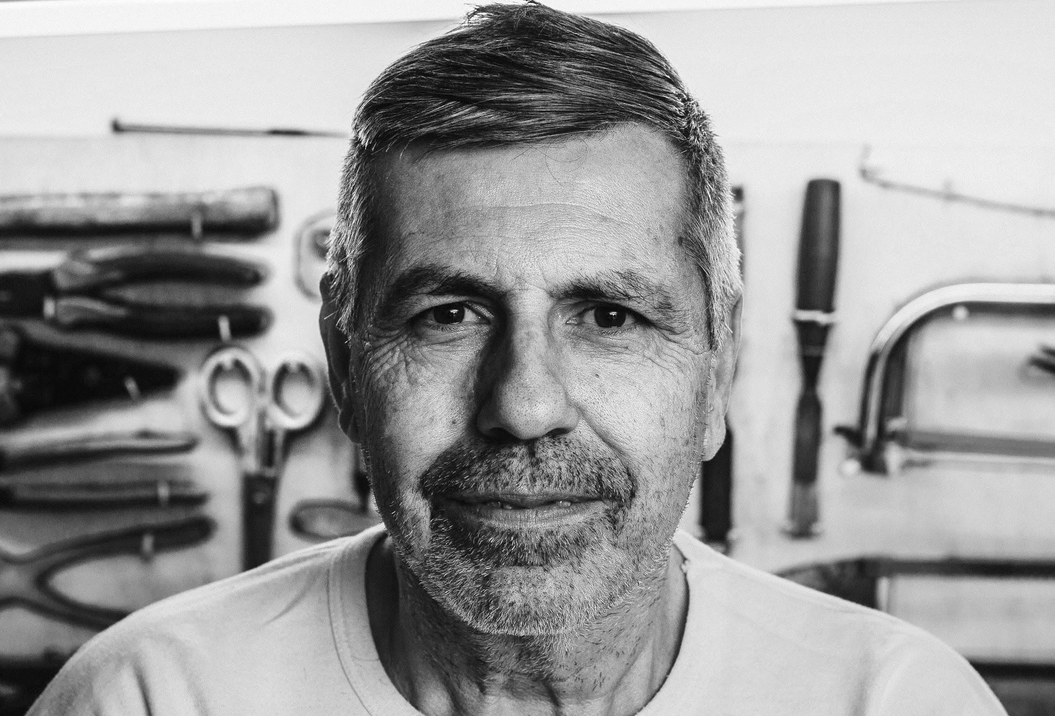
Personas
Needs:
Specific tasks that he can help with but don’t take up too much of his time
A quick easy way to feed back local intelligence to the lead coordinator
Wants:
To send factual emails and leaflets that give practical advice on how to stay safe
Report anything out of the ordinary to the group and know the chair will act on it and has a good relationship with the police
Pain
points:
Cold calling on neighbours doors to initiate a face-to-face chat - he doesn’t know what to say
Lack of knowledge around the latest advice to be giving
Unnecessary NHW meetings can feel like a WI group
Knowing the best way to offer advice to a wide variety of people in the village
Name:
Age:
62
Jim
Coordinator
Lives:
Manton, Rutland
“
Local farmer and an active member of the community. A go to man who helps with odd jobs and practical advice. Hears a lot in the pub and knows a lot of people.
They would say:
We all have different strengths in the group, I don’t tend to do door knocking
About:
”
Story:
Scale of tech knowledge?
Circle where they are on the scale
Used to be more involved but women seem to get a better response at the door. He goes to the meetings and helps his wife when she needs it by passing along relevant emails and getting involved with the odd leaflet drop.
No interest or knowledge in technology / Other people do it for me
Okay and vaguely confident
Very active and confident with technology
Notes:
He discovered that a cold caller had sold her a non-existent call blocking service for £600. Having fallen victim to one scam she was now being targeted by others. She felt too embarrassed to tell anyone and simply stopped answering the phone.

Slide 19
Prototypes
Notes:
Page 2: In bold and at 90pt (paragraph style called ‘Large Statements/Opening Question’ within text formatting), try opening presentation by asking your audience a simple, short question.

Slide 20
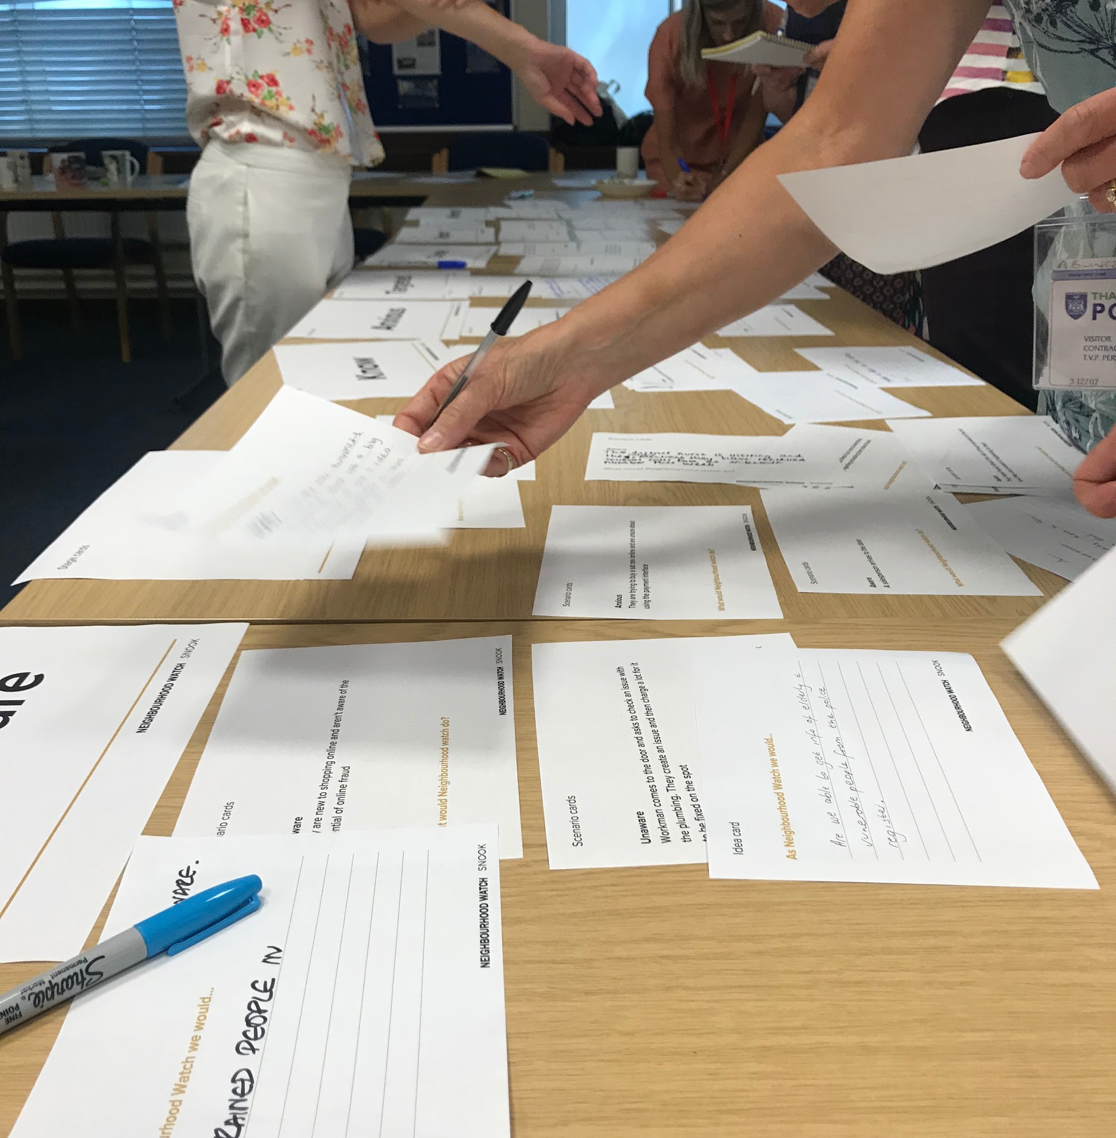
Co-design workshops
Through co-design workshops we created ideas of how Neighbourhood Watch could support these personas
at various stages of their
fraud journey.
Notes:
Over the past 7 years we have honed our experience into not only providing service design expertise but ensuring our processes take organisations on the journey. Together we want to build design capacity across the organisation.

Slide 21
Police / SNT
A joined up
support network
A useful contact list that the NHW coordinators receive from the police when they are setting up a group, makes sure they link up with partners such as Trading Standards who provide information and training on fraud and encourage a Scam Marshall role.
Bank
Action Fraud
Daughter / Family member
Barry, 91
Scam Marshall
Friend/neighbour
NHW local
Coordinator
Local Trading Standards
NHW volunteer
for elderly
National Trading Standards

Slide 22
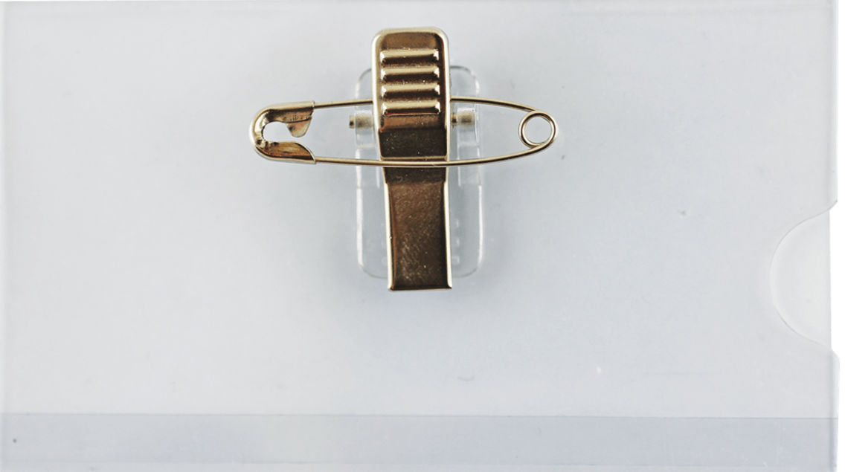
ID badges issued by police (DBS approved?) that volunteers can wear whilst out and about or at meetings to prove their identity.
We believe that…
This will give coordinators confidence to cold call and
reassure residents that they are working with the police
and can be trusted.
To find out this is true we will…
Give badges to coordinators/volunteers to wear whilst visiting residents or out and about in Cheddington village
And measure…
The cold calling response when the same volunteer is wearing a badge and not wearing a badge
How often volunteers are approached and asked
questions whilst wearing the badge
Coordinator ID Badges
Notes:
Notes: Make sure this is checked over by someone. Fresh eyes!
Check master slide for common misspellings

Slide 23
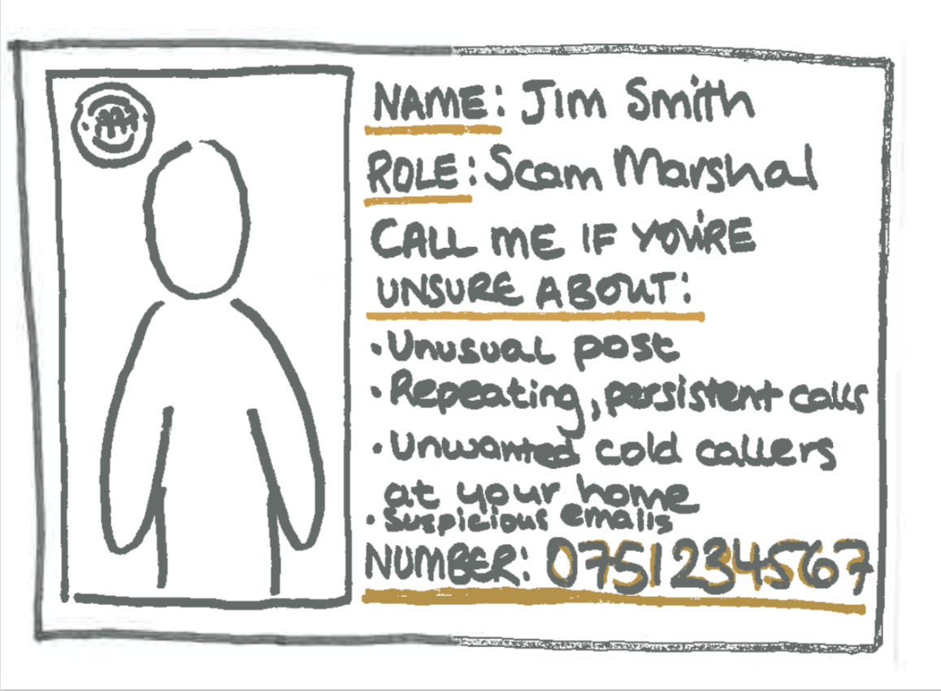
Calling cards that can be left with an elderly resident with emergency contact number of their local volunteer/fraud marshall. [Space to write in their next of kin numbers?]
We believe that…
This will encourage elderly residents to call when they are unsure or have questions about fraud.
To find out this is true we will…
Give coordinators/volunteers in Cheddington calling cards to leave with people in their area and encourage vulnerable elderly residents to leave by their phone in case of emergency
And measure…
Improved awareness of the right person to contact
Increased recognition and acknowledgement of local coordinator
Increased calls to local coordinator in an emergency
Coordinator calling cards
Notes:
Notes: Make sure this is checked over by someone. Fresh eyes!
Check master slide for common misspellings

Slide 24
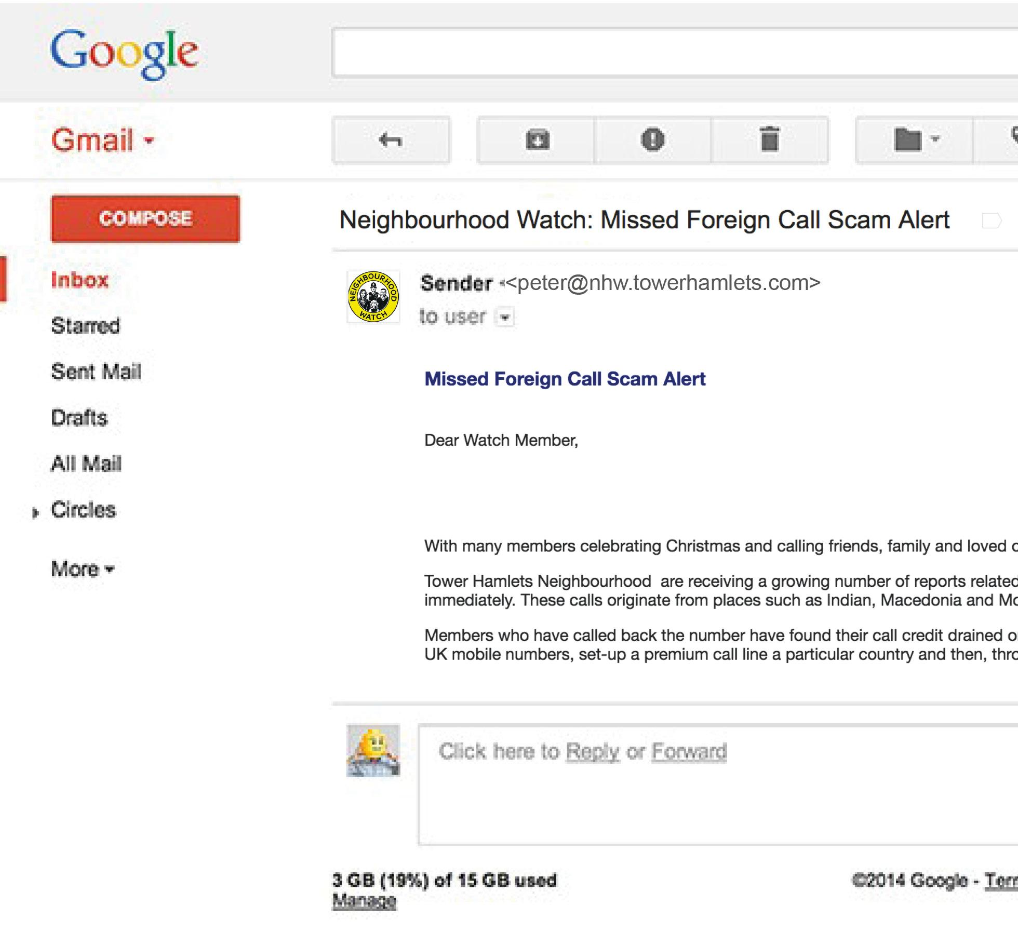
Each coordinator should get an official Neighbourhood
Watch email address to communicate with residents and
each other. A local group email list could be created for all
volunteers in the area.
We believe that…
This will give coordinators a sense of authority and reassure residents that they are working with the police and can be trusted.
To find out this is true we will…
Send the emails from NHW email addresses including those that require a response
And measure…
Increased number of people opening the email
Increased response rate for messages needing a response
Increased willingness to exchange details
Coordinator Email addresses
Notes:
Notes: Make sure this is checked over by someone. Fresh eyes!
Check master slide for common misspellings

Slide 25
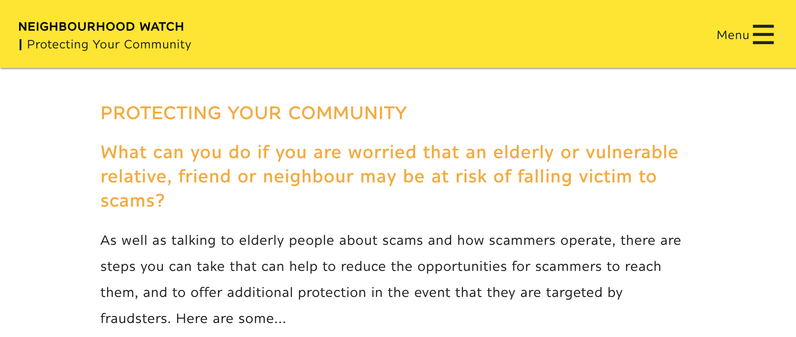
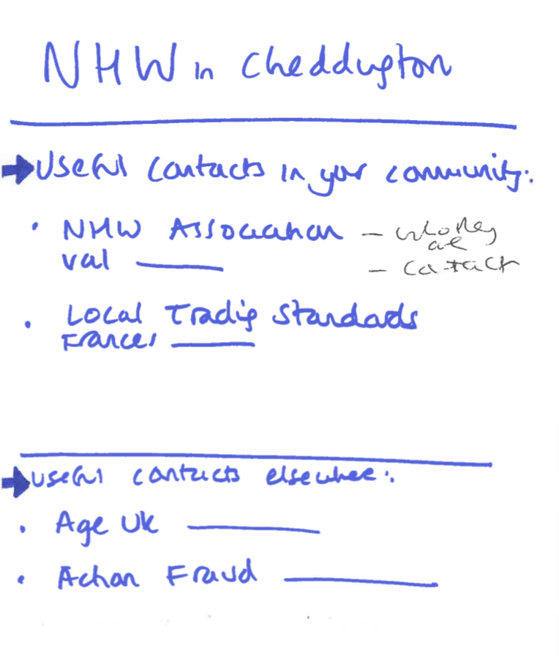
A list of local agencies, partners and contacts on sign up from
the Police. Local and national contacts with some information
on who they are and when they might be useful. [Email, printed leaflet]
We believe that…
Neighbourhood Watch groups are often unaware of other local
groups nearby that may be useful to them or people in their area.
As groups are created from the ground up, they would benefit
from more advice and guidance from NHW and the police,
particularly new groups.
To find out this is true we will…
Create a list with the police contact in Aylesbury and get feedback from volunteers in Cheddington Village.
And measure…
How many local groups police are aware of that volunteers are not
How many volunteers are passing on or refering to partners/agencies
Useful contacts list
Notes:
Notes: Make sure this is checked over by someone. Fresh eyes!
Check master slide for common misspellings

Slide 26
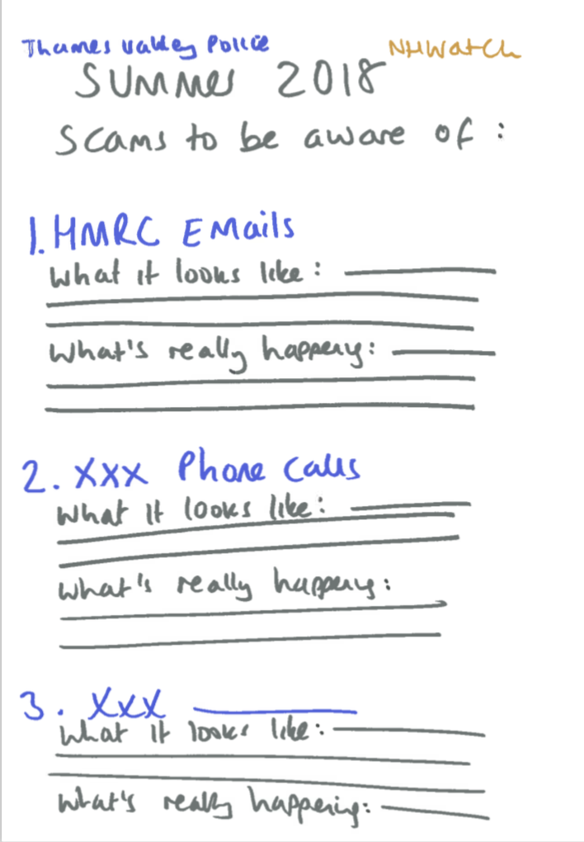
Top 10 scams list from the key contact in the Police (NHW & Community Messaging Coordinator) produced for/with the Neighbourhood Watch lead coordinator. Updated every quarter(?) or as the scams change. [Email, social media, printed leaflet]
We believe that…
Being aware of the latest scams mean that NHW coordinators can prompt and remind people to be aware and stay safe. All people including the vulnerable elderly residents can keep an eye out for the most common scams going around.
To find out this is true we will…
Create one with the police contact in Aylesbury and volunteers in Cheddington Village. Circulate and send to members of the village.
And measure…
Positive response by website, email and leaflet drop
Increased Fraud discussion and questions
Scams to look out for

Slide 27
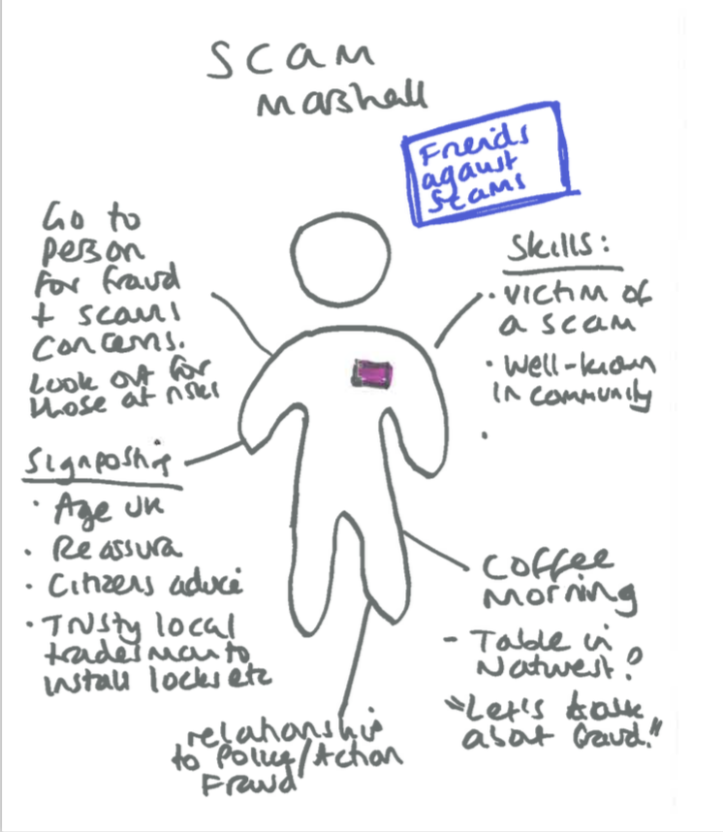
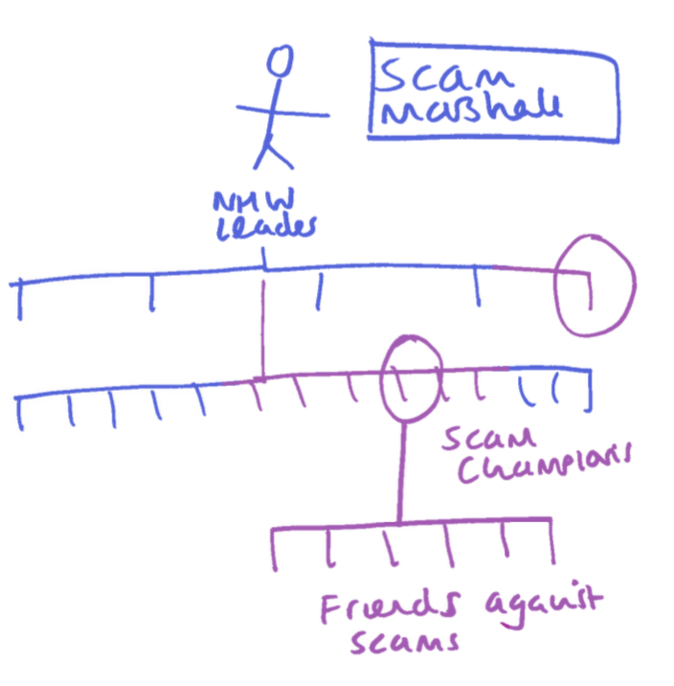
Linking in with Trading Standards to create a village “Scam marshall” role. A volunteer who has been targeted and now wants to share their own experiences and help others to recognise and report scams, acting as the go-to-person about fraud related issues. Tap in to fraud training
We believe that…
This will highlight the importance of fraud. It will give the
community a go-to friendly face who they can build up
trust with and allow the chosen volunteer to have a clear
focus and hone their skills.
To find out this is true we will…
Trial a ‘scam marshall’ role in Cheddington village.
And measure…
How many people put themselves forward as a
marshall.
How many people come forward with questions and
experiences relating to fraud.
Scam Marshall volunteer role
Notes:
Highlight the scale of the problem by getting communities and the nation talking about scams.
Change the perceptions of why people become scam victims.
Prevent people from becoming or continuing to be a scam victim by providing more adequate support.
Recruit people to join the fight against scams to make this a scam-free nation

Slide 28
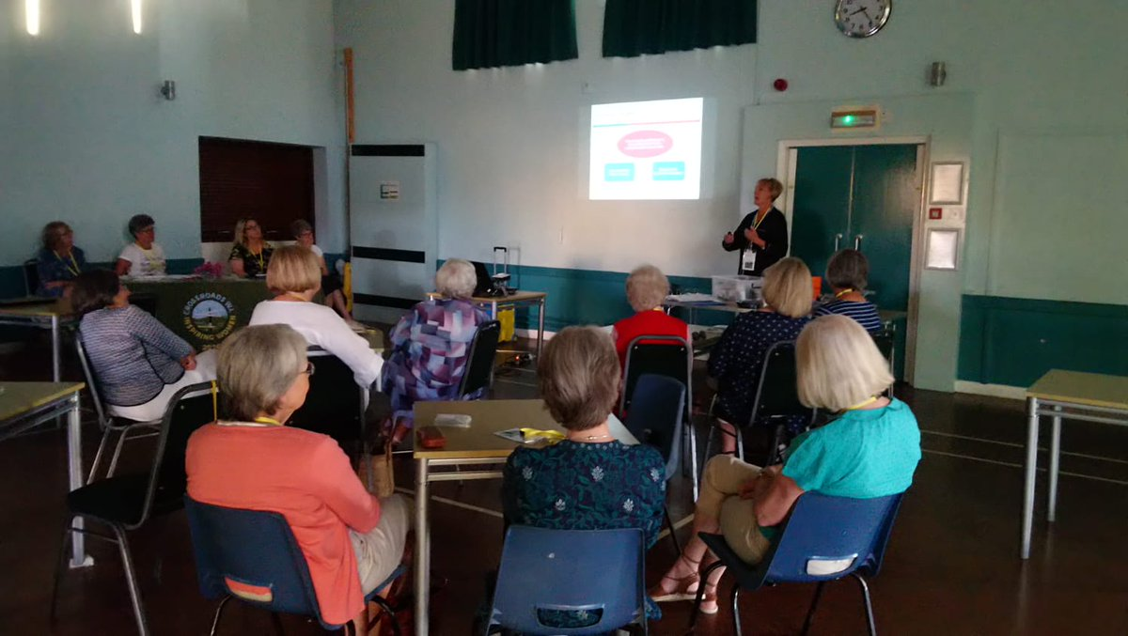
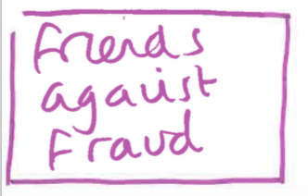
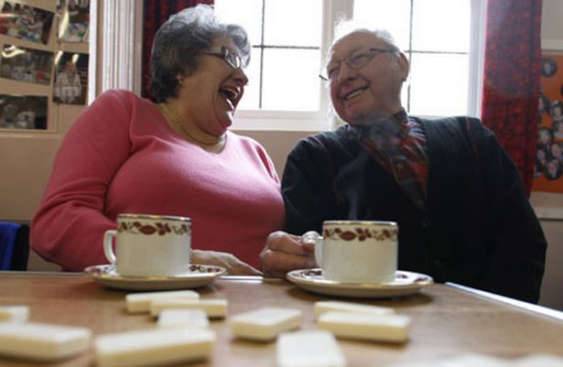
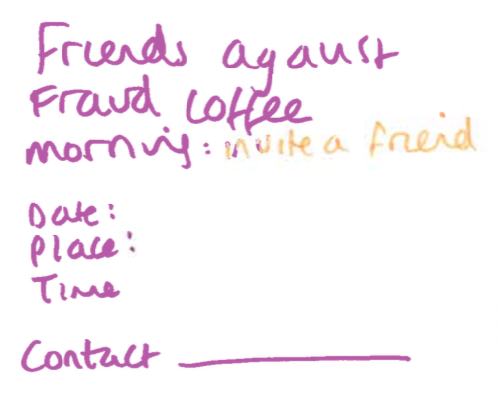
Run by the Scam Marsall. People who have been targeted or just those who want to raise awareness can join a ‘Friend against fraud’ group. Wearing a badge will encourage discussion about fraud. Option to meet up to discuss any concerns, learn how to stay safe and help raise awareness.
We believe that…
Being targeted or a victim of fraud can cause a loss of confidence, increase in isolation and anxiety. A social group with a badge will encourage people to ask questions.
To find out this is true we will…
Trial an event of some kind hosted by the ‘Scam marshall’ launching the ‘friends against scams’ group and badges.
And measure…
How many attendees come to events, invite others and request badges.
Friends against fraud group

Slide 29
A toolkit encouraging and supporting people to look out for their vulnerable friend, relative or neighbour who may be at risk of falling victim to scams. The kit can help to initiate a difficult conversation, offering emotional and practical advice without being frightening or patronising.
We believe that…
57% of people worry about an older friend or family member but many don’t know how to approach the conversation and worry it will frighten them.
To find out this is true we will…
Simulate a conversation between a family member and then a NHW volunteer with an elderly person in their home, using the packs
And measure…
How many people agree to use the stickers in their home
How many people report an increase in awareness of fraud
How many packs are requested
‘Talk about fraud’ toolkit
Where to start:
Initiating a non scary chat
Show don’t tell:
Friendly hero video, contemporaries
discussing experiences honestly
Download ‘tea for 2 pack’

Slide 30
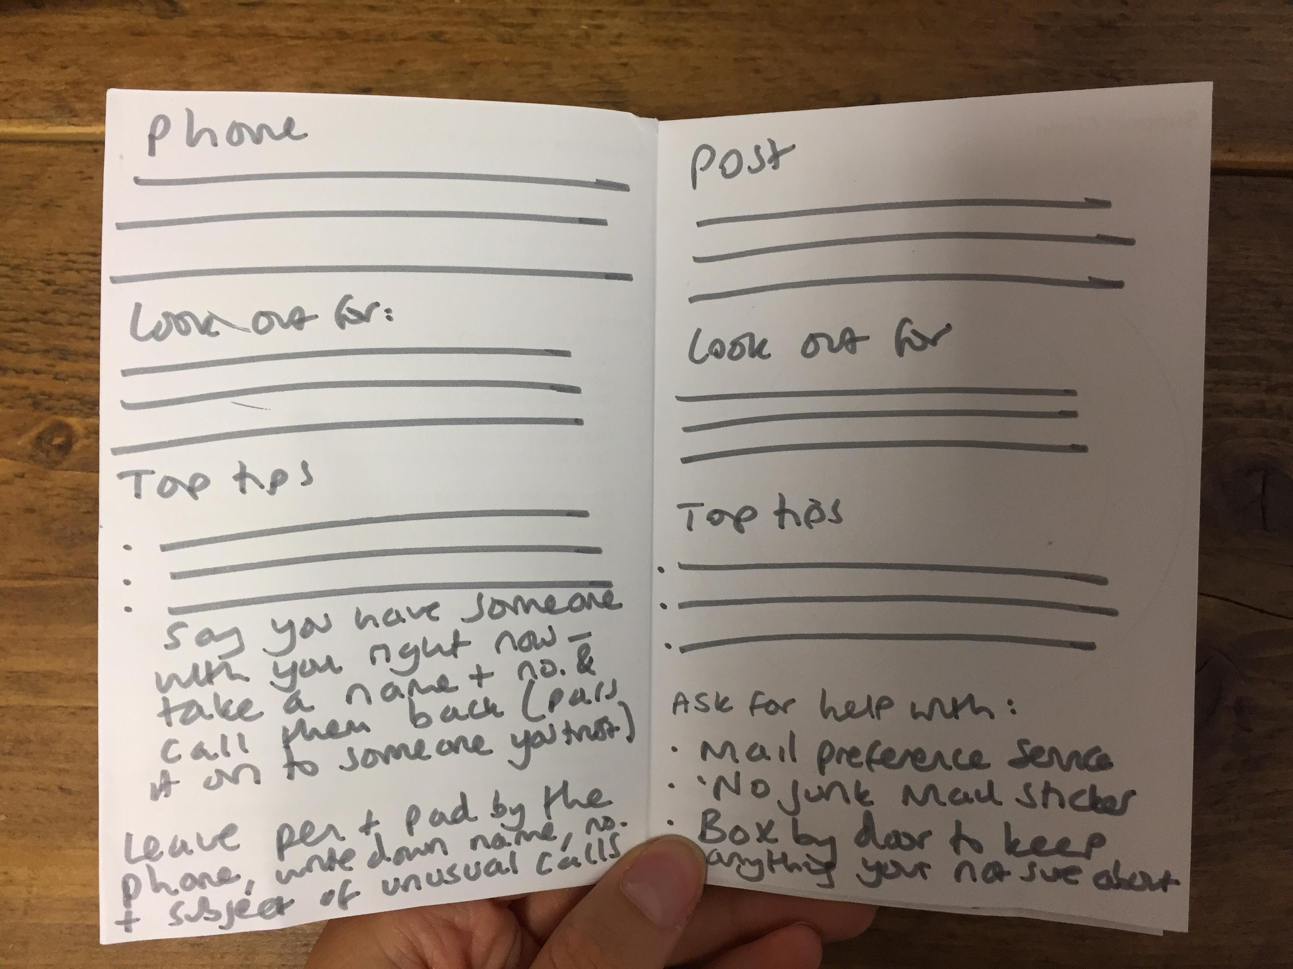
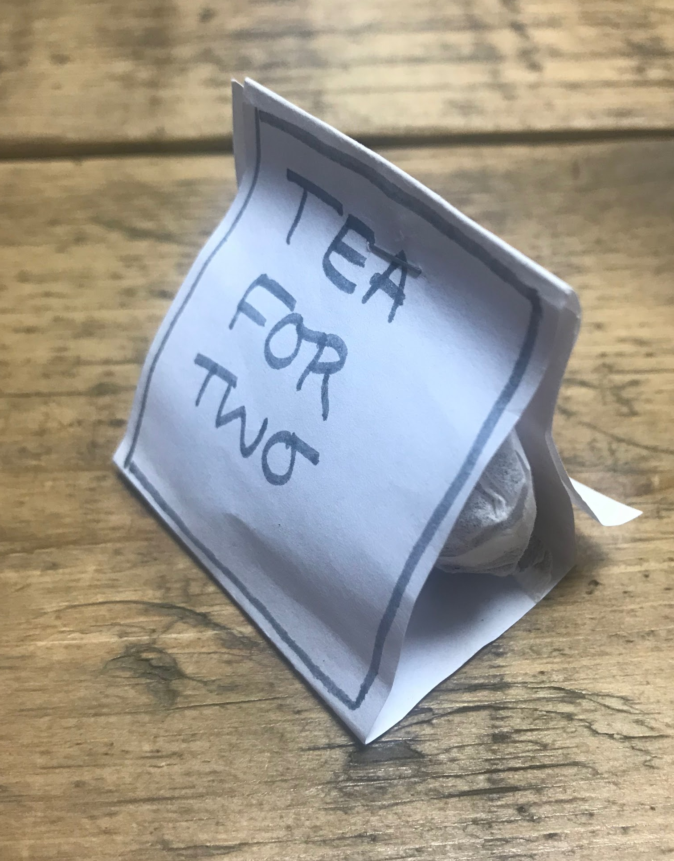
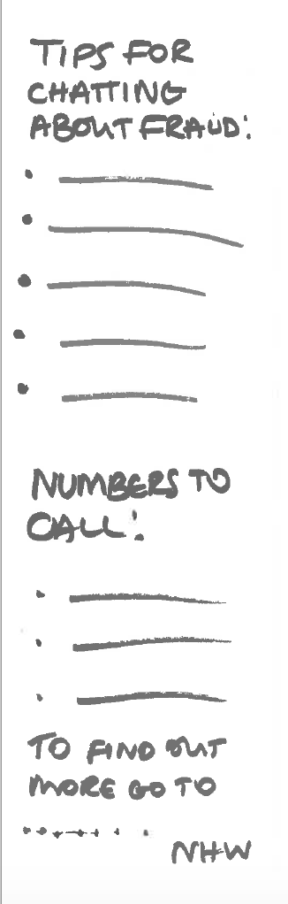
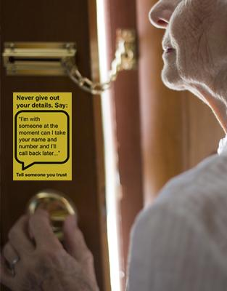
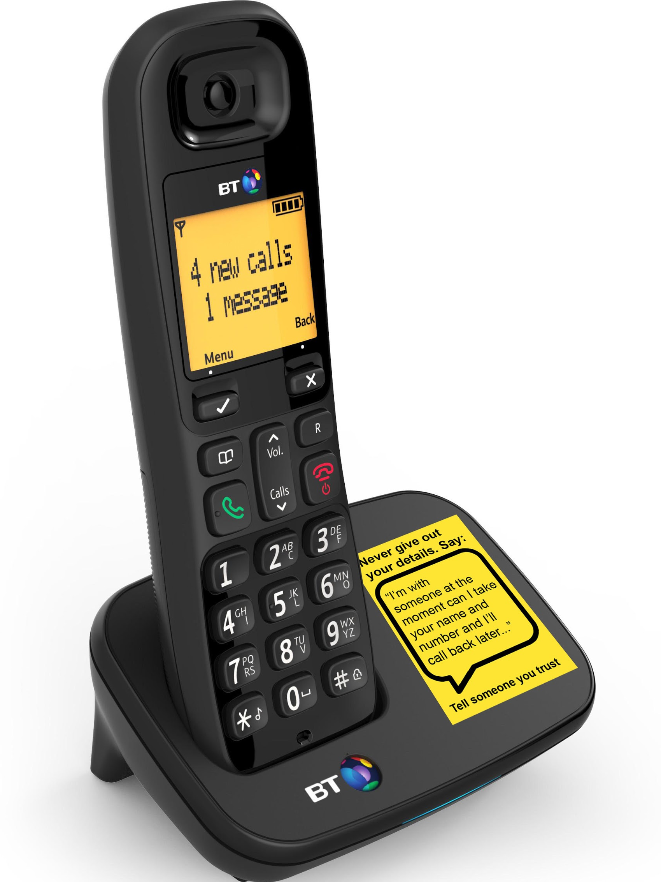
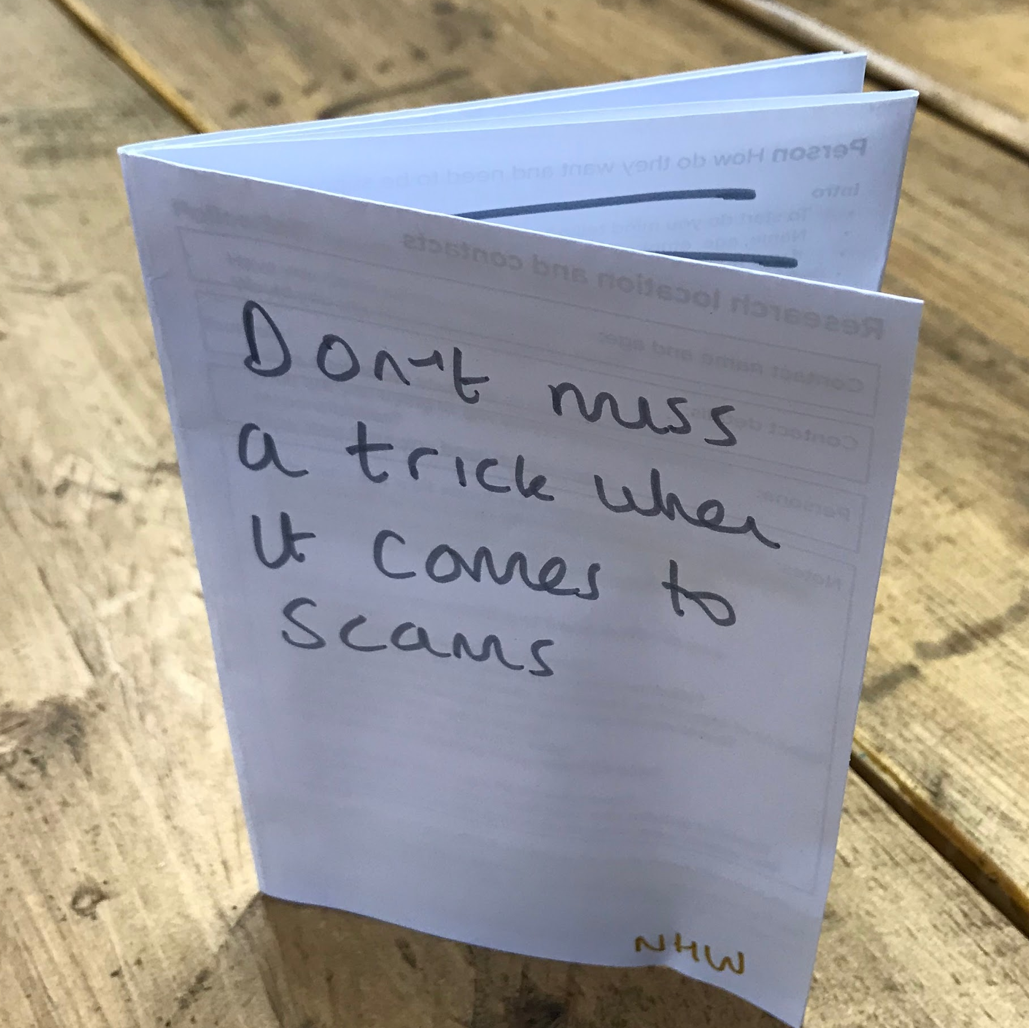
‘Talk about fraud’ toolkit
‘Tea for 2’ teabags with ice breaker and conversation tips
Reminder stickers to place round the home together
[Say “i’m with someone at the moment can I take your name and number and i’ll call you back” Tell someone you trust]
Simple, concise booklet to leave with the elderly person to read more information. Contacts on the back

Slide 31
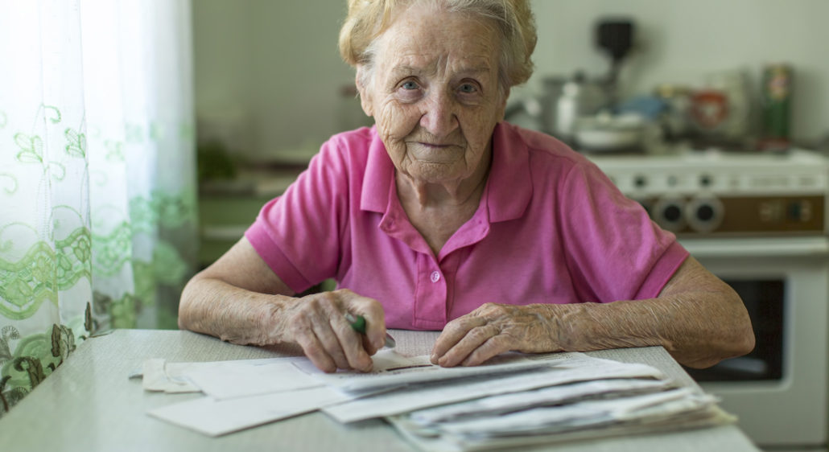
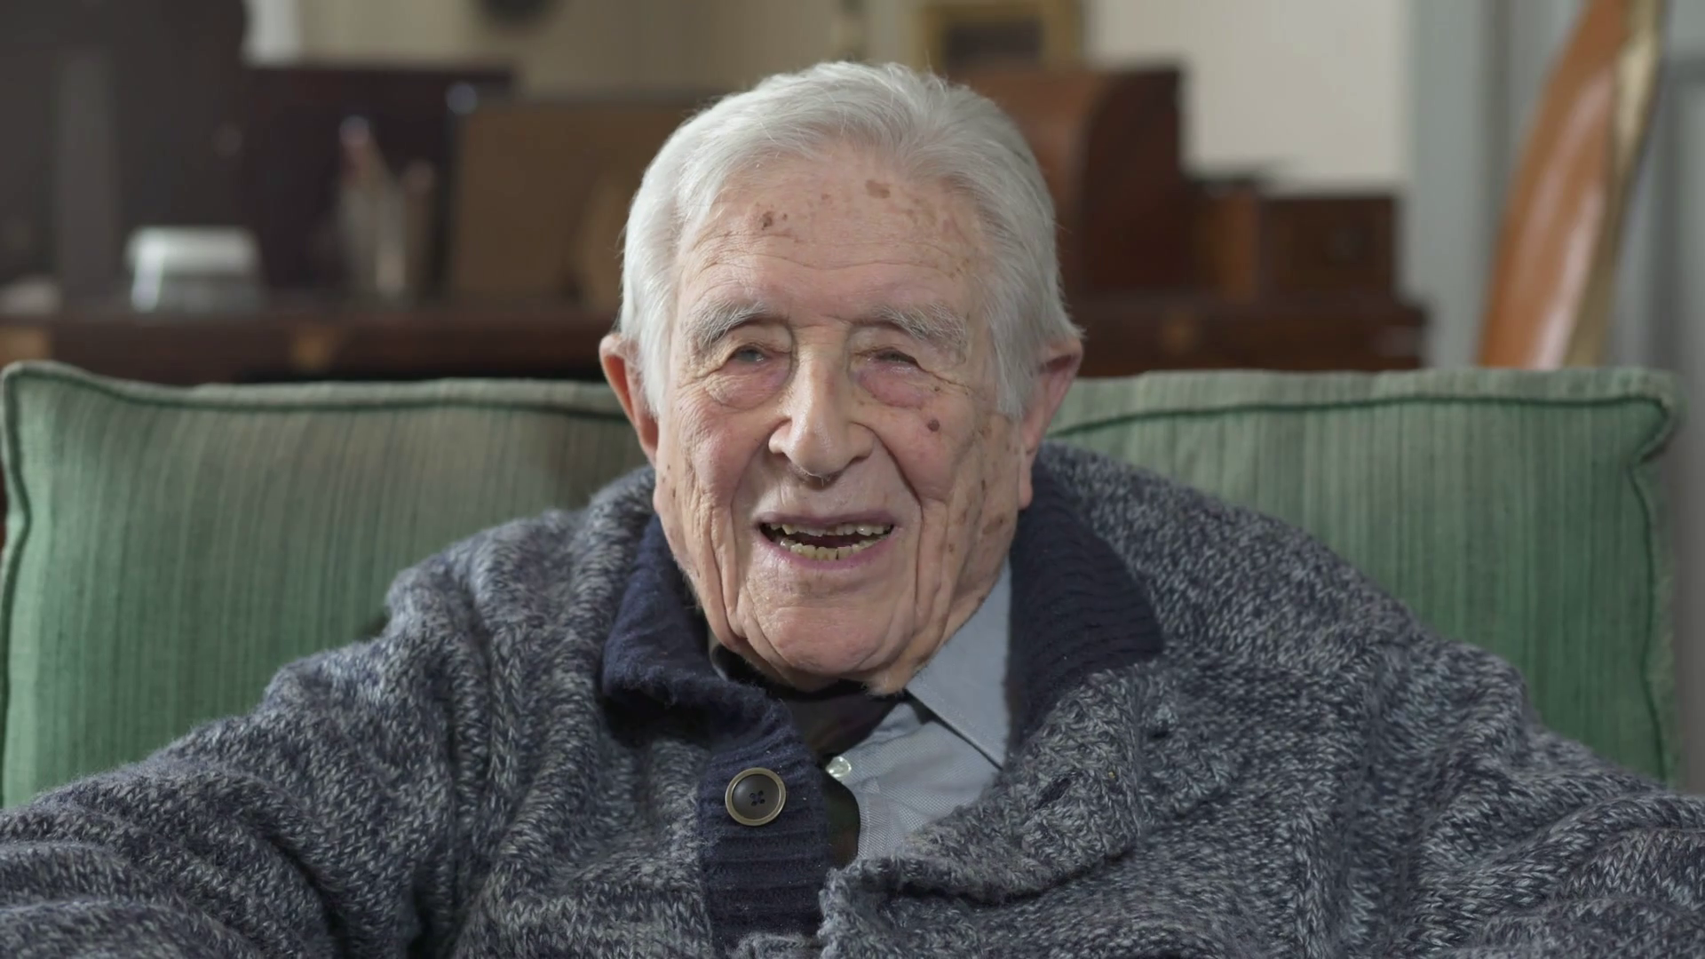
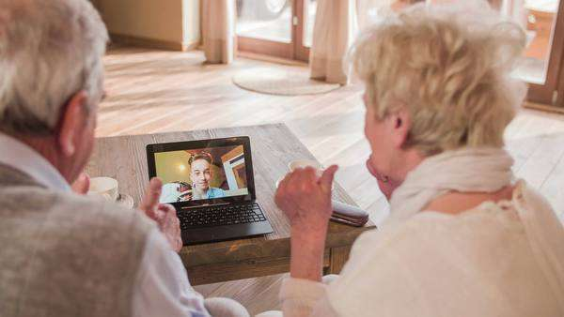
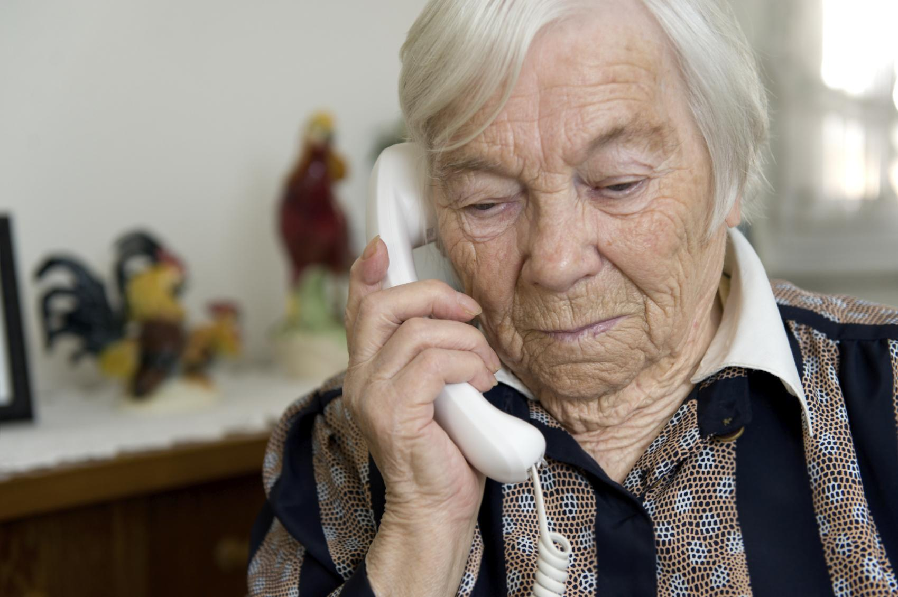

‘Hero’ short video
Natural, friendly and empowering short clips from a diverse range of independent and confident elderly people with a range of confidence relating to fraud
Message:
It happens to everyone
It is extremely common not ‘foolish’
Don’t suffer in silence
There’s lots of support near you
When explaining fraud to elderly relatives neighbours or friends, it’s a good idea to show not tell. It can also be beneficial hearing from a person of the same age rather than someone of authority of younger.

Slide 32
Unaware
Aware
Targeted
Report
Aftermath
Know
Bert, 91 talks about Fraud with his son Andy. There is a lot to remember but the stickers might help.
Bert receives another call asking for some personal details, the sticker reminds him he shouldn't give them out. He uses the sticker as a prompt and ends the call.
Bert goes to the coffee morning. He takes along some mail and tells the scam marshall about the phone calls who asks for some details and offers to report it for him.
Bert saves up any mail he is unsure about and takes it to the scam marshall along with notes about unusual calls or emails. He feels supported.
Bert receives a ‘friend against scam’ badge.
He shares a leaflet with his neighbour and invites them to come along to the next coffee morning
Bert reads the booklet he is left with to find out more. It’s a little worrying but he has the contact numbers for any questions - he doesn't like to bother his son.
Andy becomes aware Bert is recieving scam calls and uses the the ‘Talk about fraud kit to discuss this with Bert
Andy checks in with Bert occasionally when he calls to see how he is
Andy hears from Bert that he has been targeted and helps him report it to Action Fraud.
Andy checks in and reminds him to speak to NHW coordinator if he needs anything
Scam Marshall sends emails, posts, flyers and works with NHW coordinators to identify those who may benefit from being called on.
Scam marshall drops a leaflet about a coffee morning for ‘friends against fraud
Scam marshall runs a coffee morning to check over any mail and answer questions. He passes on any scams to Trading Standards
The scam marshall works closely with the elderly NHW coordinator and they make sure he gets a visit to check he is ok.
Scam Marshall drops round a list of scams to watch out for every so often which Bert sticks up near his desk.
Local or elderly NHW coordinator completes online training and
identifies those that could benefit from the Scam Marshall or ‘Talk about Fraud kit
Local NHW coordinator passes Bert in the street and asks how he is doing
The NHW coordinator works closely with the scam marshall they make sure he gets a visit to check he is ok.

Slide 33
What’s next
Notes:
Page 2: In bold and at 90pt (paragraph style called ‘Large Statements/Opening Question’ within text formatting), try opening presentation by asking your audience a simple, short question.

Slide 34

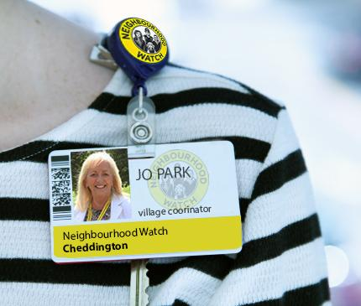
Prototype testing
We will build up these ideas, show participants some early concepts for feedback and test conversations between the volunteer and elderly person.
Elderly participants: Scams to look out for list, friends against fraud group information, ‘talk about fraud’ toolkit including tea bags, stickers and the booklet.
NHW volunteer participants: badges, calling cards, useful contacts list and scame to look out for list
After this we will leave the more established ideas with the Cheddington coordinators to trial for 3 months.
Cheddington
[police approval stamp]
Notes:
Over the past 7 years we have honed our experience into not only providing service design expertise but ensuring our processes take organisations on the journey. Together we want to build design capacity across the organisation.

Slide 35
Questions
Wrapping up the project:
Is there a time pressure to begin the 3 months of testing?
What is your vision about what you want to test and where?
What does success look like to you at the end of this phase?
How do you see this rolling out to different areas?
Notes:
Over the past 7 years we have honed our experience into not only providing service design expertise but ensuring our processes take organisations on the journey. Together we want to build design capacity across the organisation.

Slide 36
Thank you
Rachel and Marie
Notes:
Page 2: In bold and at 90pt (paragraph style called ‘Large Statements/Opening Question’ within text formatting), try opening presentation by asking your audience a simple, short question.

