Slide 1



Valencia
Valencia Spain
Spain

Slide 2

ESPAÑA
General Treasury of the Social Security
VALENCIA

Slide 3


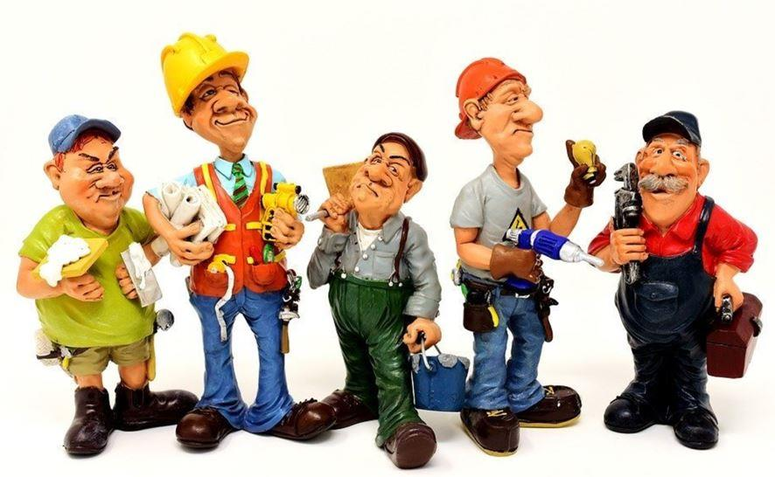
What is Spanish Social Security?
The Spanish social security system aims to protect the population against adverse circumstances that may arise at any point in life. It is funded by contributions from employers and employees.
The Social Security Department can be contacted via a publicly accessible website: a virtual help desk, known as the ‘Sede Electrónica’ (Virtual Gateway), where people can resolve problems and manage their affairs.

Slide 4
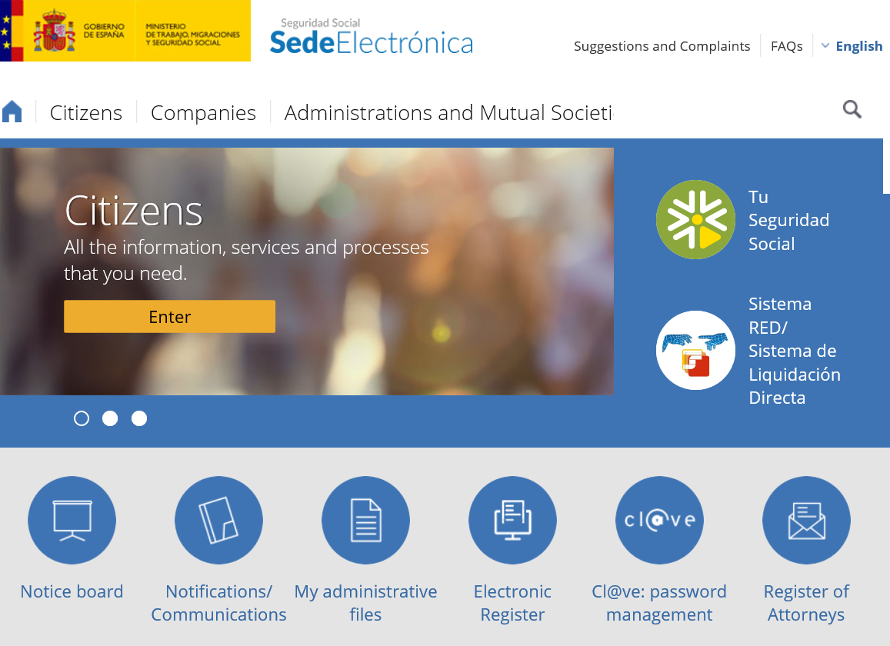
Electronic Headquarters Social Security
Who is this service for?
For all citizens and companies that want to or must interact with Social Security via the Internet.

Slide 5


The problem
People who for whatever reason are unable to access new technologies or lack the necessary skills.
Older civil servants and continual reductions in staff headcount.

Slide 6
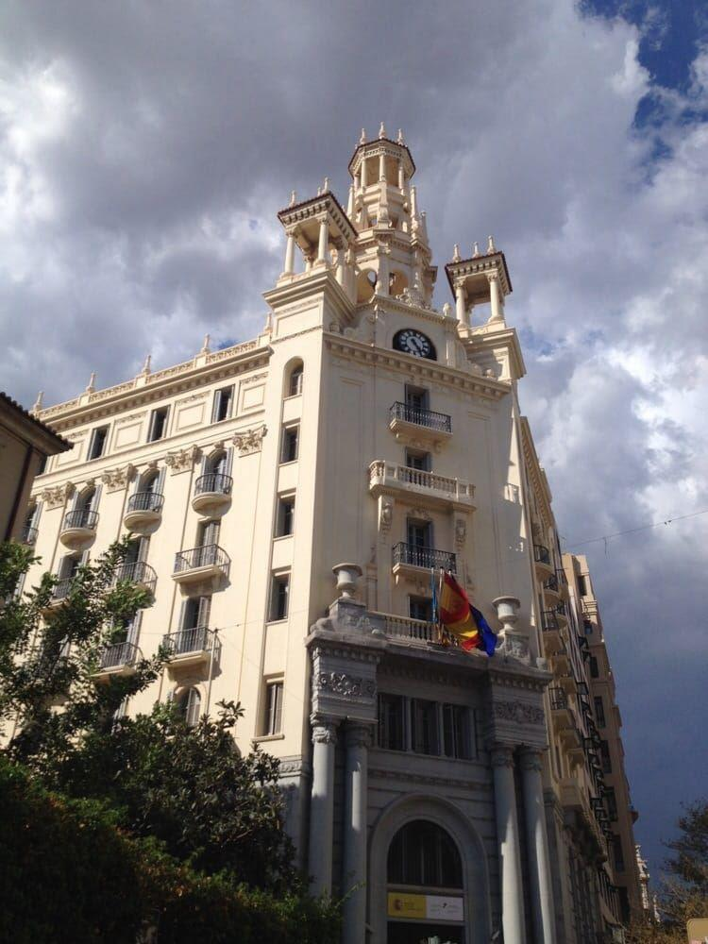
SOLUTION
Citizen Assistance Unit

Slide 7

what you intend CAU?
The Citizens’ Assistance Unit’s objective is to enable people to themselves access their employment record or check their current social security contribution status.

Slide 8
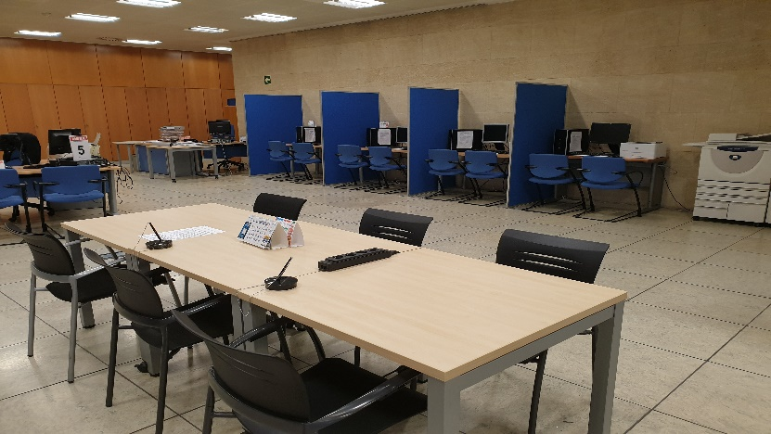
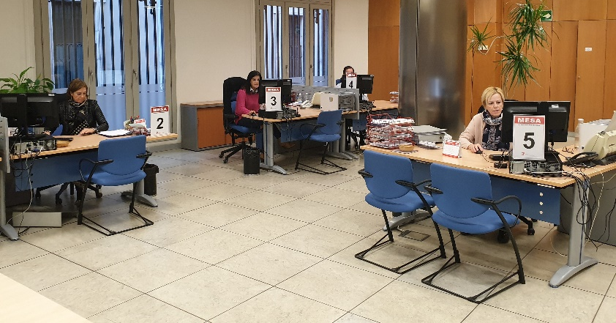
AS IT DOES?
Usually the service begins at the enquiry desk where the procedure required by the person is identified.
People are then provided with the necessary equipment to perform their procedures at dedicated user-stations.
Help will be given where needed to guide people through the desired procedure, showing them how to use the applications on mobile devices (smartphones and tablets).

Slide 9

RESULTS ACHIEVED
Since the creation of the CAU it has been appreciated;
1- Decrease in the people served
2- Iincrease in the number of procedures made by the citizens themselves.
The very existence of the unit suggests the expansion of similar offices throughout the field of the General Treasury of Social Security (TGSS).

Slide 10
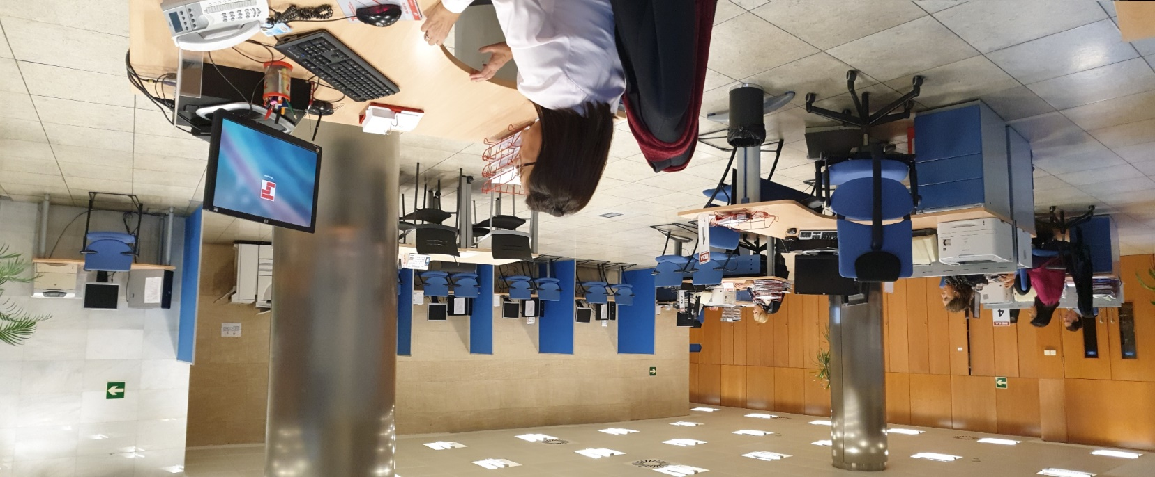
This project is designed to evolve with the times, not to stagnate and become obsolete.
Officials of the Citizen Assistance Unit

Slide 11
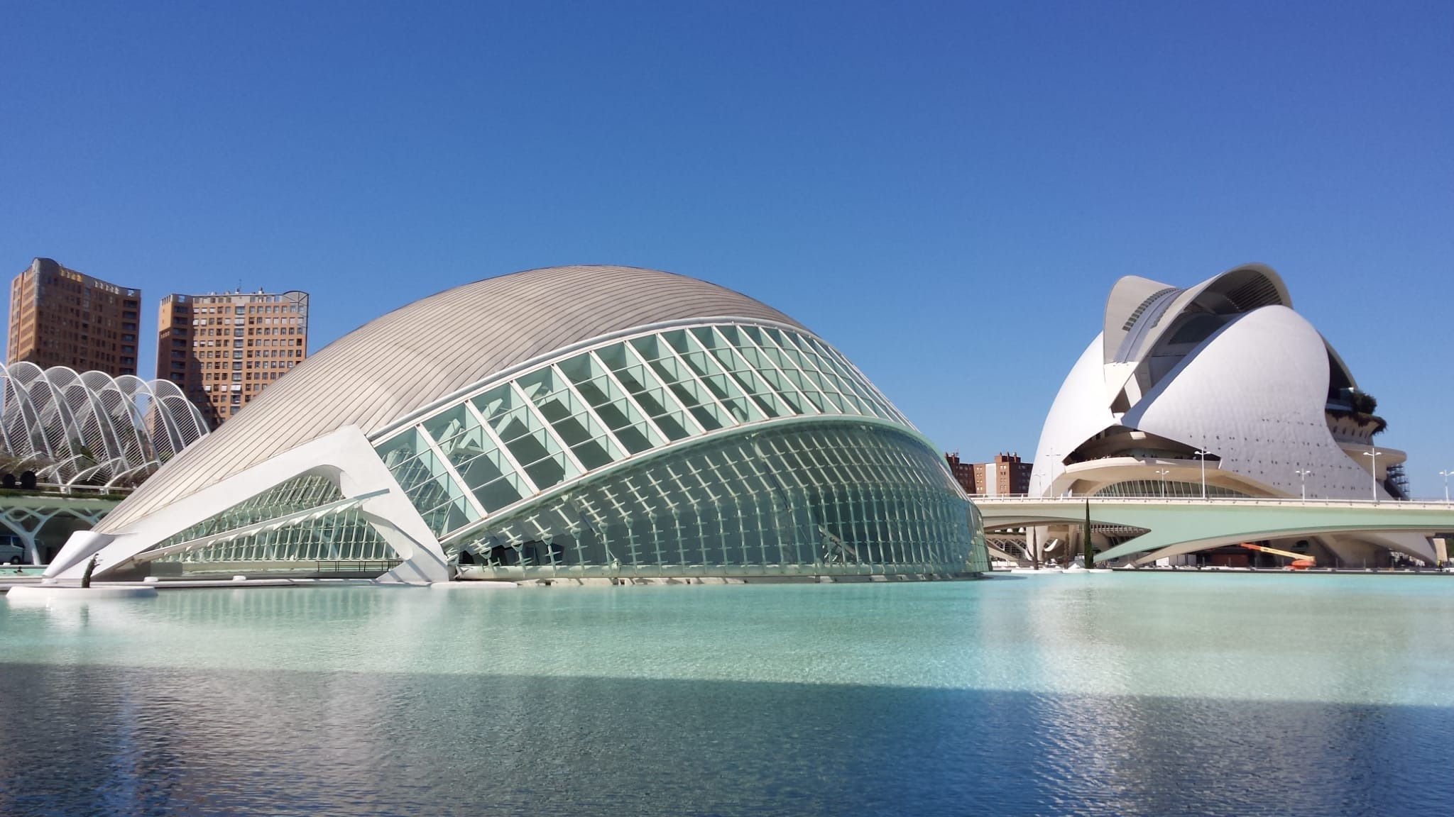
Thanks for your attention

