Slide 1
Risk Detector
Ms Jasmin Grünbaum
Ms Ines Gullichsen
4.10.2019
National Audit Office of Finland
Notes:
Ines

Slide 2
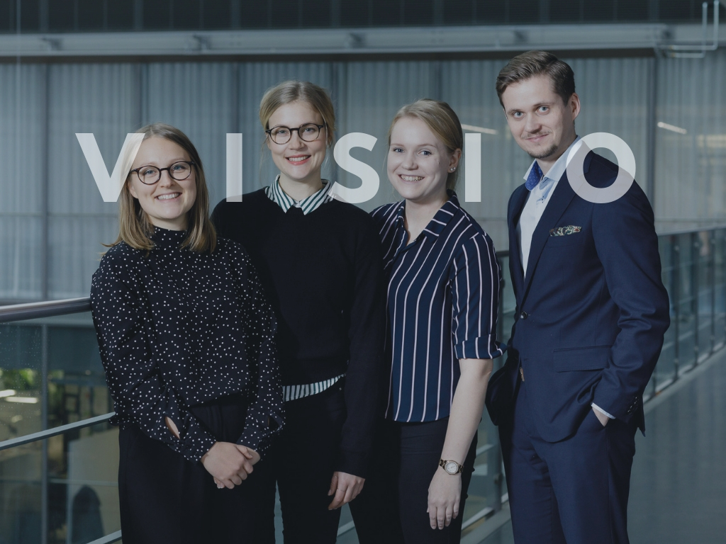
Notes:
Ines: So first a bit about the project team. There’s four of us ja tätä ohjelmaa kutsuttiin VISIOKSI - vision. We all started working at the NAOF in May last year. We are a part of a Young Professionals program. Most of us started working here straight after university.
The program lasts for a year and a half. Me kierretään yksikköjä ja osallistutaan eri projekteihin.
Miksi ohjelma järjestettiin? – Uusiutuminen, kehittyminen, muuttuvassa maailmassa.
Meillä oli näiden tehtävien lisäksi oma yhteinen projekti. We were assigned a project, that we were to work on for the next year. The goal of the project was simple.. Bring AI to the office. Now this.. Is easier said than done, especially for four people with zero knowledge on AI.
Vaikka meillä oli monipuolista osaamista, huomattiin että on vielä paljon opittavaa ..

Slide 3

Embrace the uncomfortable – you learn to adapt!
You are not alone – there are others who can help you.
Just (try to) do it.
Notes:
Jasmin:
Embrace – you learn to adapt to whatever situation comes along.
You are not alone – there are always other who are eager help you.
and then last one, that we stole from Nike and spiced it up a bit – just do it! Sometimes you just have to start find your own way.

Slide 4
You don’t need to know everything
Colleagues from other SAIs
Experts within different governmental sectors
Possible suppliers
NAO Finland staff
Seminars and trainings
Notes:
Jasmin:
As we were given this project we knew that we had to understand more about data analytics and AI.
At the same time we also had to understand the environment that we were working in, and what sort of AI solutions would benefit the organization and hopefully even audit work.
So, we started going to different seminars and trainings on data analytics and AI. We reached out to the staff in the NAOF and asked about the existing data analytics solutions and the auditors needs regarding them. We also met up with experts within different governmental sectors and talked about the bigger picture; how could we track and utilize real-time data on different public projects?
We also met up with our Norwegian and Dutch colleagues. These meetings gave us a lot of inspiration and also confidence, it is possible to work in a somewhat unorthodox way within an audit office and there are plenty of possibilities to utilize data analytics in the field of auditing.
After talking with all of these experts we realized that we do not have the time nor the expertize to code a tool by ourselves. So we decided to turn to technology companies, who were experts in solutions based on AI and data analytics.
Tavattiin eri ICT-toimittajaa, eri firmoja ja ehdotuksia. sitten tavattiin Bilot, jolla oli tällainen Reverse Hackathon konsepti! Aikataulu sopi meille ja alkoi samantien.
So we came across an organization called Bilot. They were organizing a Reverse Hackathon. A fast pace competition within the company and its coders.

Slide 5
BilotGO.AI - Reverse Hackathon
Innovation
Business case identification
Hard Work
04-06/2019
Judgement Day
03-04/2019
Teams work on their challenges over the course of 8-10 weeks
06-2019
Presentation and judgement
Winner is chosen
Notes:
Jasmin: AVATA (reverse) HACKATHON KONSEPTIA. The hackathon lasted only 8 weeks and there were three teams that all had their own client company to code an AI solution for.
Our competitors were big listed companies, so we knew that an audit office with zero opportunities to make a solution that would bring profits, was not as tempting as the others. Ainoo julkinen toimija

Slide 6
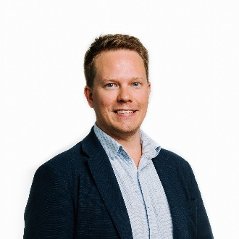

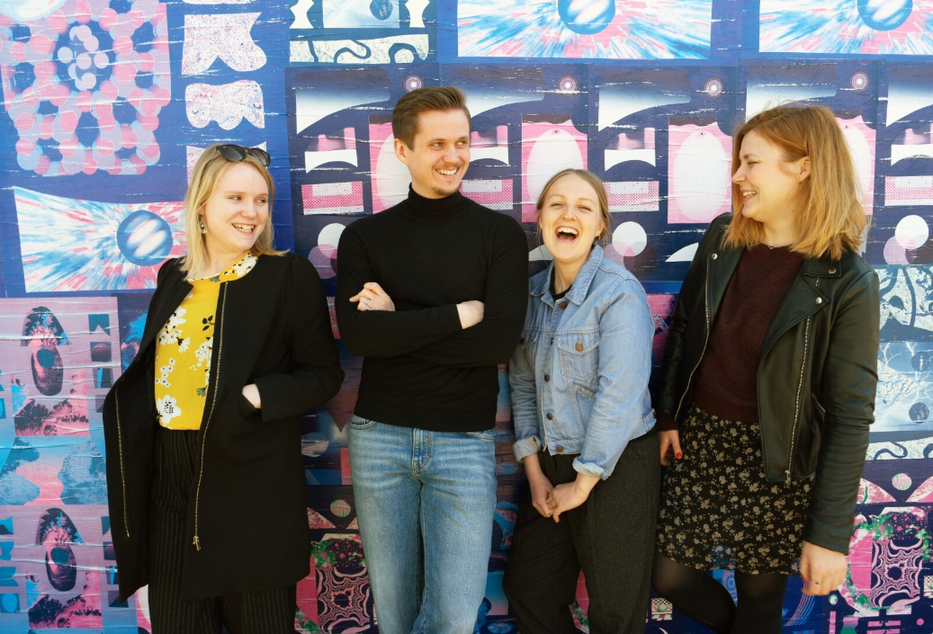
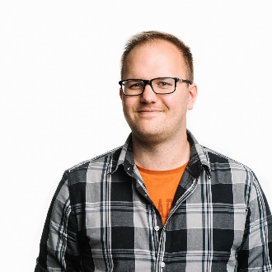
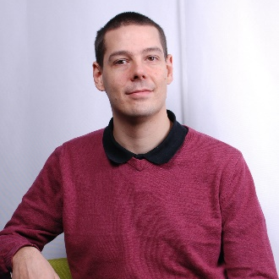
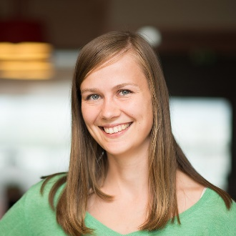
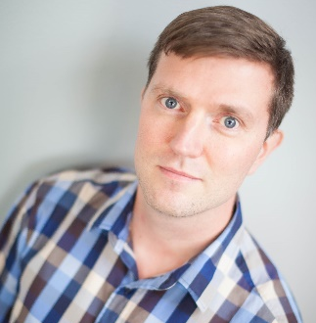
VTV x BILOT
Project manager
Coder
Data Scientist
Coder
In addition 10+ NAOF staff members
UX designer
Coder
Notes:
Ines: Lyhyesti kuvasta.
In the beginning of the process, we organized a workshop, with the aim to come up with a problem to which we could create a tool that included data analytics and AI. We invited around 20 NAOF staff members to participate. The workshop started with a lecture on data analytics and AI so that we could all be on the same page on what actually is possible.
The problem our team had was that we did not have a case in mind, to which we would like to find a solution. We really needed to brainstorm with our auditing experts.
Our auditors came up with great ideas and themes in where data analytics could be utilized.
We ranked the ideas based on how doable the solution was and its economic significance.

Slide 7
PROCUREMENTS
Notes:
Ines: We decided to focus on procurements. Procurements are of huge economic significance and make up about 8 % of the State Beudget.

Slide 8





Current situation
CHALLENGES
Auditors are manually working on
large datasets
Struggling with finding the potential procurement risk cases
Auditors have to recognize the potential risk areas based on their own expertise and judgement
Notes:
Jasmin:
There are various challenges when it comes to procurements. Auditors have to work with large datasets and they’re doing this manually.
The potential procurement risk cases can be difficult to find AND auditors have to find these based on their own expertise and judgement.

Slide 9


Introducing Risk Detector
Advising auditors on risky procurements
MAIN TARGET GROUP
THE TOOL
FINANCIAL AUDITORS
Guides auditors in planning and targeting their work
Identifies potential risk cases: what procurements auditors should focus on?
Especially for accounting unit level audits
Notes:
Jasmin: The tool can also be useful for audit planning or even performance auditors

Slide 10
Demo
Notes:
So next we’re going to show a demo of the tool. All of the data is based on public data sources.
Yhdessä! Katsotaan ens viikolla

Slide 11





Top benefits
Helps to identify potential risky procurements
Makes the impossible possible
Ensures the quality of the audit work
Gives the overall picture to the auditors
Notes:
Ines:
Helps to identify potential risky procurements
- Previously finding the risk cases has only been in the hands of the auditor
- An automatic safety net for auditors
Makes the impossible possible
- Saves time – without the tool it’s impossible to cover 100% of the data
- By utilizing the tool auditors do not have to recognize the risky procurements from the data masses
manually
Improves the quality of the audit work
- A more systematic and consistent way of detecting the real risky cases
Gives the overall picture to the auditors
- New perspectives: 4 year time frame, alerts about risky suppliers, provides an overall picture of the
governmental unit’s procurements

Slide 12
Making of Risk Detector
Notes:
Jasmin: This is how the tool was actually built

Slide 13
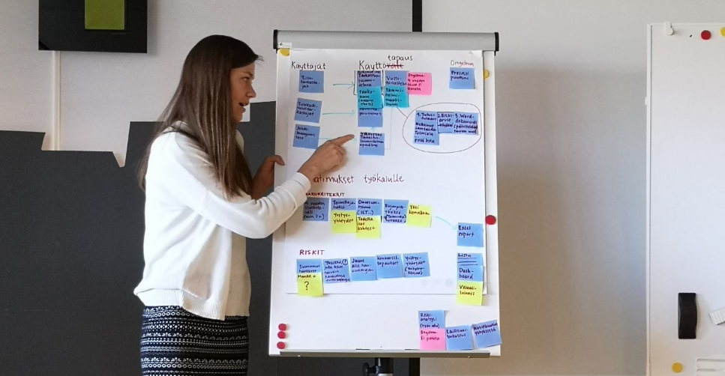
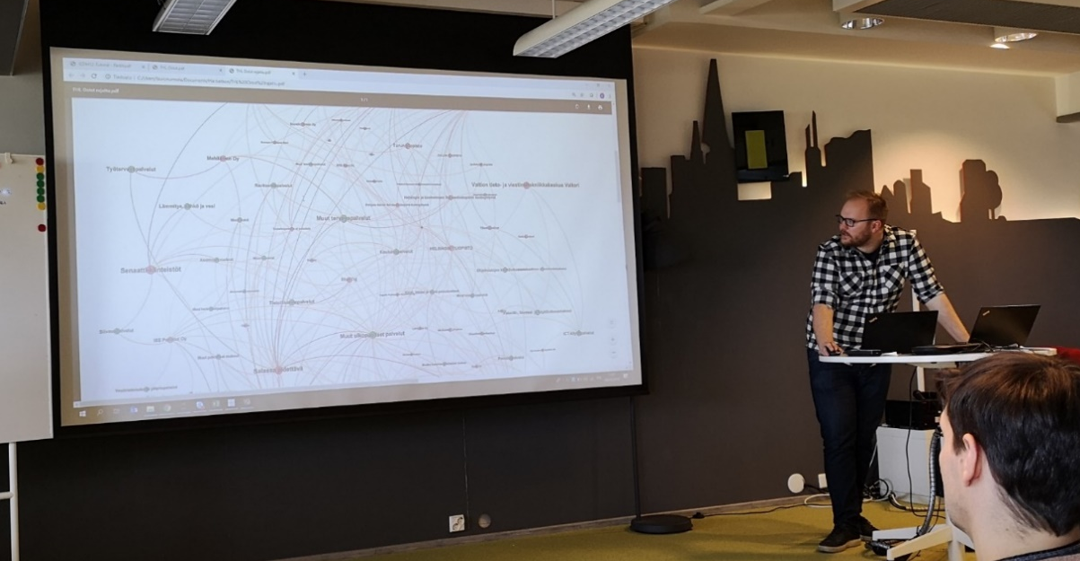
The process
Business understanding / UX design
Understand the problem we are trying to solve, tool requirements and functionalities
Data understanding
Enrich the Tutkihankintoja.fi dataset with other public data. Also some experiments with Python, Tableau and Power BI
Notes:
Jasmin:

Slide 14
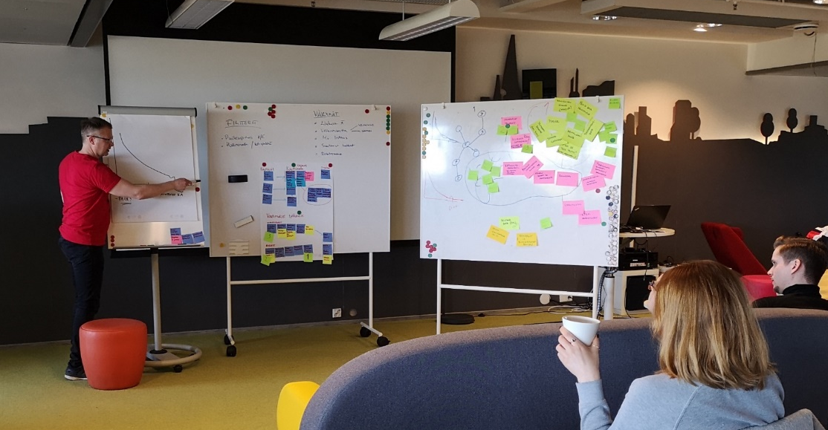
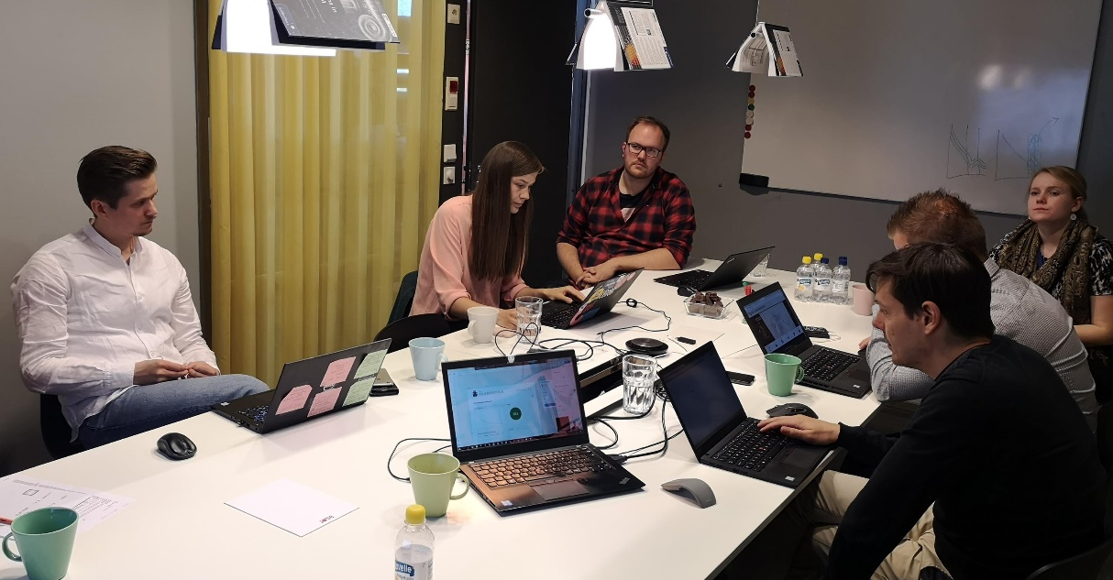
Co-design with end-users
The visualizations were co-designed together with the auditors. Commitment was strong on both sides.
UX/UI design
As an end user tool, UX was an important part of the design process. NAOF’s brand guide was used in the layout design.

Slide 15
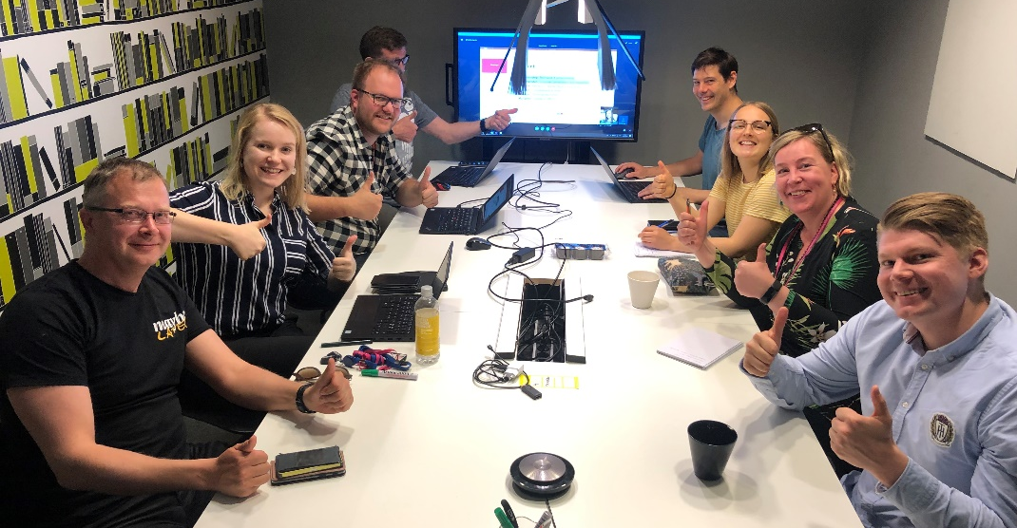
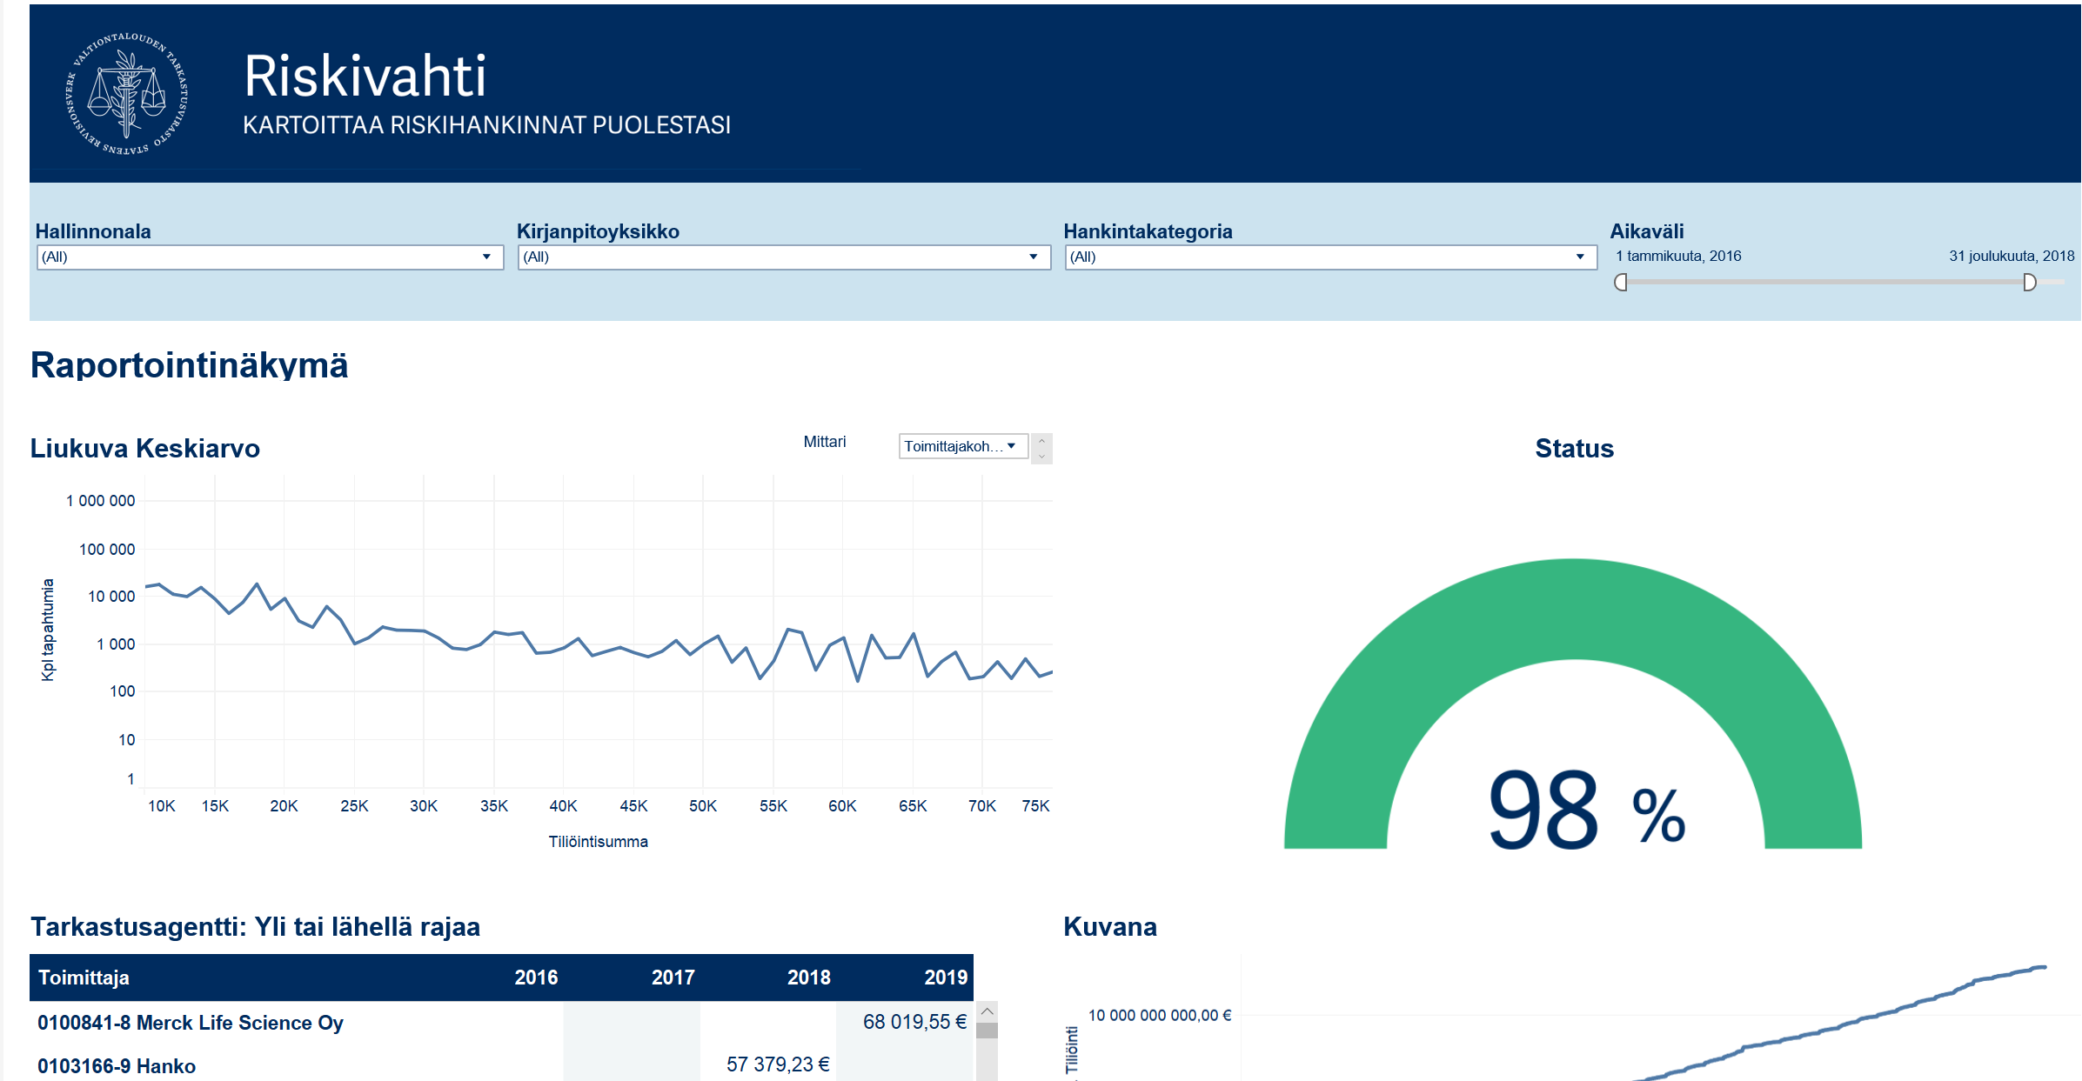
Modeling and evaluation
After thorough research into graph theories, a focus on visualizing the buyer-supplier network was chosen.
Deployment
After some experiments with Angular, Tableau was eventually chosen as front-end tool. Azure is running in the background.

Slide 16
Data and Technology
Notes:
Ines

Slide 17
Public procurement data 2018
4 070 719 411 €
62
buyers
24 789
suppliers
614 010
invoices
tutkihankintoja.fi (2018)
Notes:
Tiina

Slide 18
Challenges
Low expressive power of data
  Original dataset has only a handful of features
Heavy bureaucracy
  SUPO clearance process slow (data protection)
  100% built on public datasets
Completely new area of analysis for the hackathon team
  Graph analytics, spend analytics
Notes:
Tiina

Slide 19
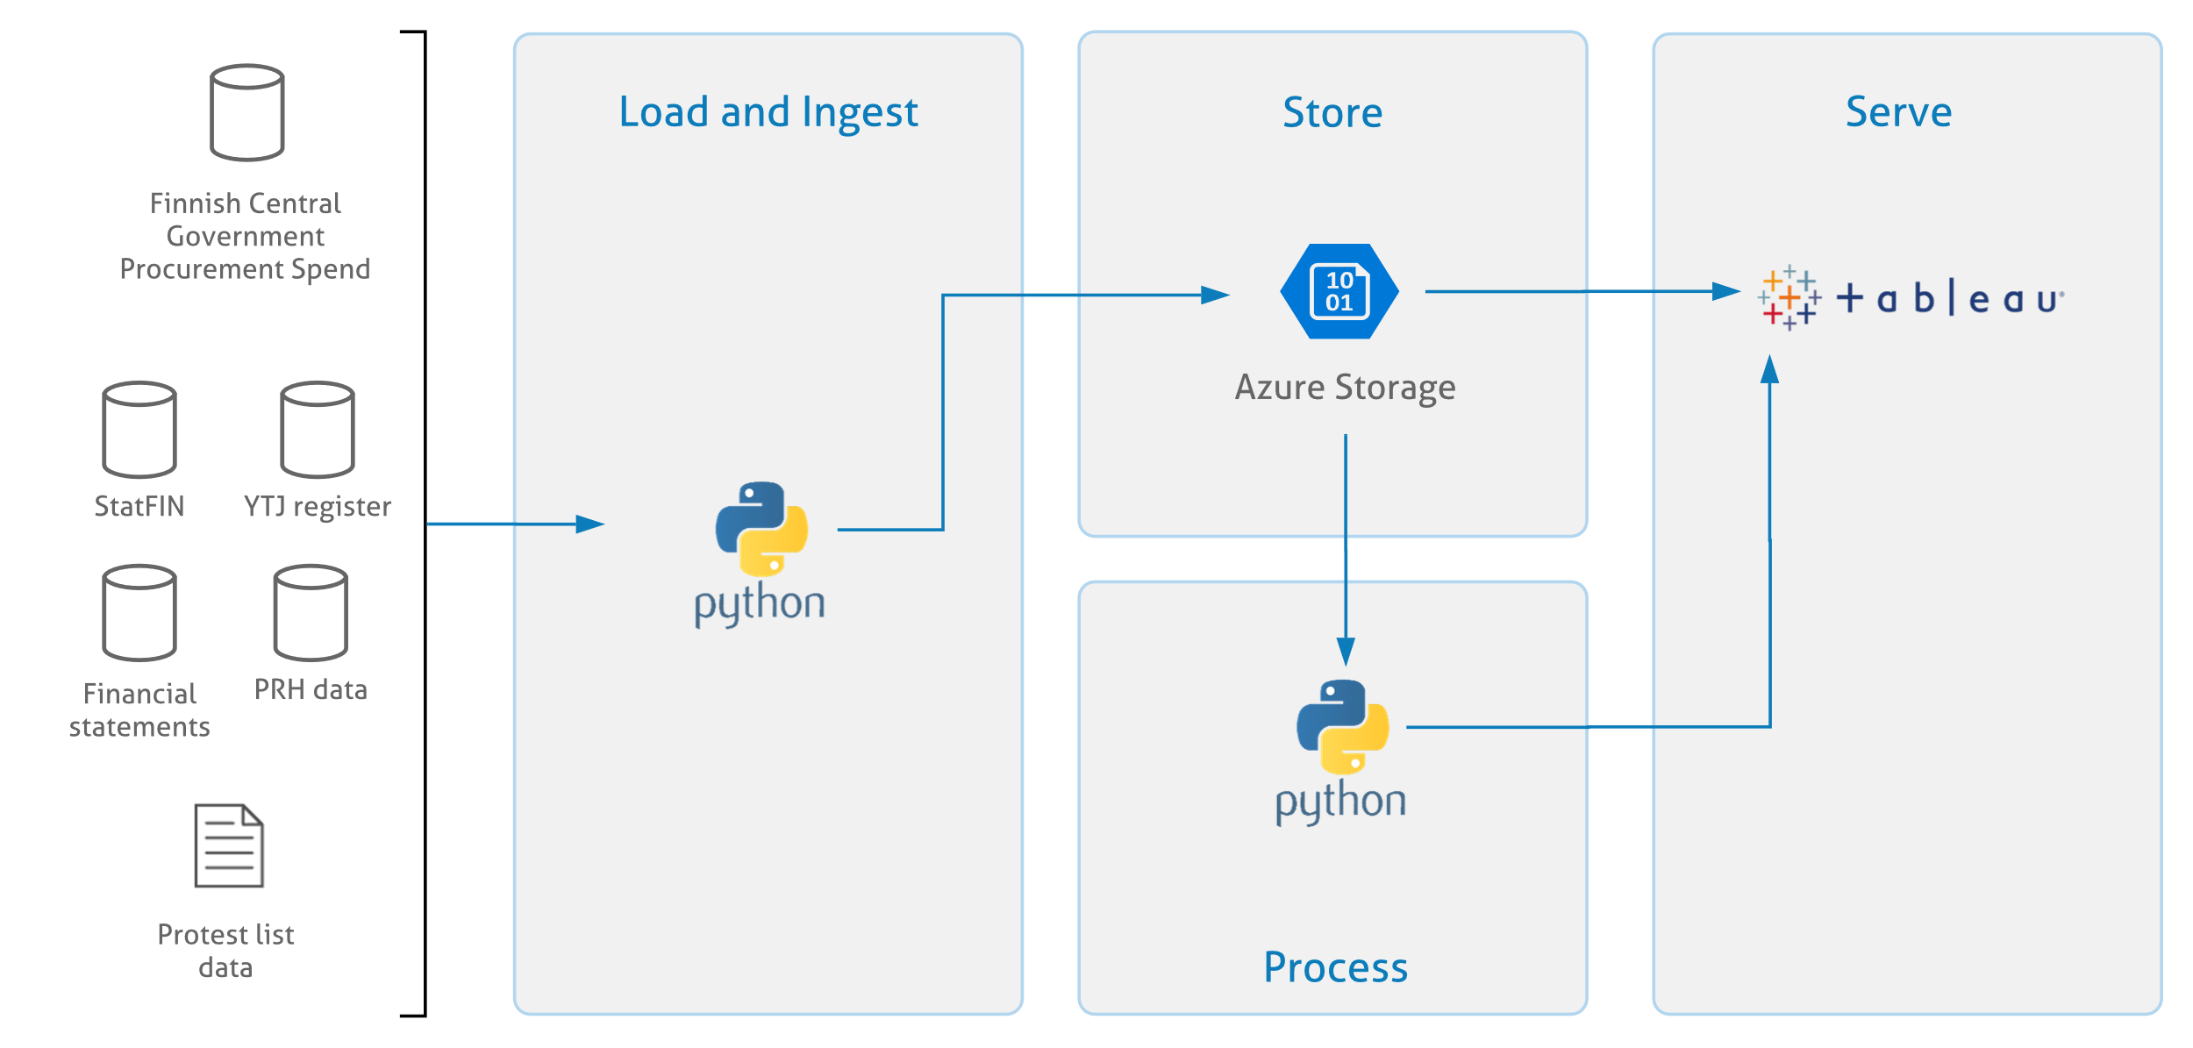
Data enrichment and pilot architecture
Notes:
Ines:
As we mentioned, all the data used in this tool is public. Here are the data sources used. The architecture is very simple, due to the short time of the process.
For future use, we might change tableau to power bi, since power bi is more compatible with our computers and the arctichture itself would be more sophisticated when used in real life.
-

Slide 20
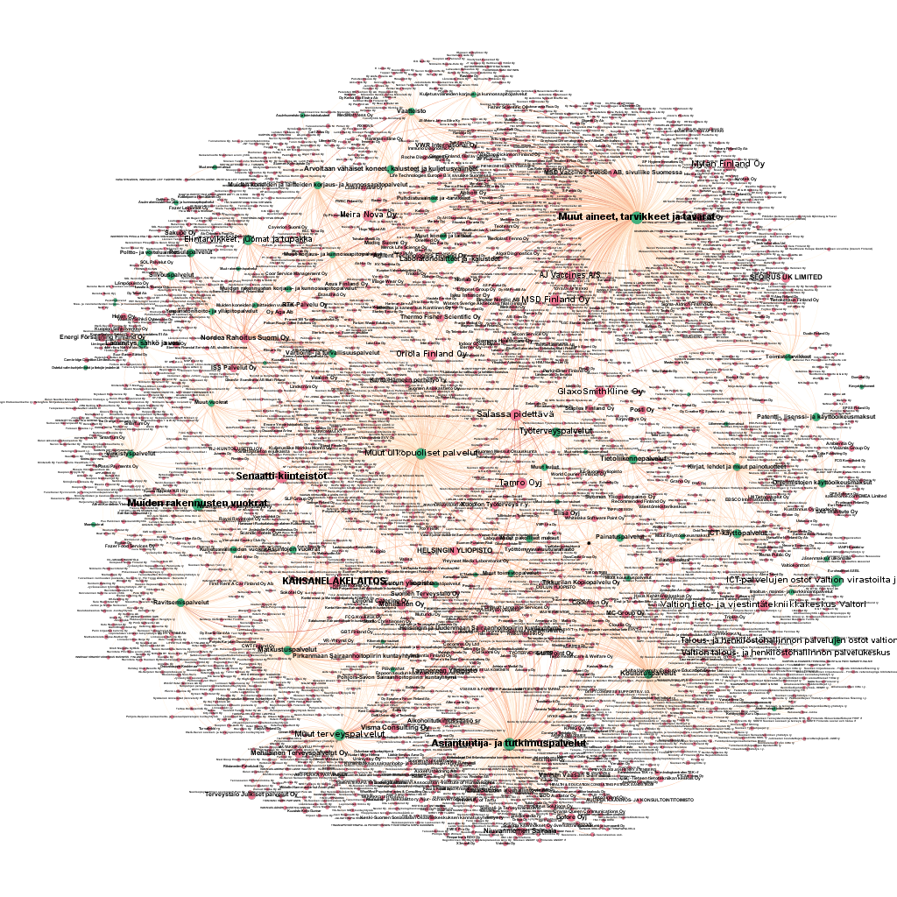



The AI part: Network out of purchaser-supplier relations
The whole of relations between purchasers and suppliers constitutes a bipartite network
  Similar to: Tinder, Netflix
  Visualization: Cutting edge meets classic
Notes:
Ines:
It points out anomalities, and gives higher outlierscores.

Slide 21
Next steps
Notes:
Jasmin:

Slide 22
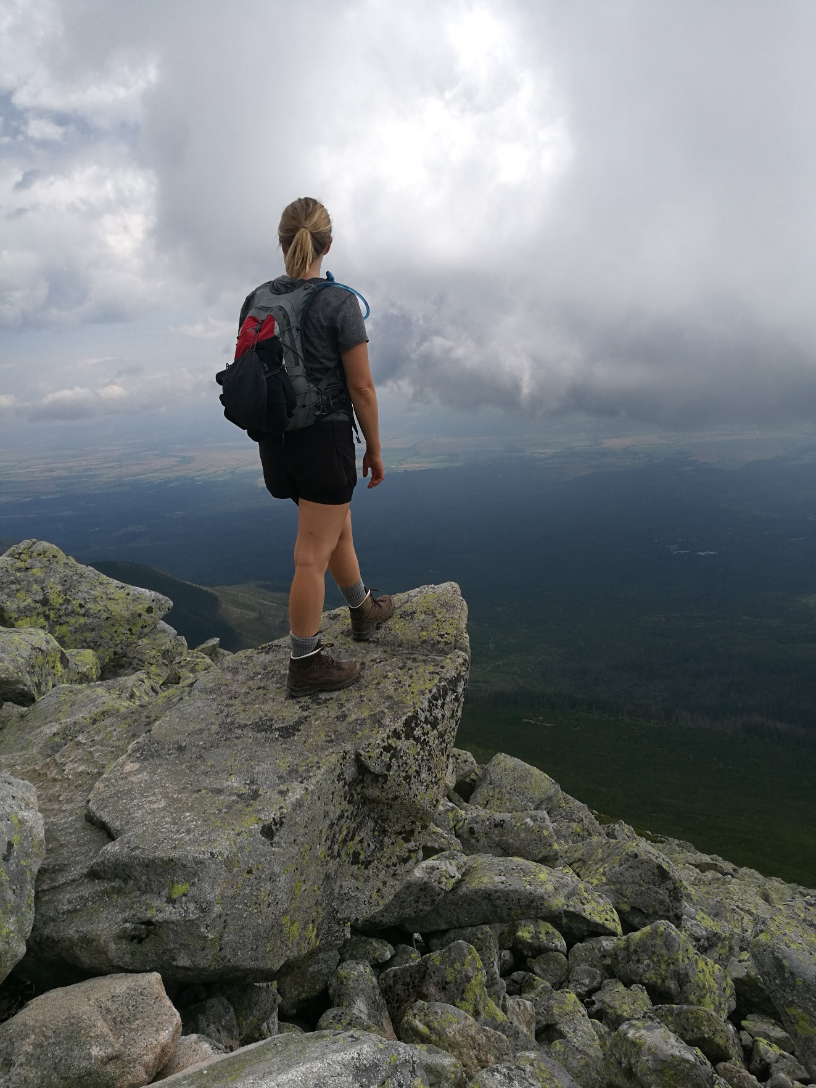
What’s next?
Young Professionals program is over
The future of the pilot is in the hands of the management
The development possibilities are endless
  Find chained procurements
  Check the inner circles
  Enrich the data with actual invoices
The tool has raised interest internationally
Notes:
Jasmin:
Meidän osalta tää projekti on loppu
On ollut puhetta että laitetaan koneille ja kokeillaan.

