Slide 1

INFORMATION PLATFORM “NATIONAL OBSERVATORY OF
“FORESIGHT” OF CEPLAN
Translated from Spanish to English - www.onlinedoctranslator.com
National Director of Foresigh and Strategic Studies

Slide 2



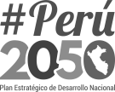
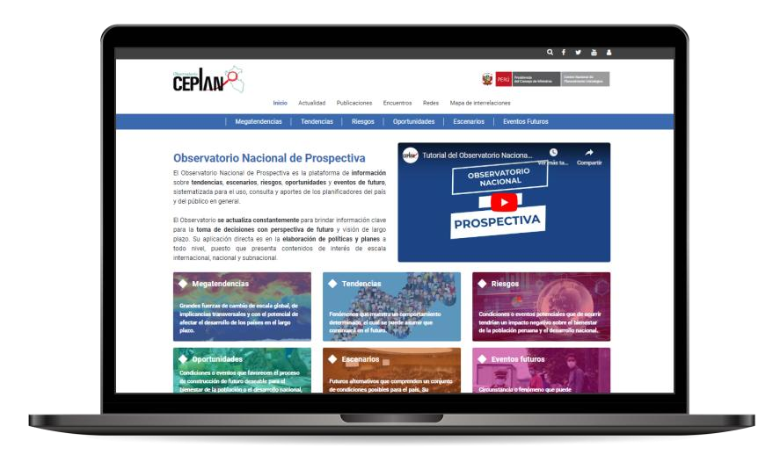
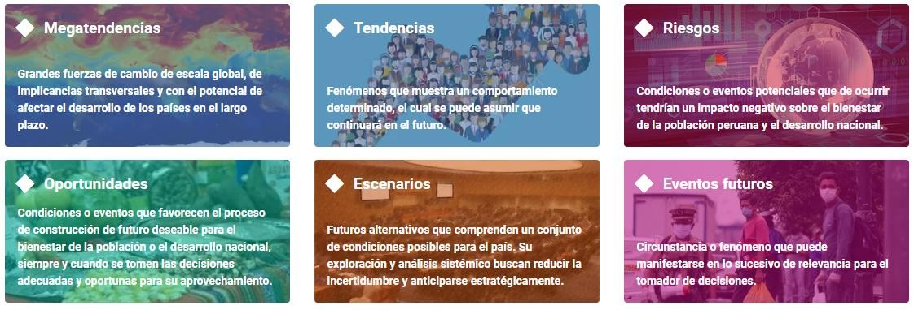

1. What is the National Foresight Observatory?
The platform systematizes and integratesinformation of a prospective natureabouttrends, scenarios, risks, opportunities and future events, systematized for use, consultation and contributions by the country's planners and the general public in the corresponding planning processes.
The Observatoryis constantly updatedto provide key information for decision-making with a forward-looking perspective and long-term vision. Its direct application is in thedevelopment of policies and
all levels, since it presents content of interest on an international, national and subnational scale.
plansat
Six
modules
power plants

Slide 3



Role
fundamental
2. Importance of the Observatory
Direct impact on the
planning
Contribution to the
Consolidation as
strategicwhen
toasting
elaboration of
essential toolfor
information to the
policies and plansto
decision-making strategic.
operators of the Sinaplan.
all levels.
Variety of resources
available inonly one
Accessibility
comprehensive platform:
Scopeto the national public
working papers,
and international.
current affairs notes,
scenario studies, etc.
Platform
Dynamic
Continuous update
Dynamic materialsfor
of content with relevant information and
current.
research and consultation of
easy download.

Slide 4
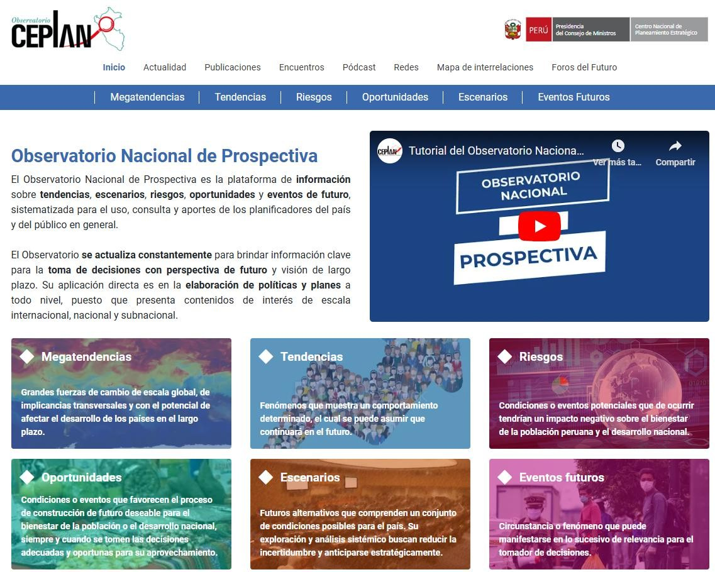
3. Sections and uses
Seven
modules
complementary
Six
modules
power plants

Slide 5
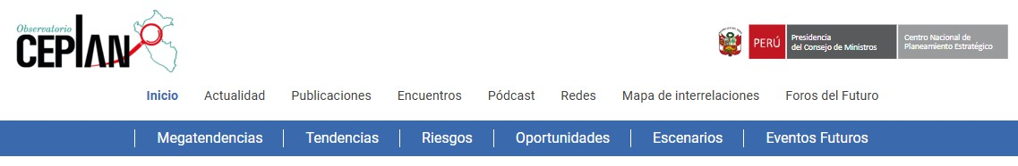
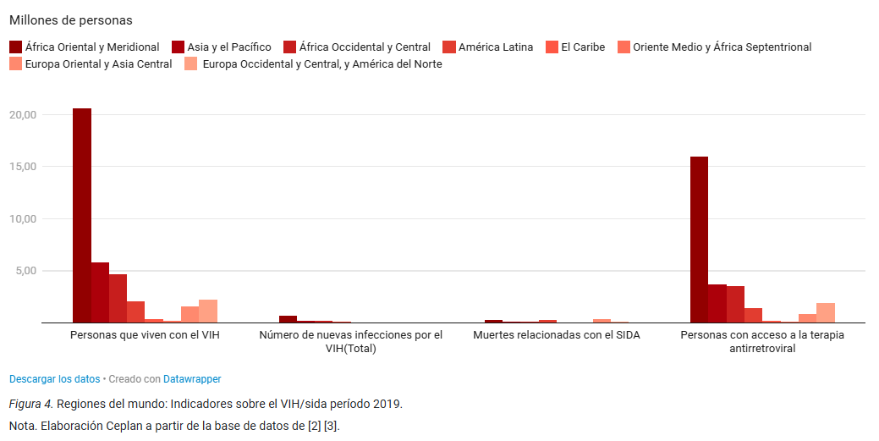
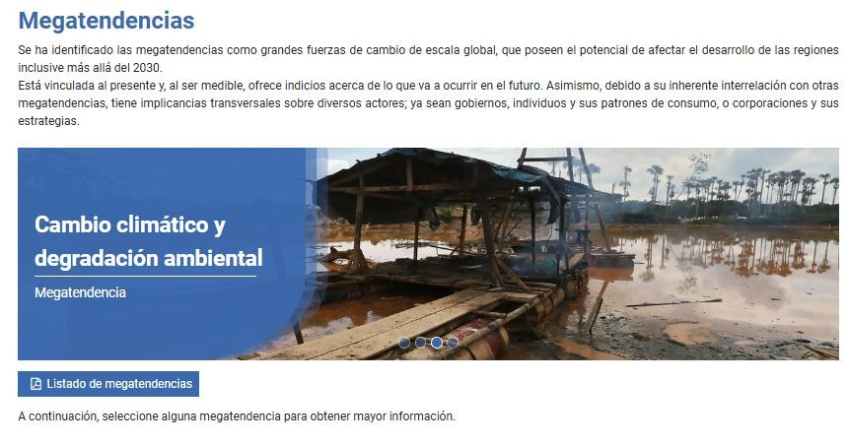
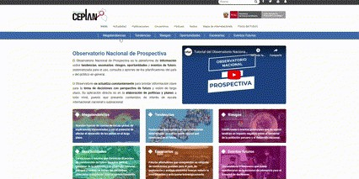
Section: Megatrends
Megatrends:This section identifies and analyzes the major forces of change on a global scale that have the potential to significantly influence Peru's long-term development, even beyond 2030.

Slide 6
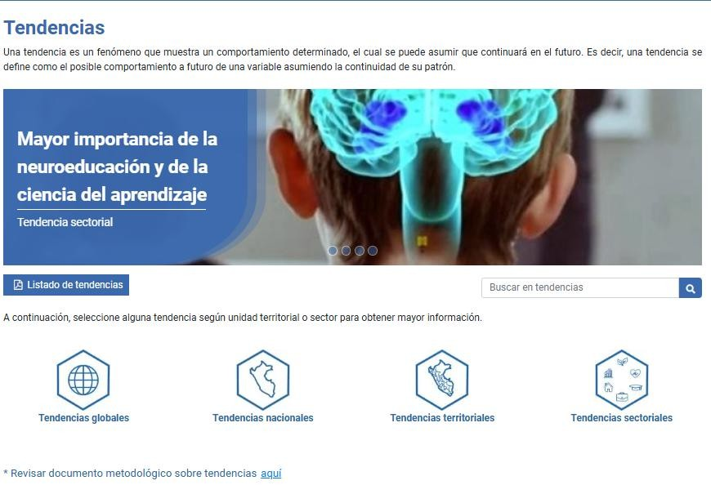
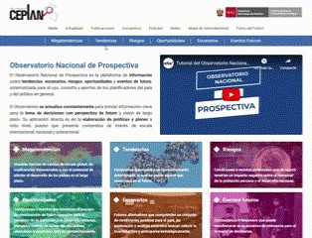
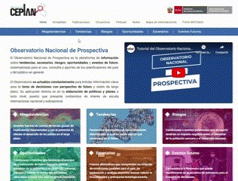
Section: Trends
Tendencies:This section provides information on current trends that may influence the country's development. It includes analyses of patterns and changes in various areas, including economics, technology, society, and the environment. Understanding these trends is essential for anticipating future scenarios and planning strategically.

Slide 7
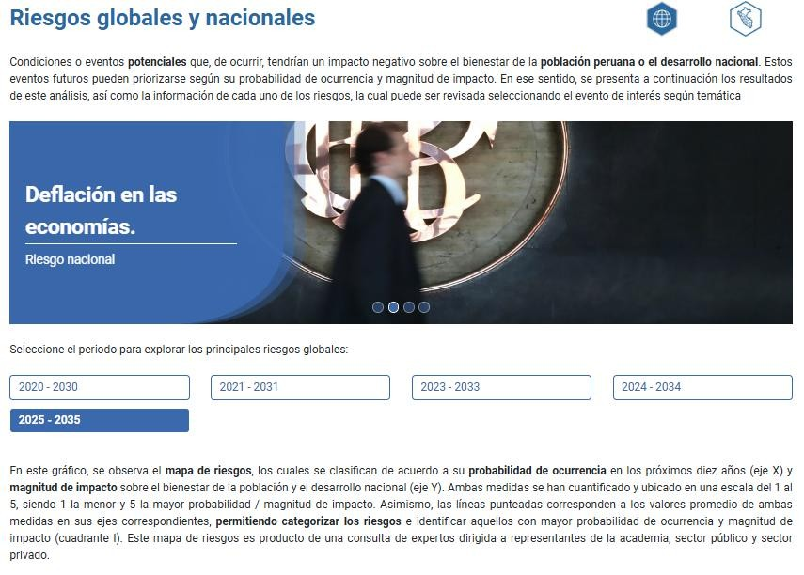
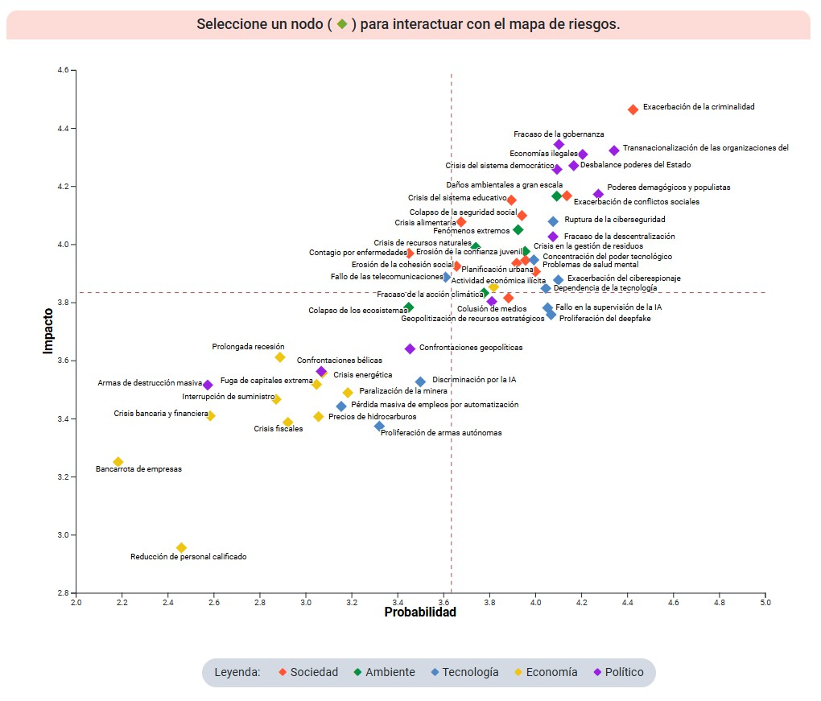
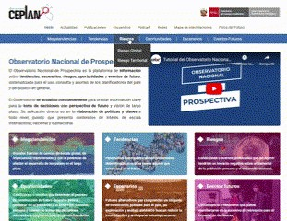
Section: Risks
Risks:A risk is a potential condition or event that, if it occurs, would have a negative impact on the well-being of the Peruvian population or national development.
This section analyzes factors that impact the country's development. Each section is divided intoglobal (international context) andterritorial(national reality).

Slide 8
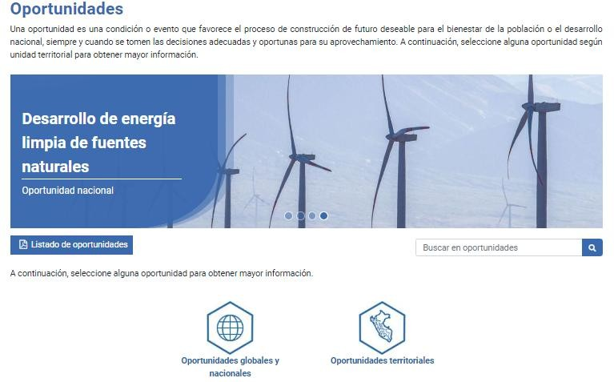
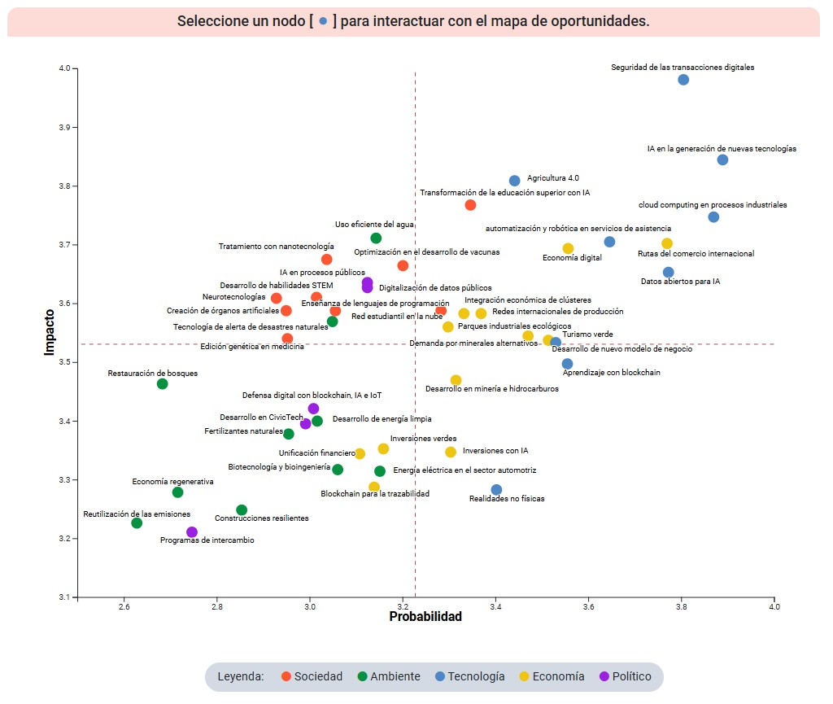
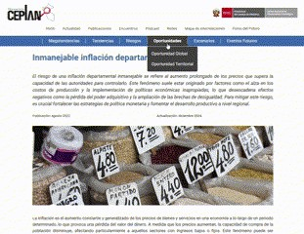
Section: Opportunities
Opportunities:An opportunity is a condition or event that favors the process of building a desirable future for the well-being of the population or national development, provided that appropriate and timely decisions are made to capitalize on it. Select an opportunity by territorial unit below to learn more.
This section analyzes factors that impact the country's development. Each section is divided intoglobal(international context) and territorial (national reality).

Slide 9
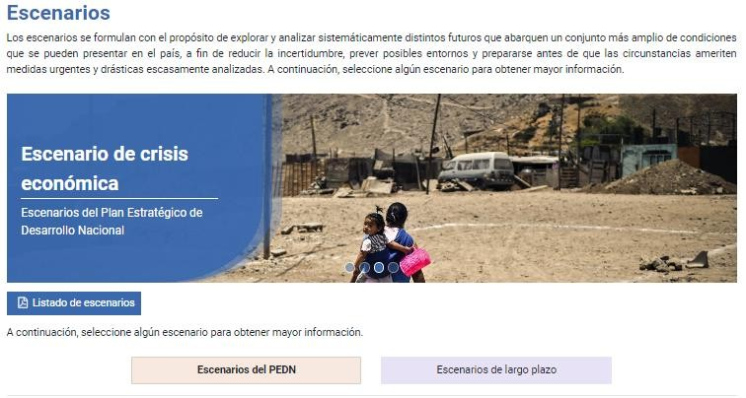
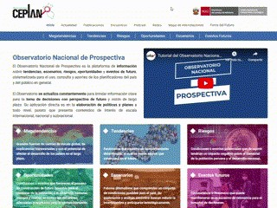
Section: Scenarios
Scenarios:Scenarios are designed to systematically explore and analyze different futures that encompass a broader set of conditions that may arise in the country. This is done in order to reduce uncertainty, anticipate possible scenarios, and prepare before circumstances warrant urgent and drastic measures that have rarely been analyzed. Select a scenario below to learn more.

Slide 10
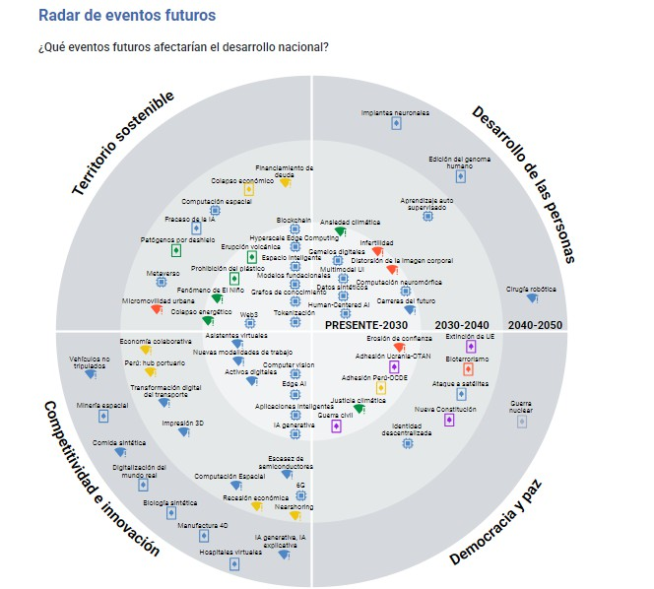
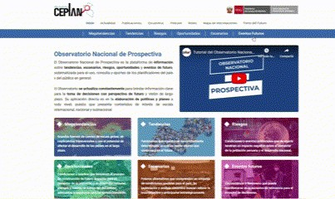
Future Events Section
Upcoming events:Events classified by theme and according to their level of impact:
Weak signal:Indicator of change that an event may have based on its historical data or its current emerging state and that may affect the dynamics of national development due to its high degree of uncertainty.
Wild Card:A high-impact, low-probability phenomenon whose dual nature allows for the visualization of disruptive, positive, and negative scenarios that national development could face in the medium to long term.
Emerging Technology:These are technological innovations and advances that are in the initial stages of development, but that show great potential to significantly impact various areas of society, the economy, and daily life.

Slide 11
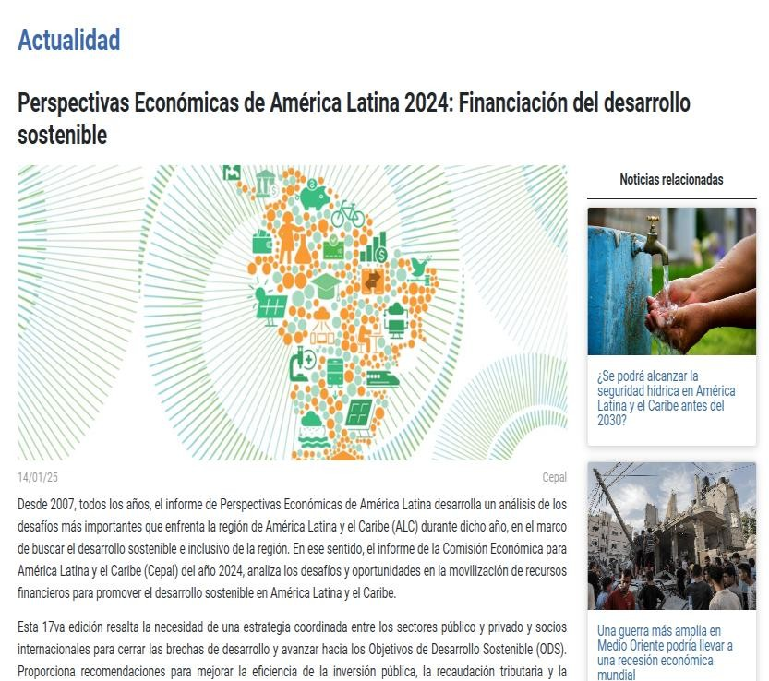
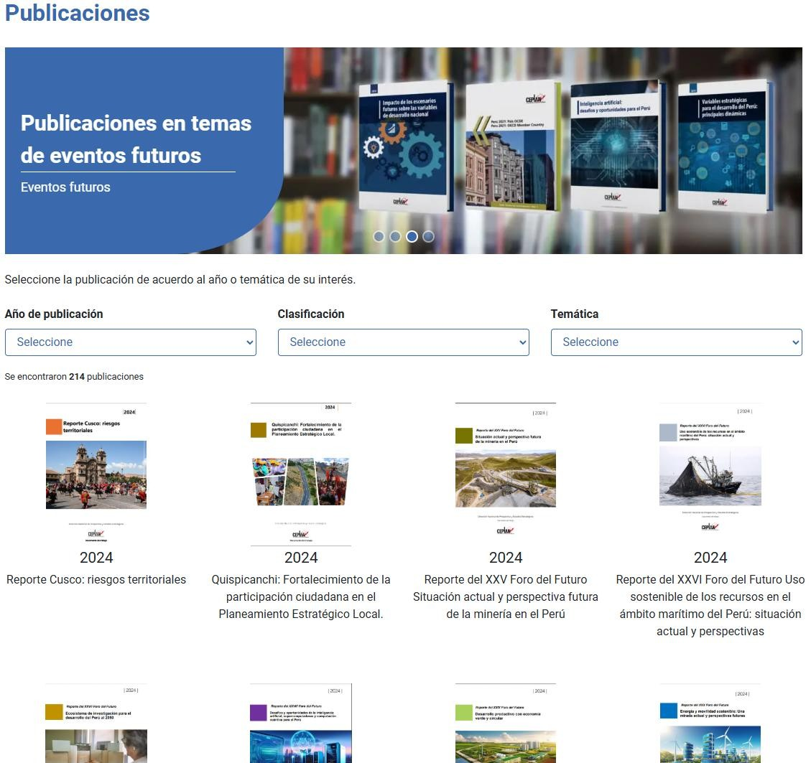
Add-on modules
Publications:
collects
information
This section documents,
and studies
carried out by the Observatory and
others
entities
Are
related.
publications offer In-depth analysis and relevant data that support informed planning and decision-making.
Present:This section provides relevant and up-to-date information, ensuring that planners and the general public have relevant data to strategically anticipate future changes and challenges.

Slide 12

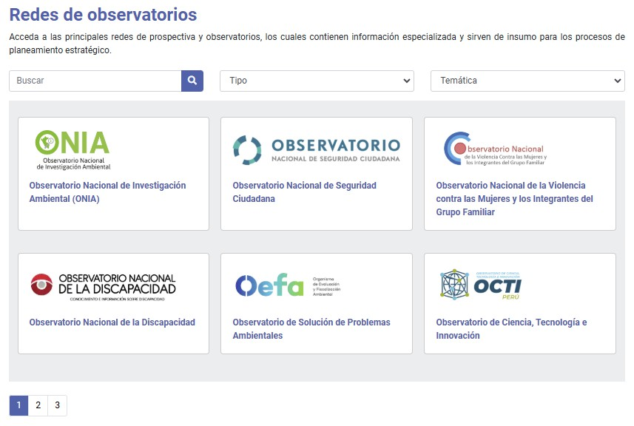
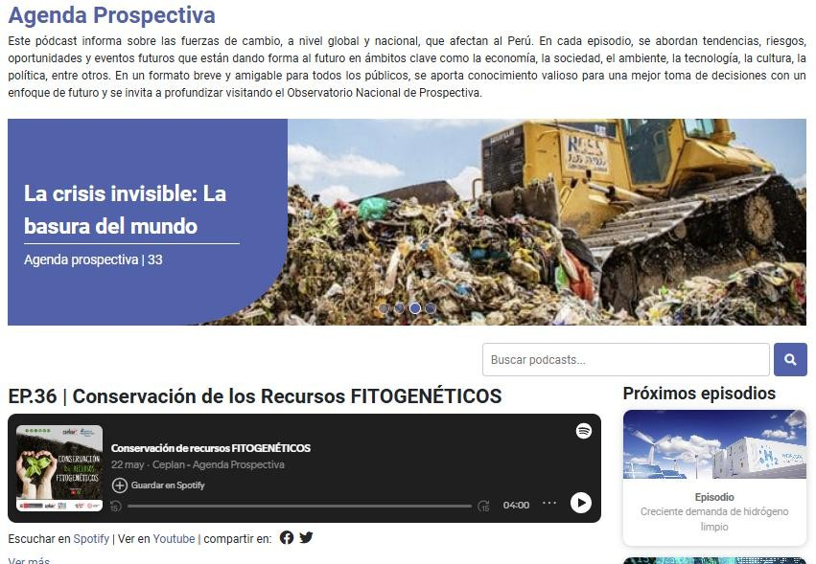
Add-on modules
Podcast:The Observatory offers a series of podcasts that report on the forces of change, both global and national, affecting Peru.
Networks: This section provides access to specialized platforms that provide key information for strategic planning.
Meetings:This section highlights events and meetings organized by various organizations, where topics relevant to national foresight are discussed.

Slide 13
Add-on modules

Slide 14
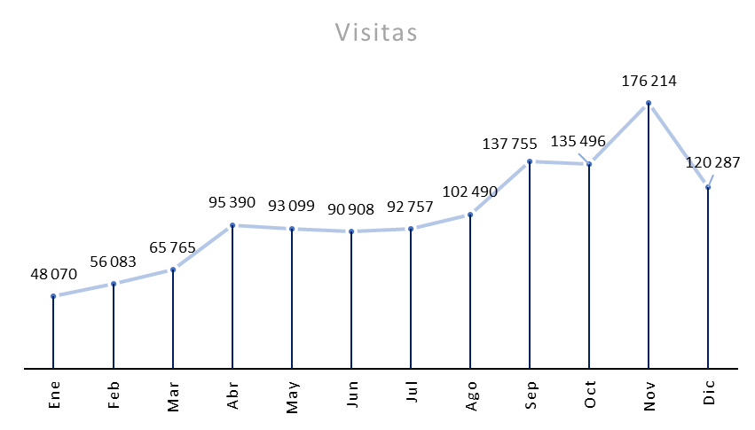
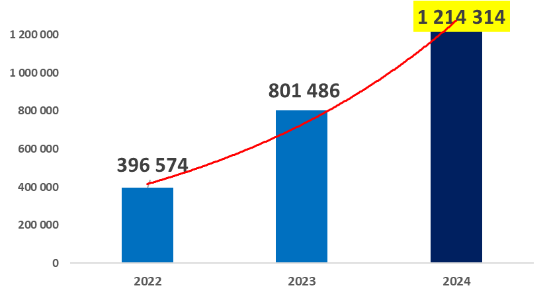
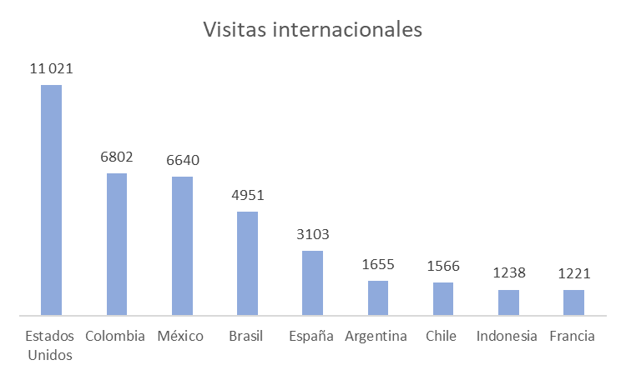
4. Impacts and results
Visits to the National Foresight Observatory:
Annual Total 2024:
1 214 314visits

Slide 15
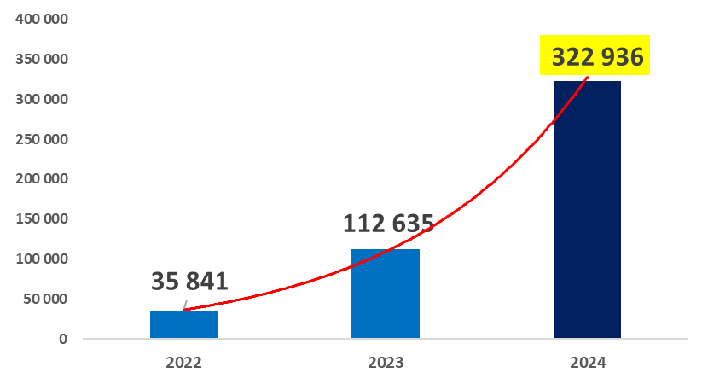
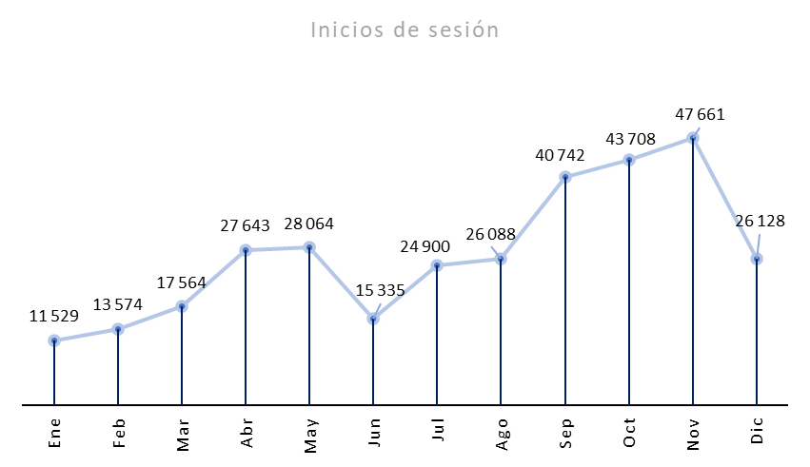
4. Impacts and results
Logins to the National Foresight Observatory:
Annual Total 2024:
322 396logins

Slide 16
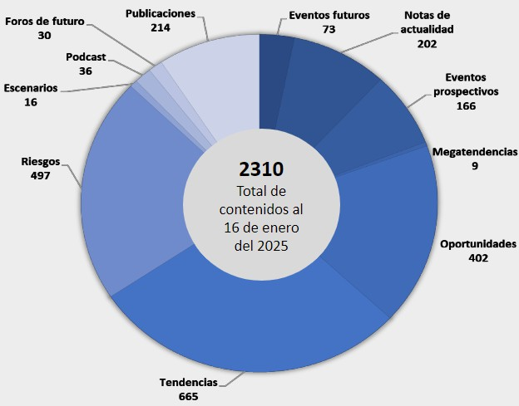

4. Impacts and results
The National Foresight Observatory hasa total of 2310 contents of informationas of January 16, 2025, which range from trend, risk, and opportunity sheets,
megatrends, events
futures, among others.
Module | Figures and Tables
Tendencies | 2480
Risks | 1641
Opportunities | 941
Megatrends | 317
Scenarios | 133
Future Events | 239
Total: | 5751
Each of these contents
account with he with
graphics
interactive,
Observatory account
5751 figures and tables.

Slide 17



5. Risks of migrating or disappearing the Observatory
Loss of identity and visibility
  The National Foresight Observatory has aown identity
as a source of strategic
information and national planning in a single space, its migration could dilute its visibility and purpose.
Loss of autonomy in information management
  Currently, Ceplan manages the observatory with specific planning and foresight criteria, when migratingautonomy could be loston the design, updating and presentation of information.
Risks of data homogenization
  GOBPE tends to standardize information under the same scheme, this can generate
Limitations on the presentation of specialized data or Foresight analysisCeplan's
own.
Difficulties in updating information
  The speed of updating and publishing information could be affected ifdepends on bureaucratic or technological processesfrom GOBPE.

Slide 18



5. Risks of migrating or disappearing the Observatory
Loss of functionality and usability
  The observatory is designed to respond to the needs of specific users interested in strategic planning, a migration could lead to theloss of tools or visualizations of key modules.
Technological dependence on third parties
  Ceplan couldlosing control over technological infrastructure, depending on external suppliers or technical teams for any modification or improvement to the platform.
User resistance
  Those already familiar with the observatory may find the transition difficult, which couldreduce platform usage and affect the dissemination of information.

Slide 19
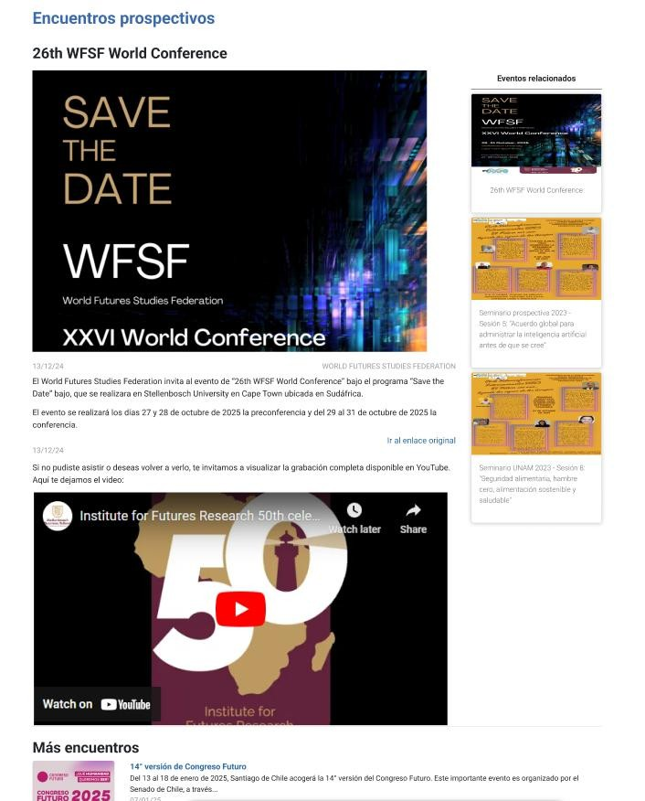
6. Next steps that Ceplan will implement in the Foresight meetings module
Video viewing of Foresight meeting
After the meetings are held, if there are videos on YouTube, these will be uploaded to the platform, which improves the user experience and enriches the content within the Observatory.
Link:
See full design

Slide 20
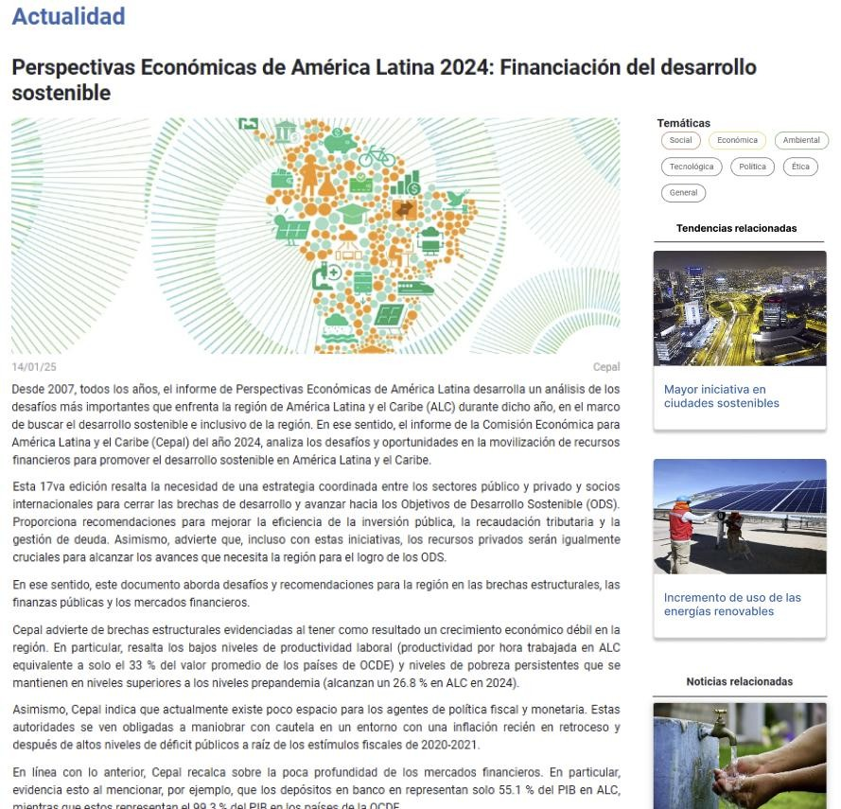

6. Next steps that Ceplan will implement in the current affairs module
List of current affairs notes with themes
In the next steps, the goal is to link each news story to specific topics, which will be related to various trends, risks, and opportunities. These topics will be reflected within the story itself, directing users to other information sheets on the platform.
This way, when a user views a current news story, they can identify the topic it relates to and explore various trends, risks, opportunities, and other factors that may be useful in the Foresight field.
Link:
See full design

Slide 21
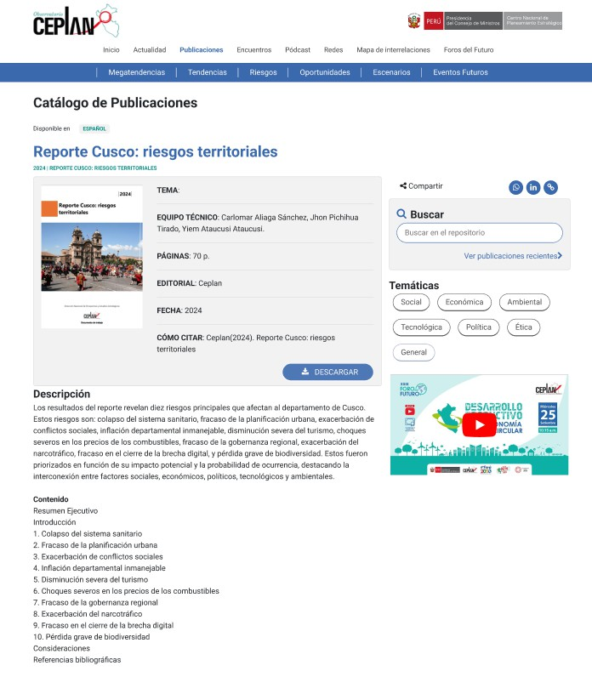
7. Next steps that Ceplan will deploy in the publications module
Video display in posts
Within the study publications, we propose incorporating YouTube videos that explain the published study in order to offer an in- depth and easily disseminated analysis.
Sharing functionality
The sharing function will also be displayed by clicking on the links through which you wish to share.
Link:
See full design

