Slide 1
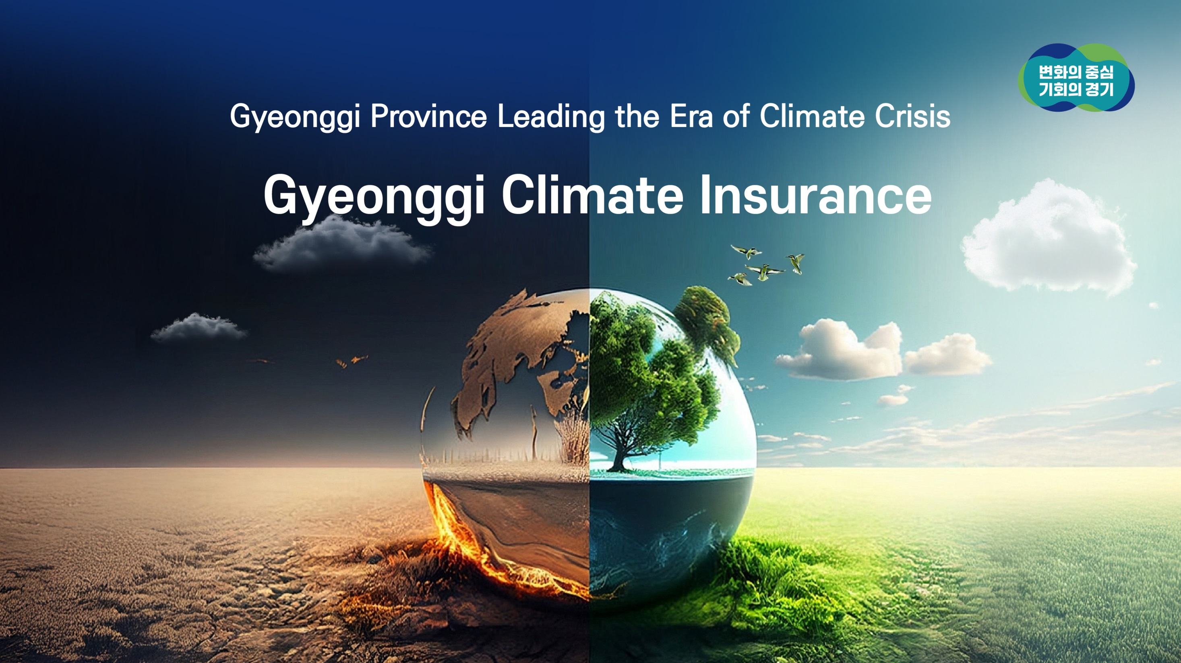

Slide 2
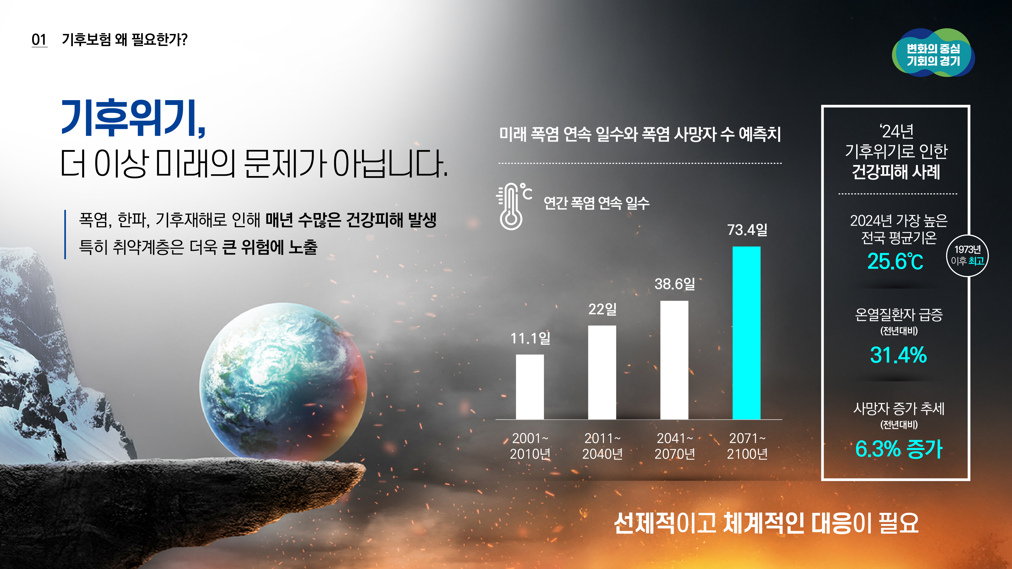
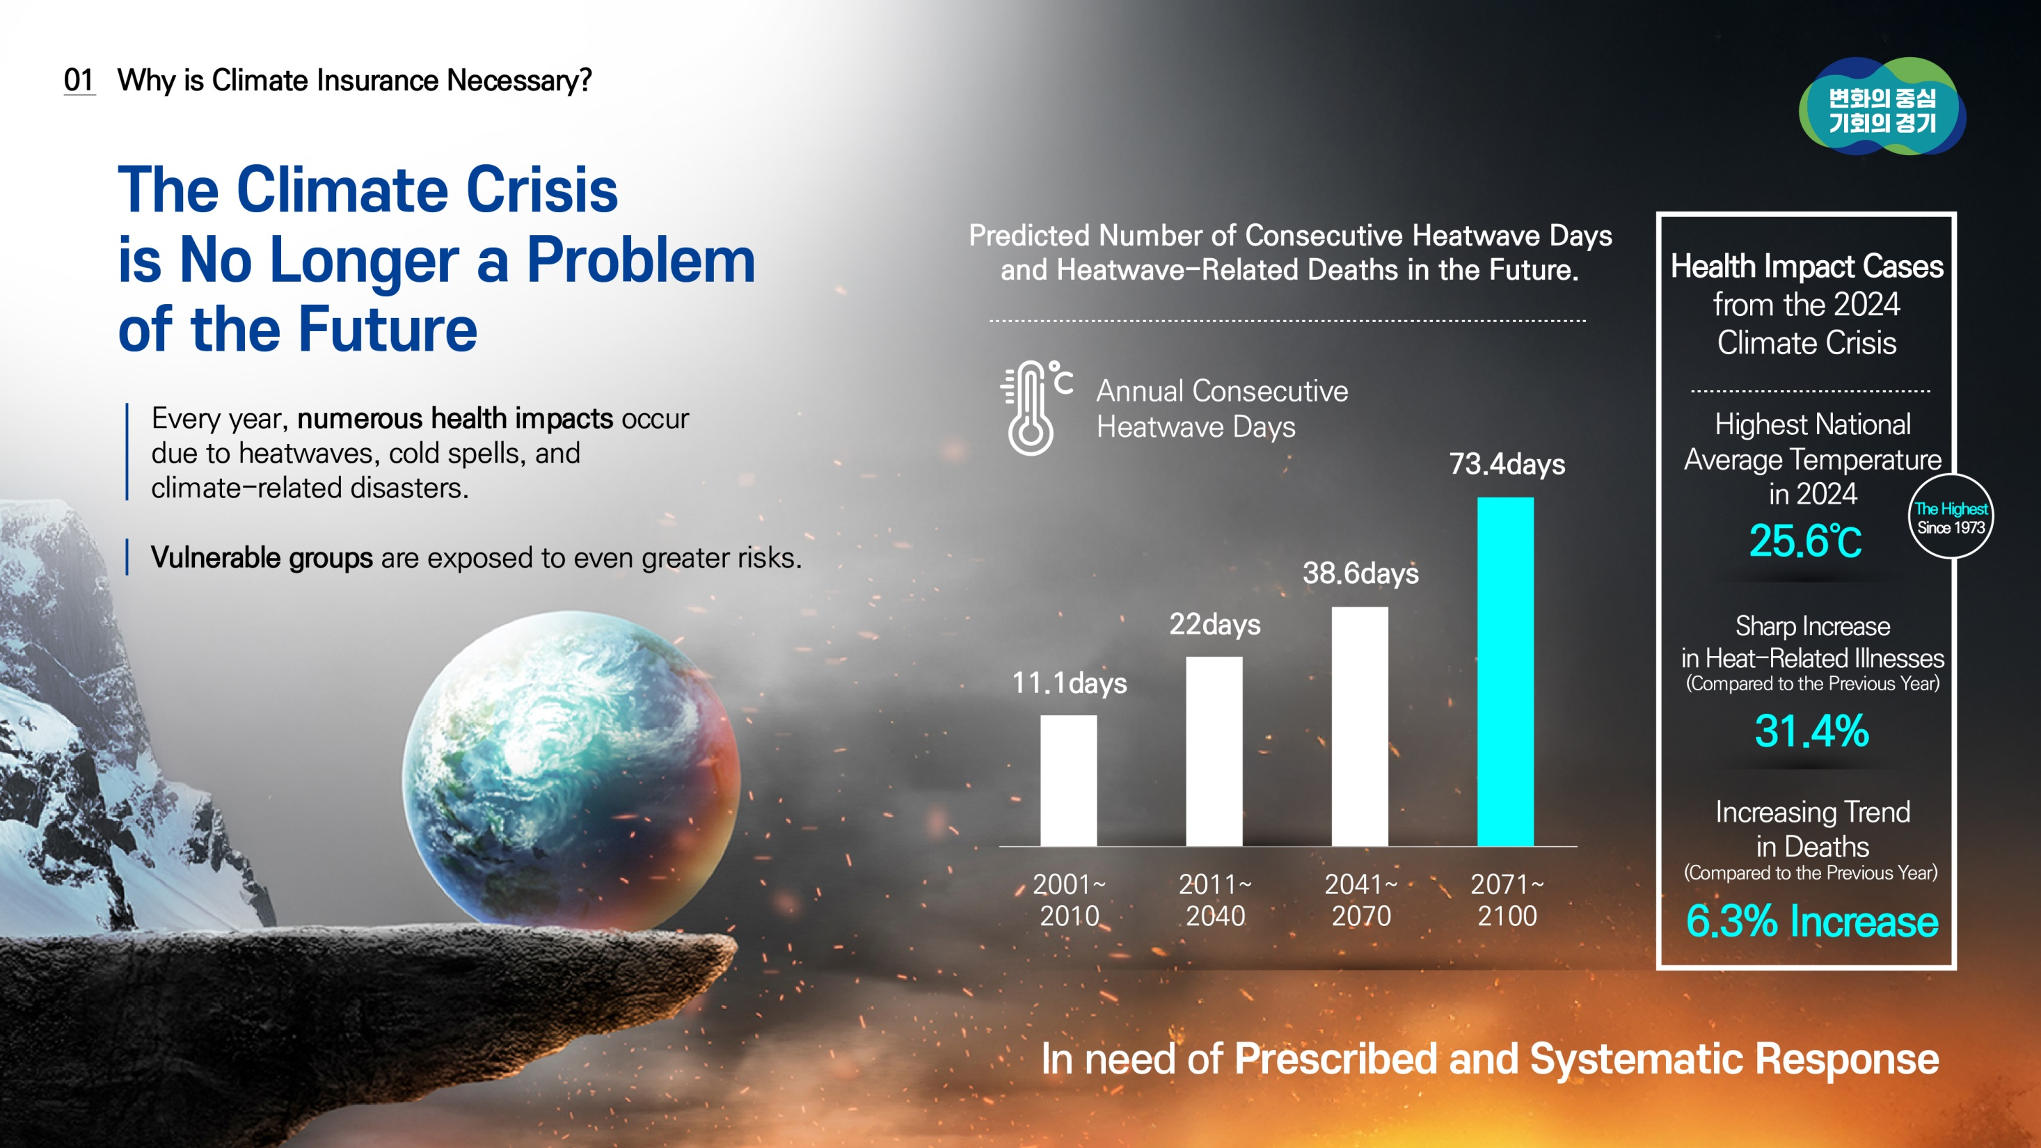
03
03

Slide 3




04
Why is Climate Insurance Necessary?
Climate action, like national security and public safety,
is a public good that should be the responsibility of the national and local governments.
Extreme Weather
Impossible to Predict and Prevent in Advance.
Limitations in Preparedness for Climate-
Related Diseases and Accidents
The Necessity of Building a Social Safety Net
to Prepare for Risks and Losses Due to the Climate Crisis

Slide 4
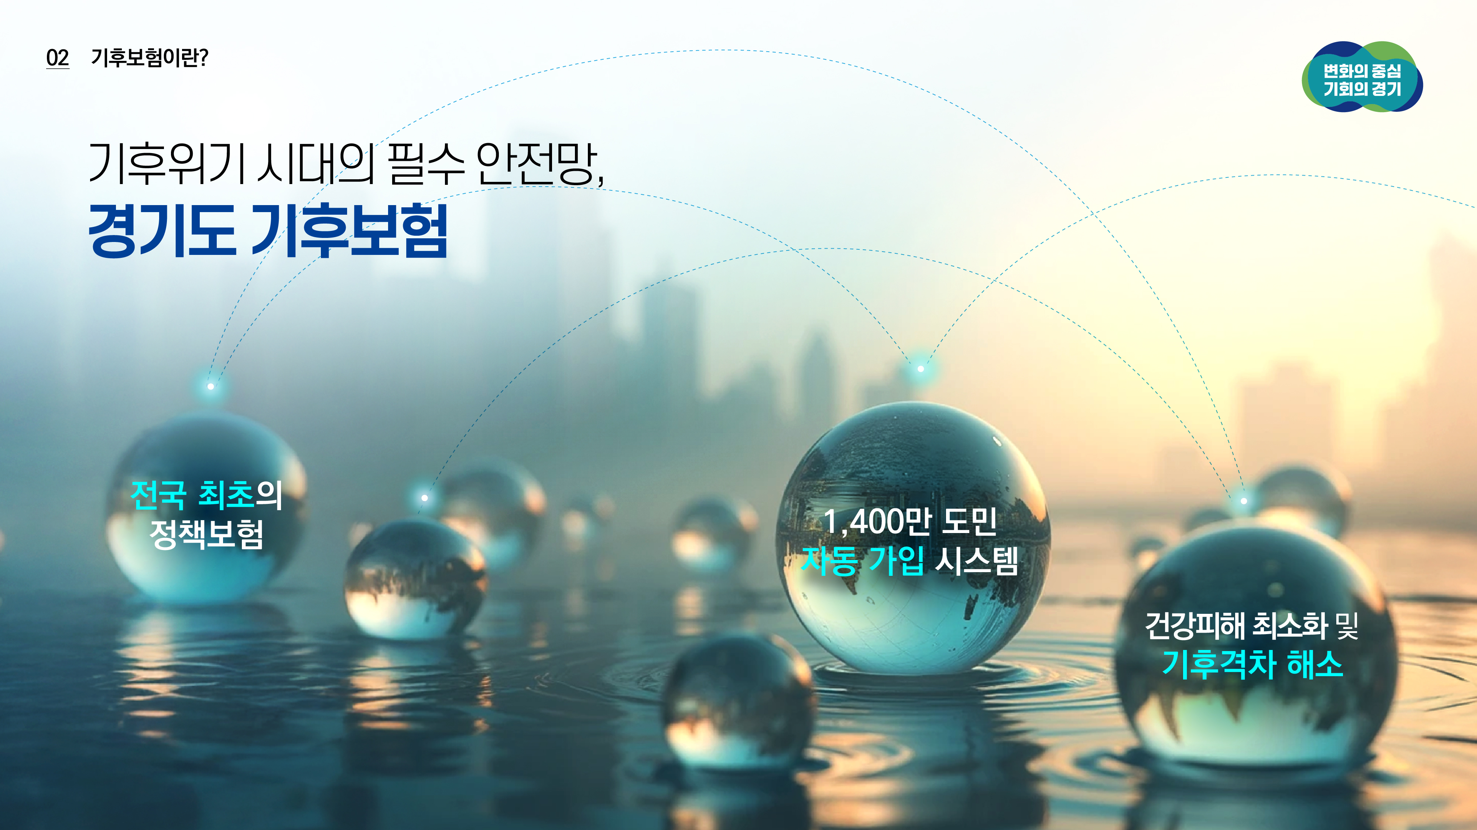
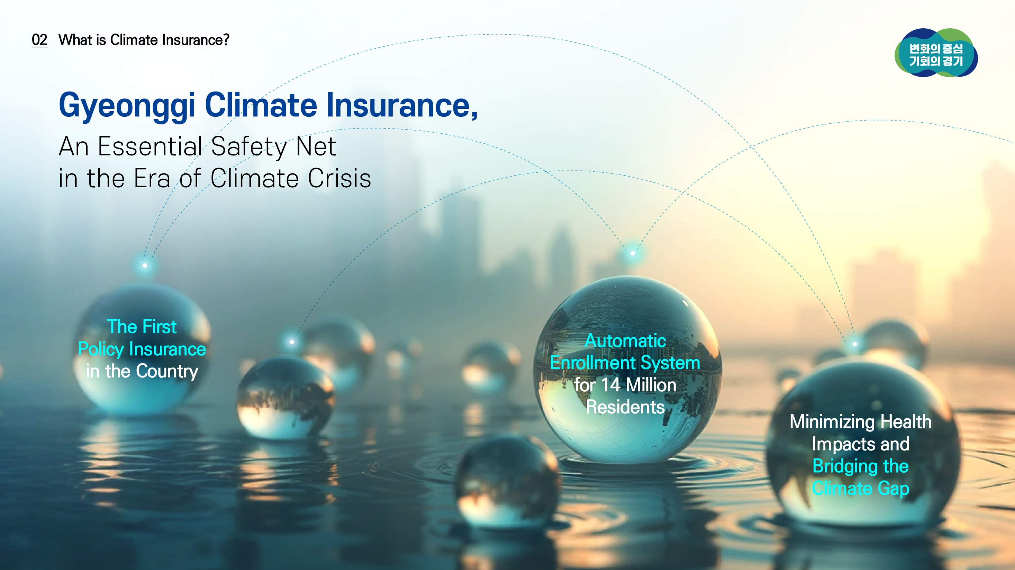

05
05

Slide 5
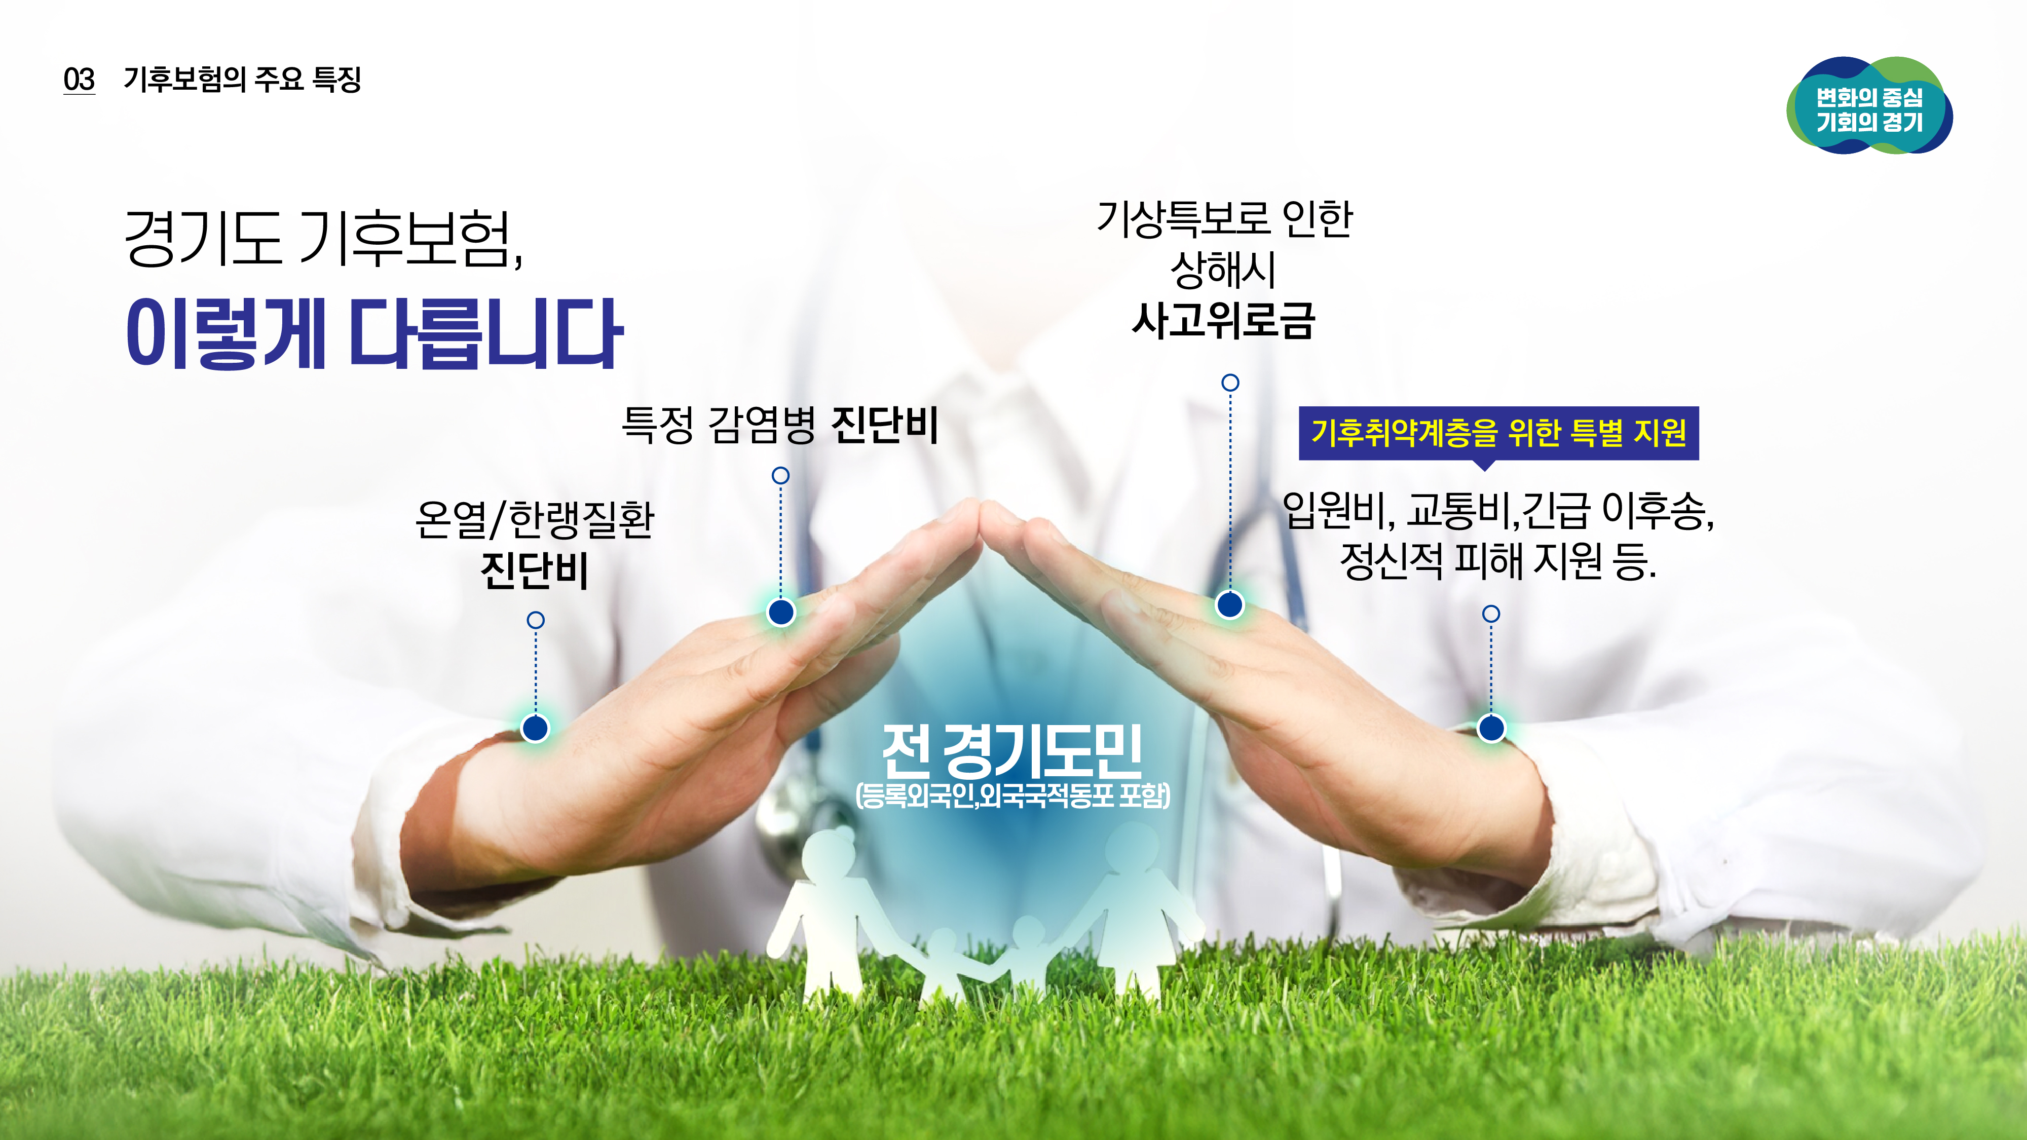
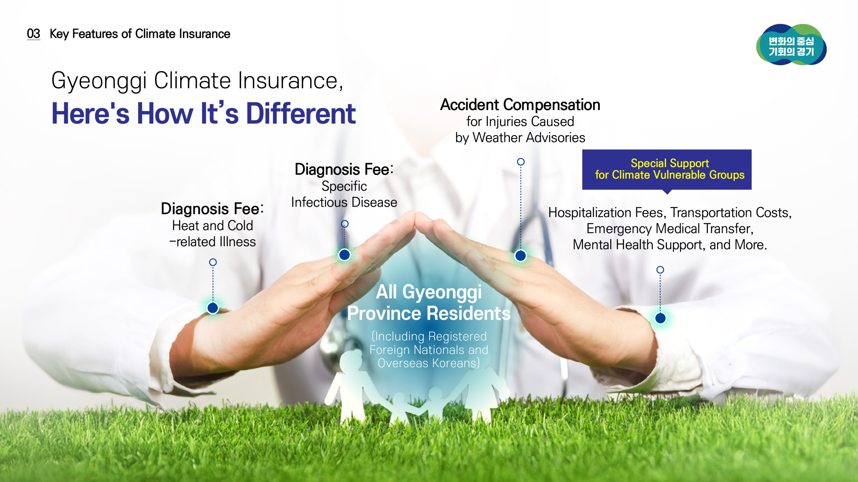
06
Key Features of Climate Insurance
06

Slide 6






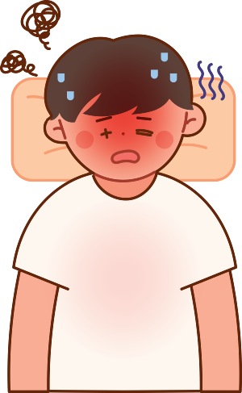
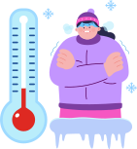


07
Climate Insurance Support Details (For All Gyeonggi Residents)
A Strong Social Safety Net
for Gyeonggi Residents
For All 14 Million Residents
Support for the Accident Compensation of Injuries Diagnosed for Over 4 Weeks (When a Weather Alert is Issued)
Support for the Diagnosis of Heat-related Illness
Support for the Diagnosis of Cold-related Illness
Support for the Diagnosis of Certain Infectious Diseases
Protection of the Health and Safety of Residents in the Face of Climate Crisis!

Slide 7
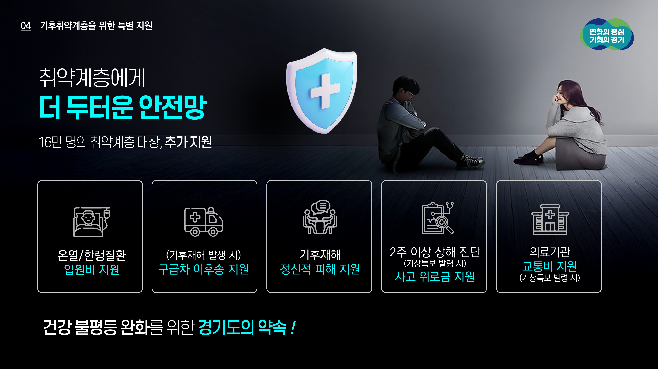
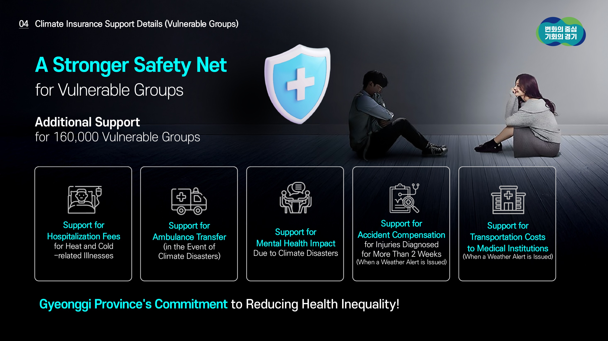
08
08
Climate Insurance Support Details (Vulnerable Groups)

Slide 8
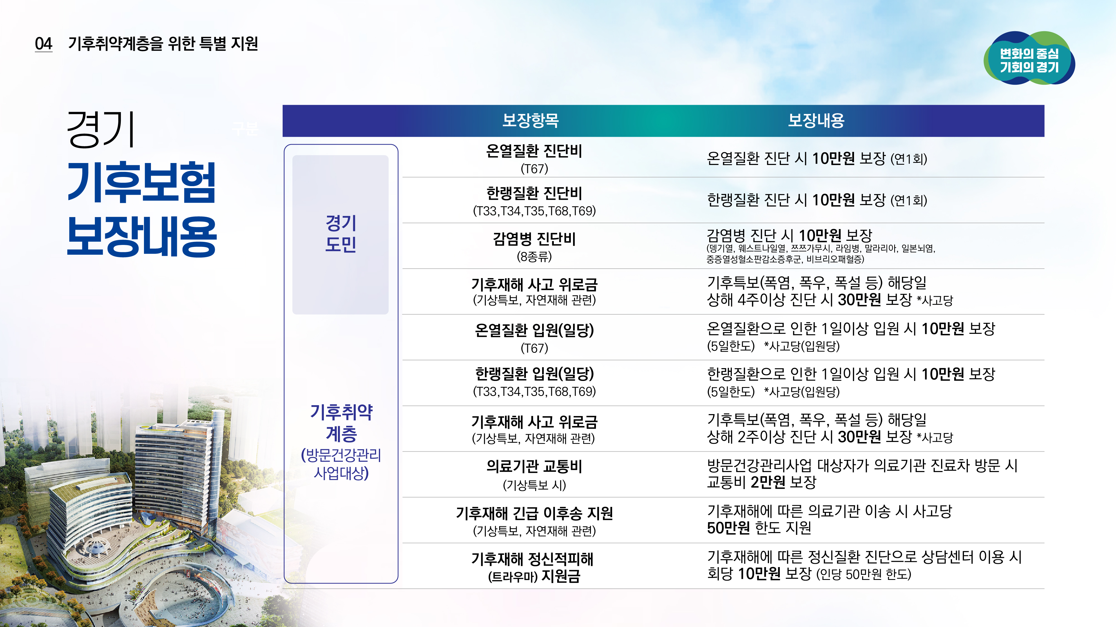
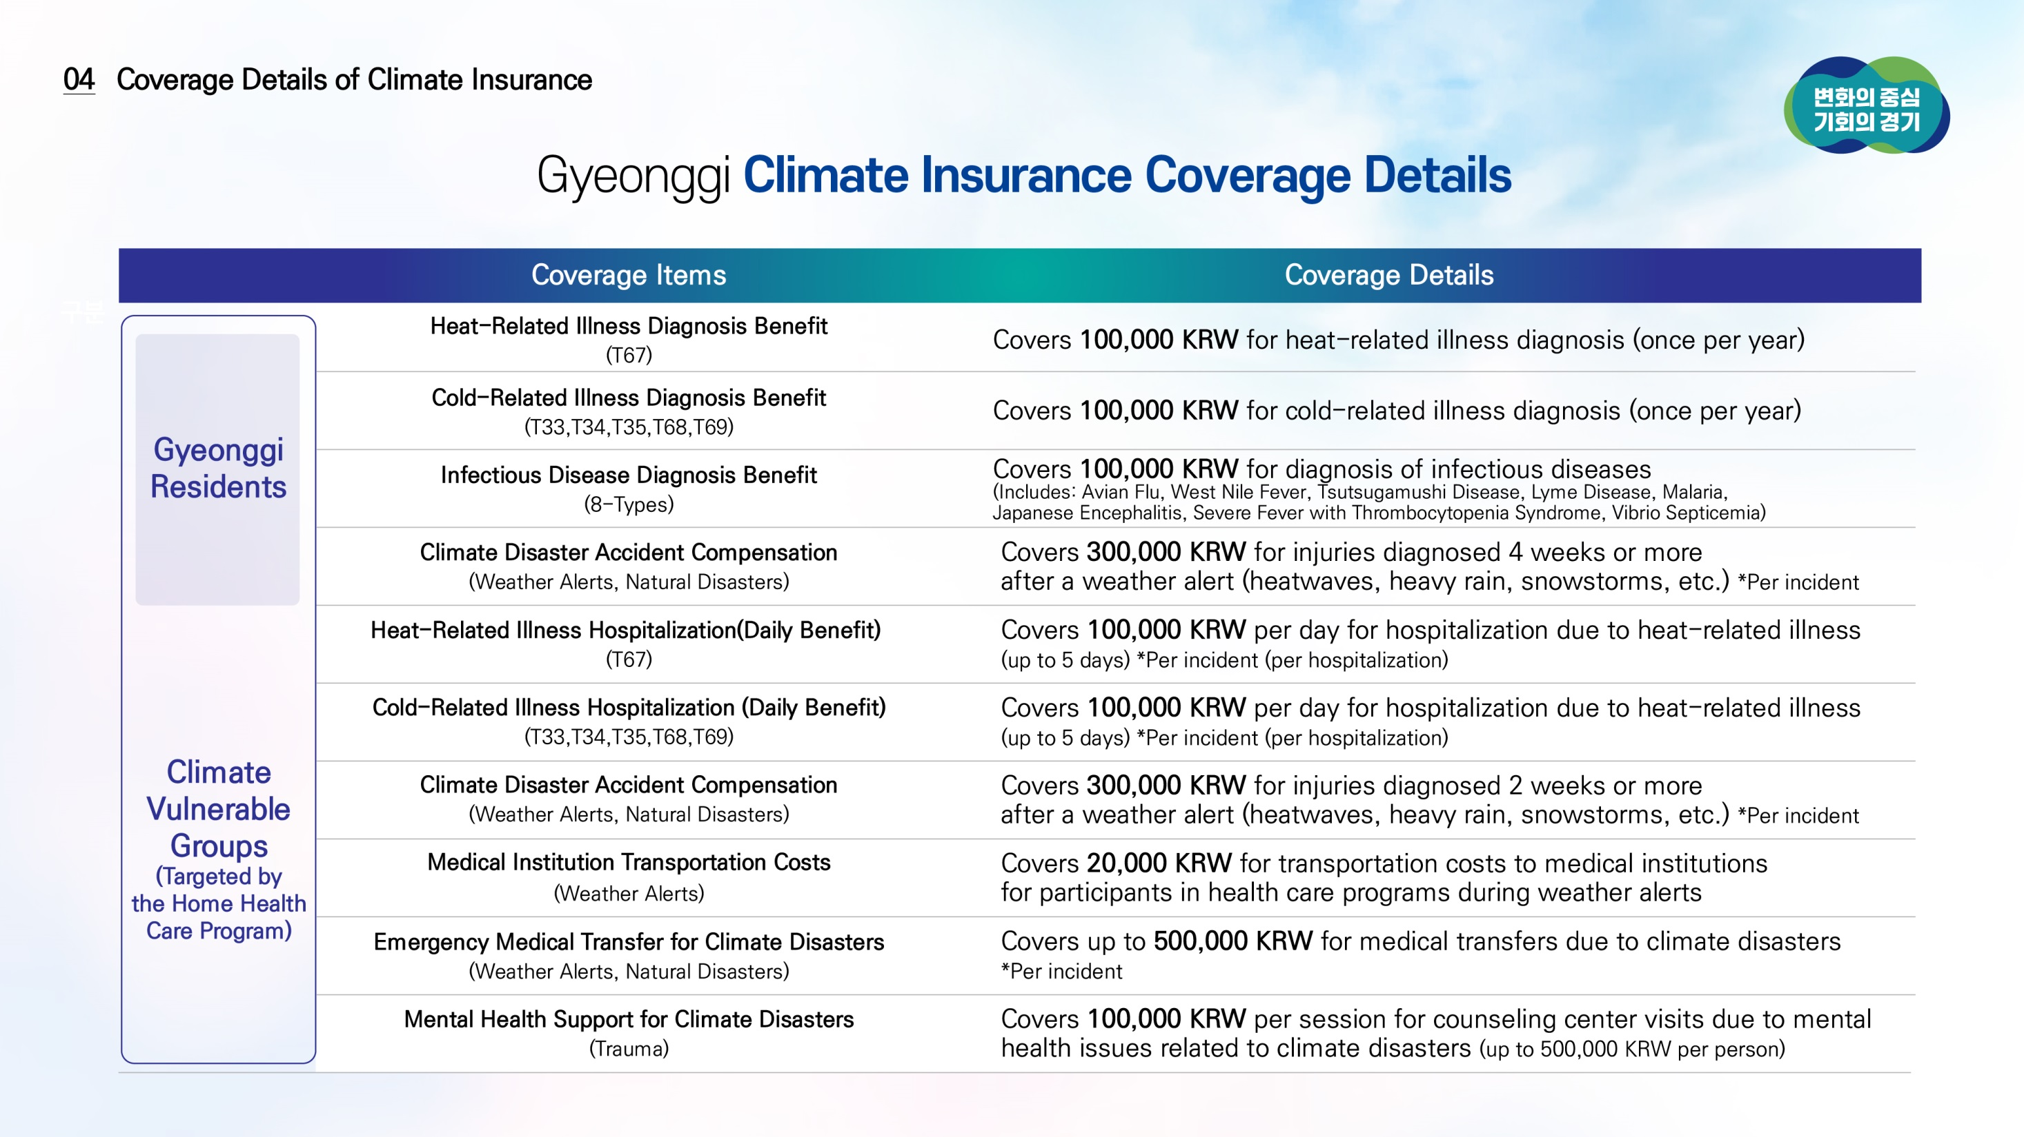

09
Coverage Details of Climate Insurance
09

Slide 9

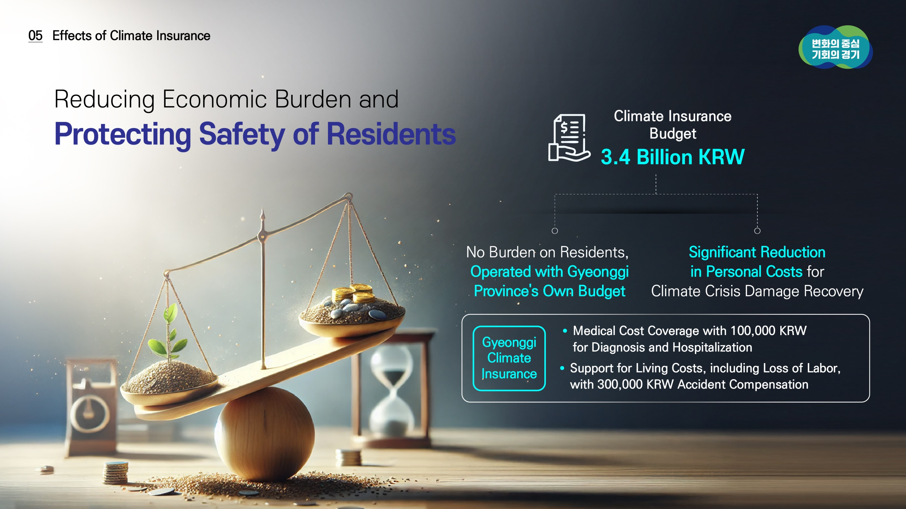

10
10
Effects of Climate Insurance

Slide 10
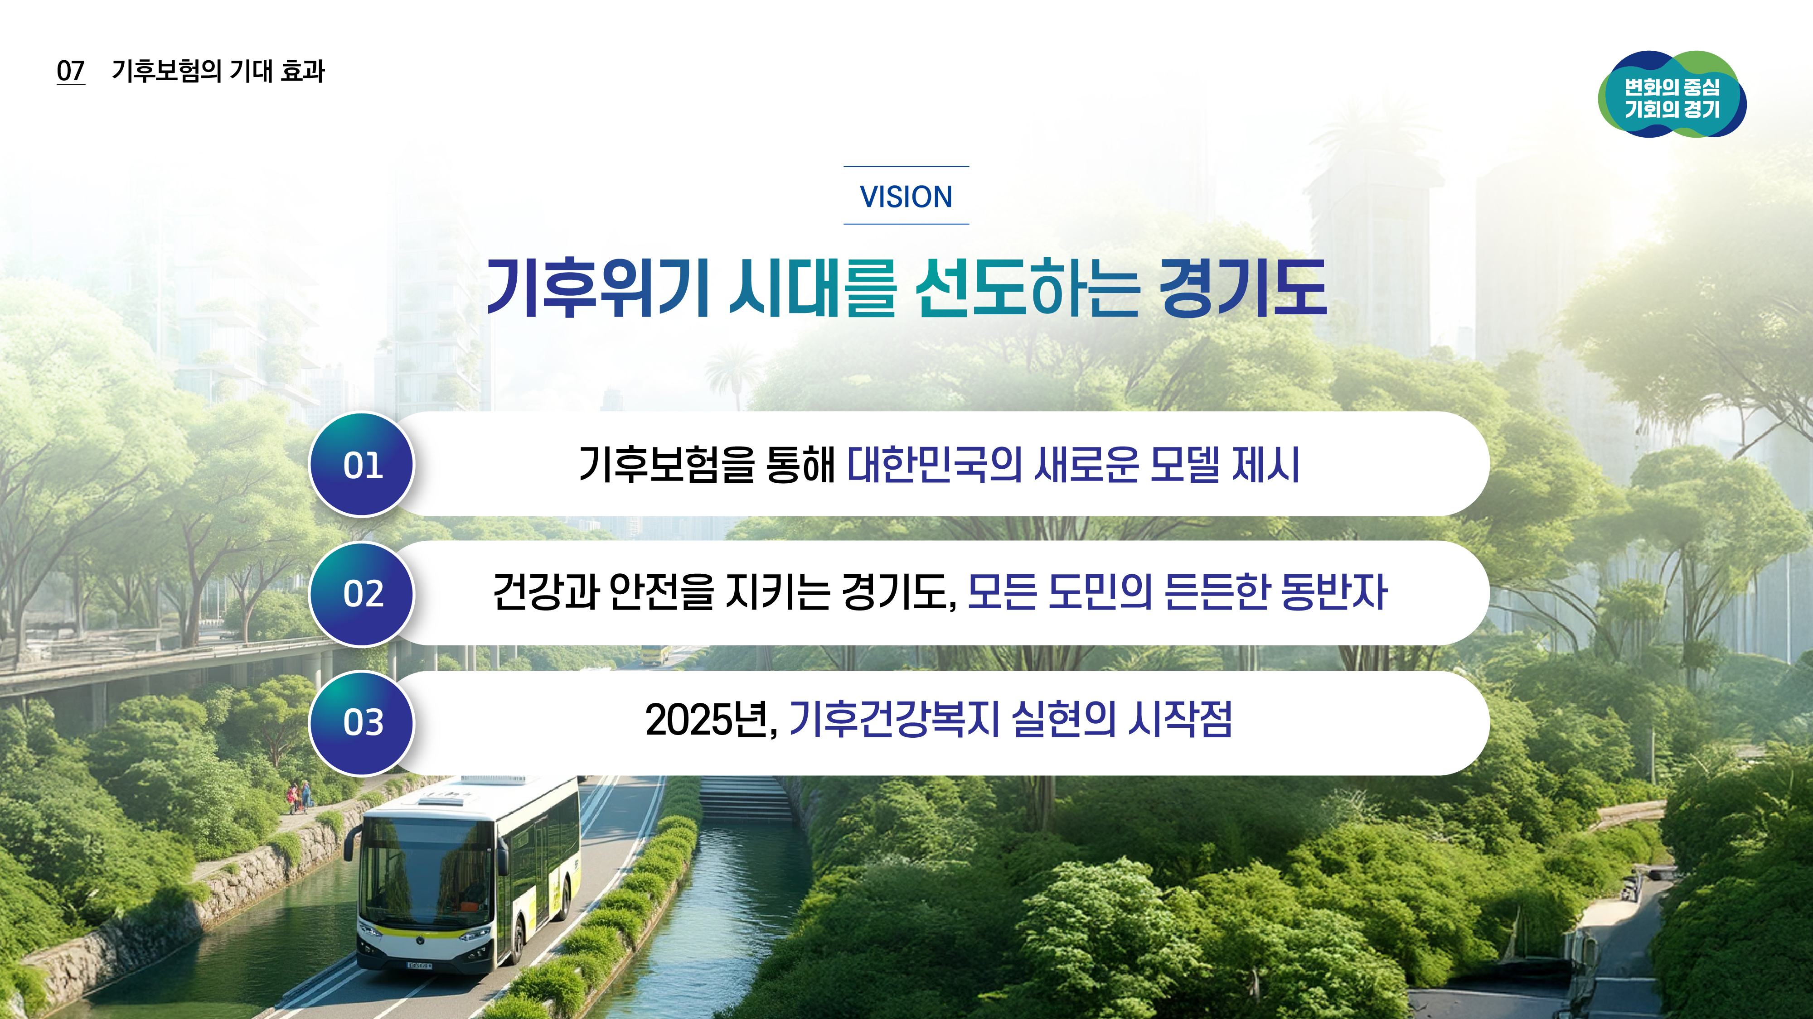
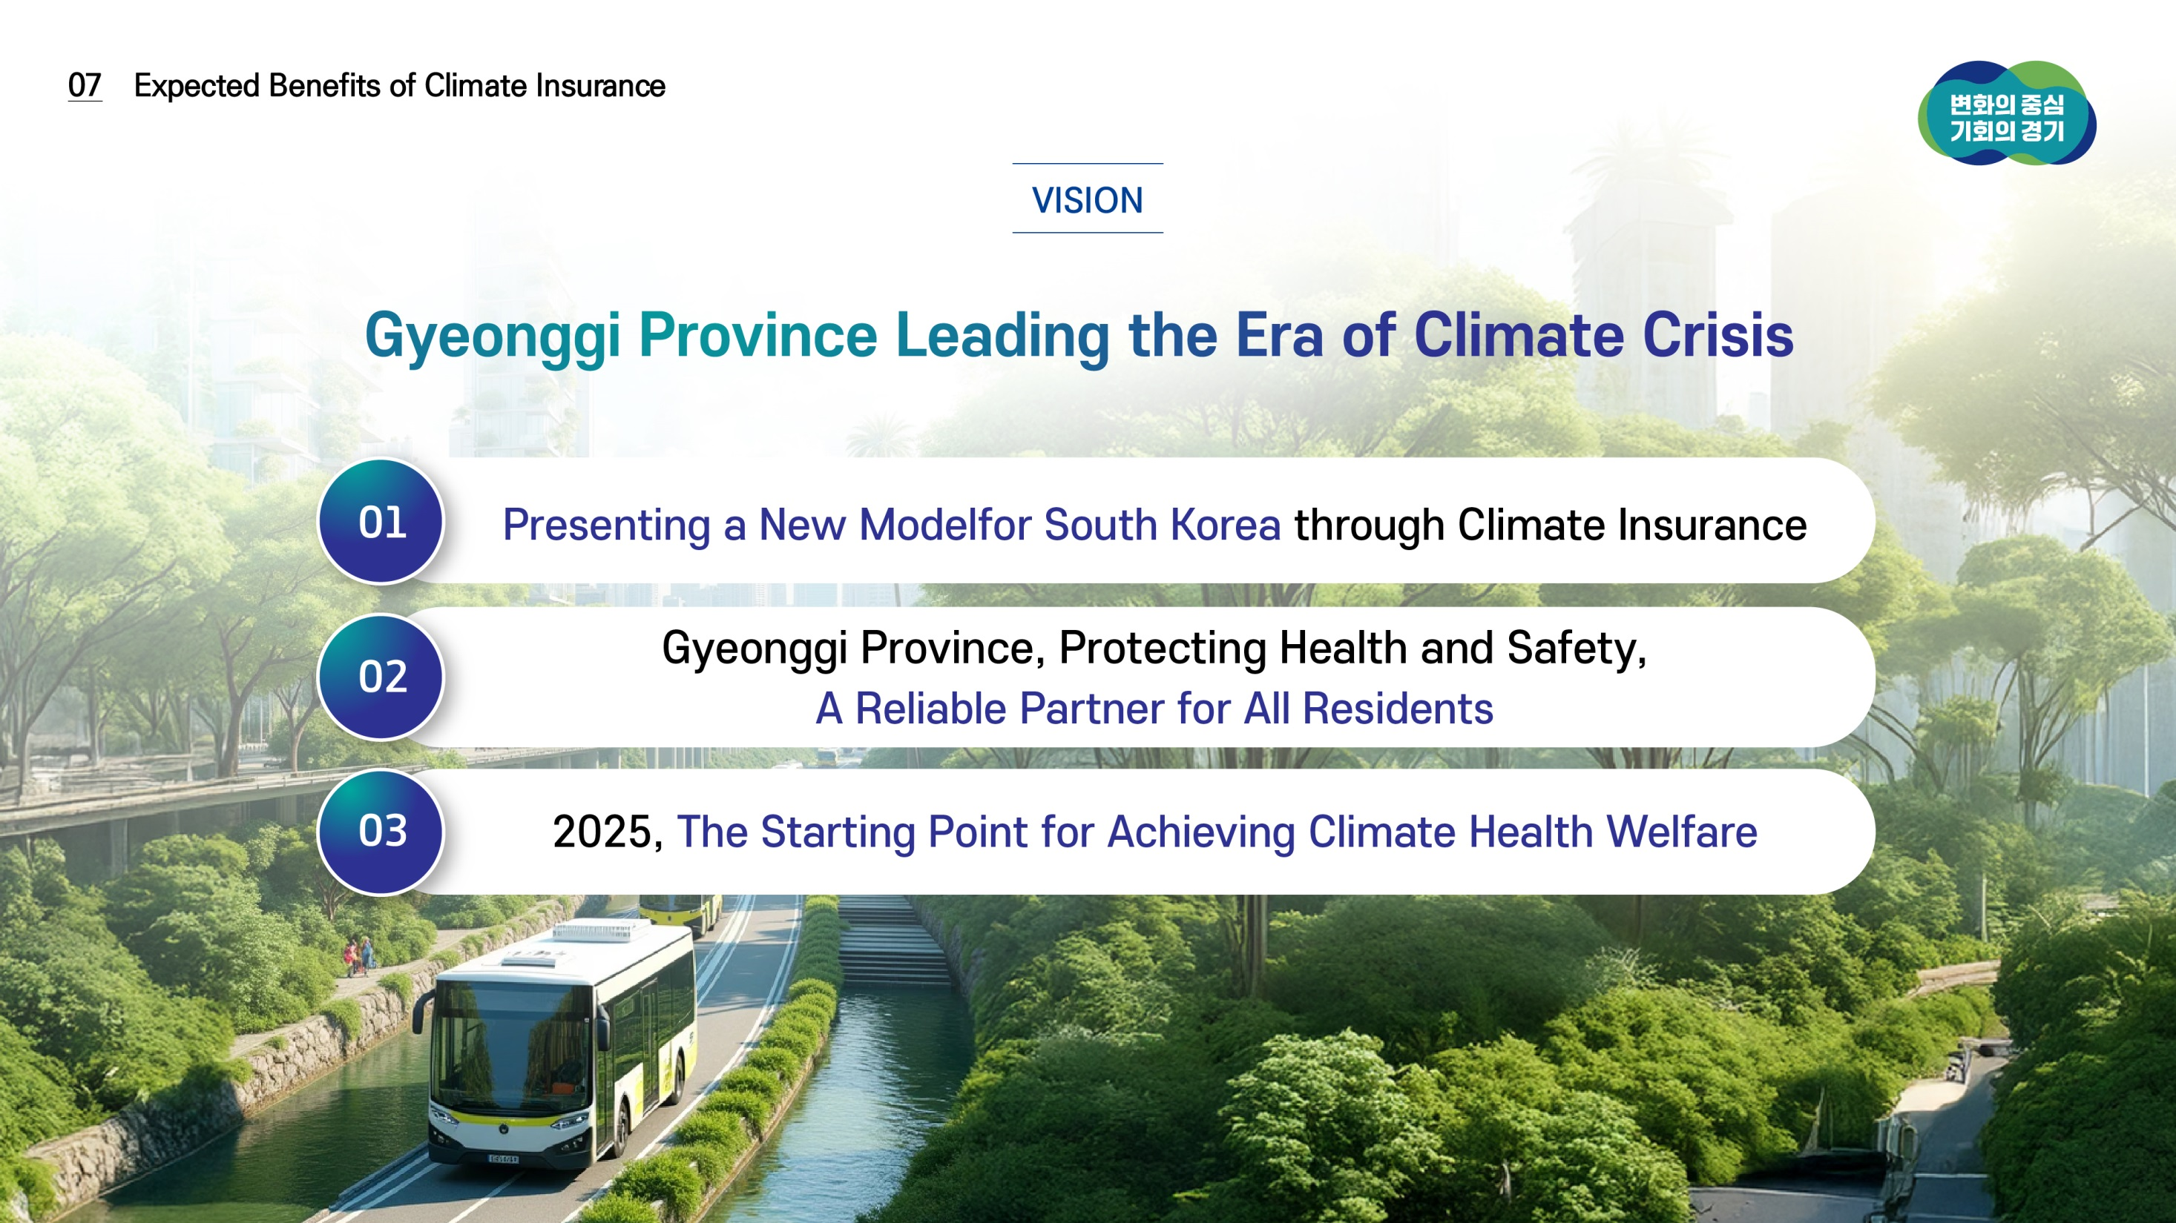
12
12

Slide 11


An Essential Safety Net in the Era of Climate Crisis
Gyeonggi Climate Insurance
Thank you

